Slide 1
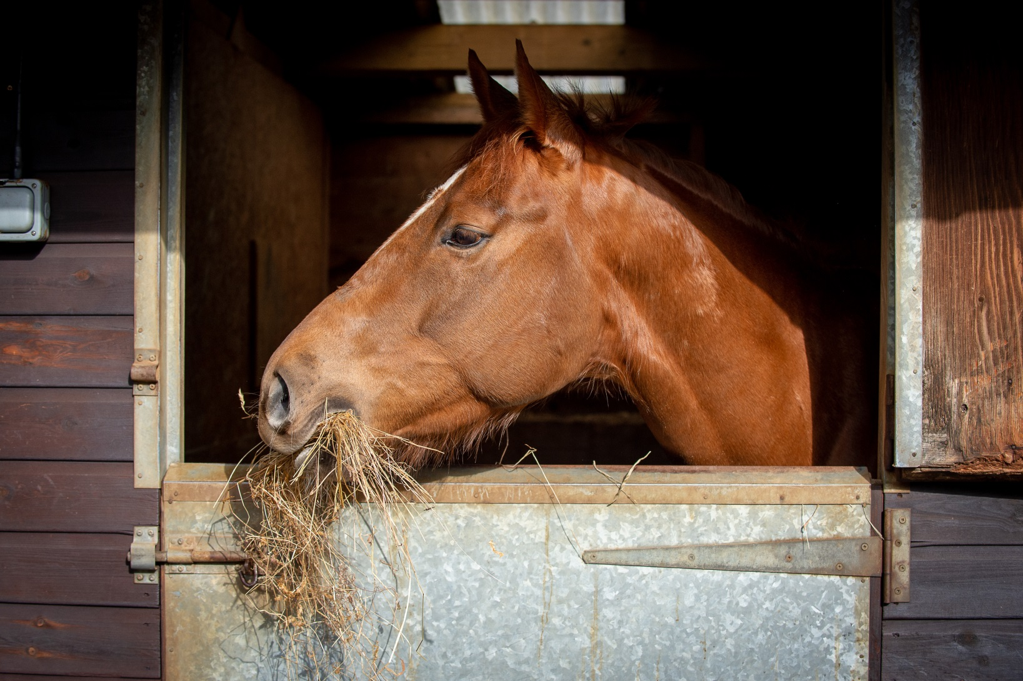
Horse Knowledge
Feeding
Notes:
The feeding section covers a brief overview of the digestive system, the types of feed that horses can eat and what is not suitable for them.
Basic introduction to common types of bucket feed (chaff, alfalfa, mix, cubes, sugar beet)
Consider bringing in feed samples to show the group

Slide 2
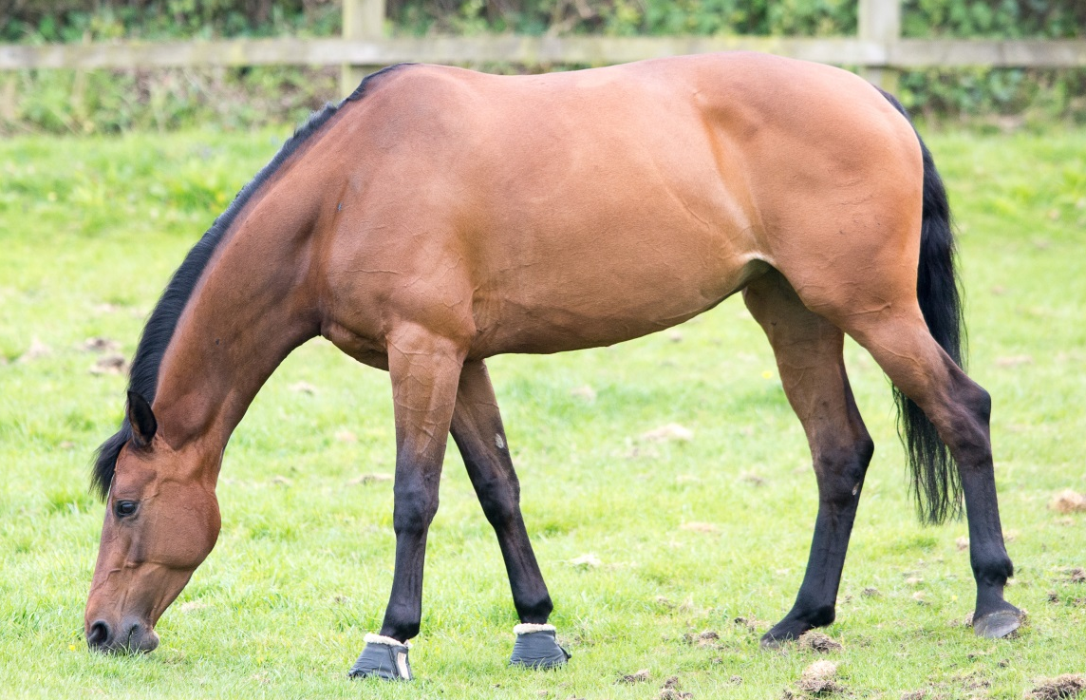
The digestive system
Through the intestines
Into the stomach
To the rectum
Swallowed down the oesophagus
Droppings passed out of the anus
Starts with
the mouth
Notes:
The digestive system
Give a brief overview of the digestive system in basic terms
Participants have the same diagram in the booklet to complete

Slide 3
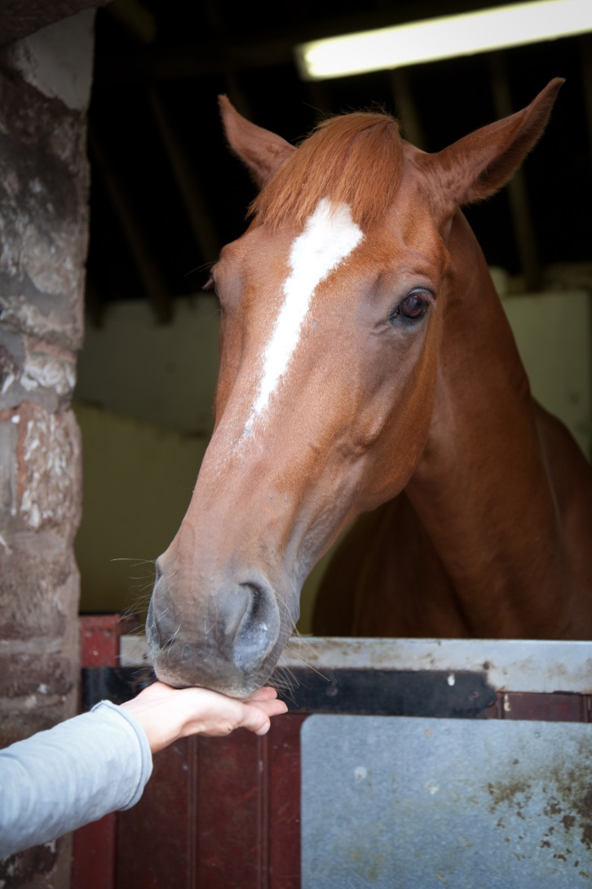
Treats
Notes:
Ask the group if anyone feeds horses treats
As a group discuss what kind of treats they think are suitable for horses. Any surprising suggestions? Has anyone made their own treats for their horse?
Discuss the issues with horses expecting treats regularly.
Discuss ways of feeding treats – by hand, in bucket, treat balls etc
Why should grass cuttings should never be fed to horses?

Slide 4
Rules of feeding
Clean fresh water should be freely available
To keep the horse hydrated
The main part of the diet should be fibre based
The horse’s digestive system works most efficiently on fibre
Don’t work your horse straight after a bucket feed
To allow the horse to digest his food first
Feed little and often
The horse’s stomach is the size of a rugby ball and can’t cope with large amounts of feed in one go
Feed good quality feed
Feeding mouldy or dusty feed can cause illness
Always weigh each feed
To make sure the horse receives the same amount in each feed
Feed each horse as an individual
Every horse is different and their feed requirements will be different
Make Changes gradually
To allow the system time to adjust to the new feed
Stick to a routine
Horses thrive on routine
Notes:
Rules of feeding - ask the group (individually or discuss in small groups) to write down as many rules of feeding as they can and then create a list
The rules will appear on the slide when you click – you might want to add more to this slide or on a flip chart
Either as a group discuss each rule and the reasons for it or split into smaller groups and allocate each group a rule or two to discuss, then come back together to discuss the whole list and the suggestions given.
Participants have space in their booklet to write the reasons for each rule
In the booklet there are spaces for participants to write the reasons for each rule given on the slide

Slide 5
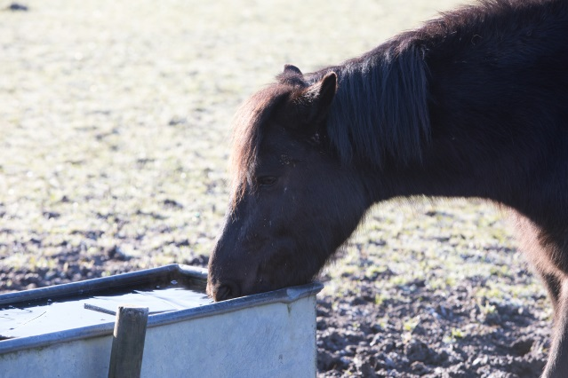
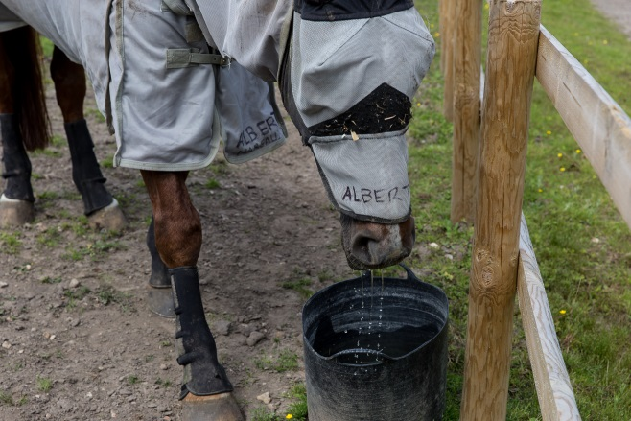
Methods of providing water
Method | Advantages | Disadvantages
Water bucket | Can monitor how much horse drinks. | Easily knocked over. Need to be refilled by hand.
Notes:
Split into small groups to come up with methods of providing water to horses in the stable (revision from part one) and the field and possible advantages and disadvantages of each.
Discuss the answers and write the on a flip chart or white board
Participants have this table in their booklet to complete.

Slide 6
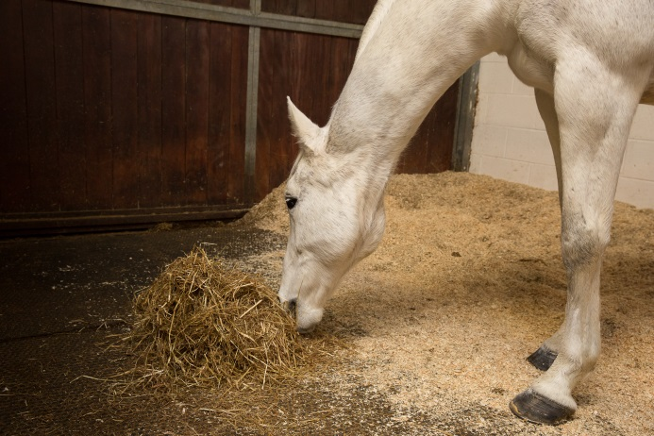
Feeding hay and haylage
Method | Advantages | Disadvantages
Eating from floor | Natural eating position for the horse | Can be wasteful
Notes:
Split into small groups to come up with different methods of feeding hay or haylage
Discuss the answers and write the answers on a flip chart or white board or add to table on slide.
Participants have this table in their booklet to complete

Slide 7
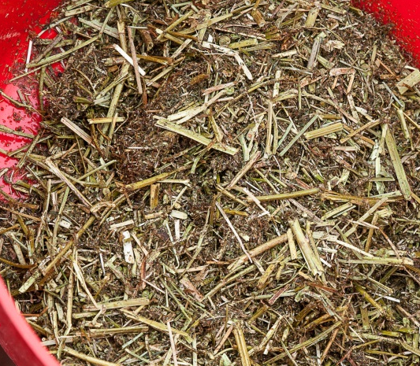
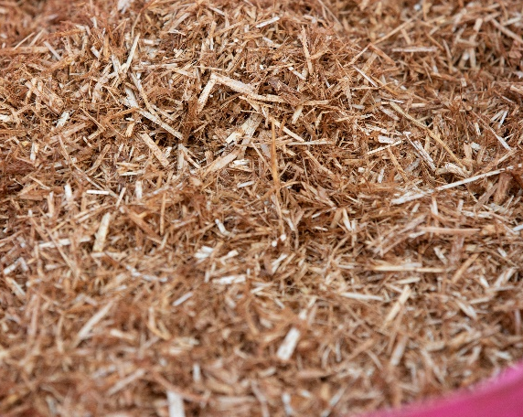
Types of bucket feed
Alfalfa
Chopped up Lucerne grass
Green colour
Chaff
Chopped up hay and straw
Brown colour
Notes:
Ask the group if anyone knows what the two feeds are in the pictures?
Discuss why chaff and alfa are used in bucket feeds and the differences between them.
There is space in the booklet for participants to write notes about each feed next to the picture

Slide 8
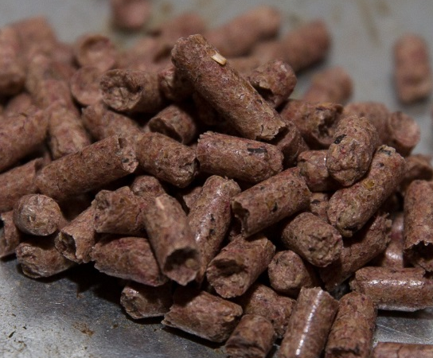
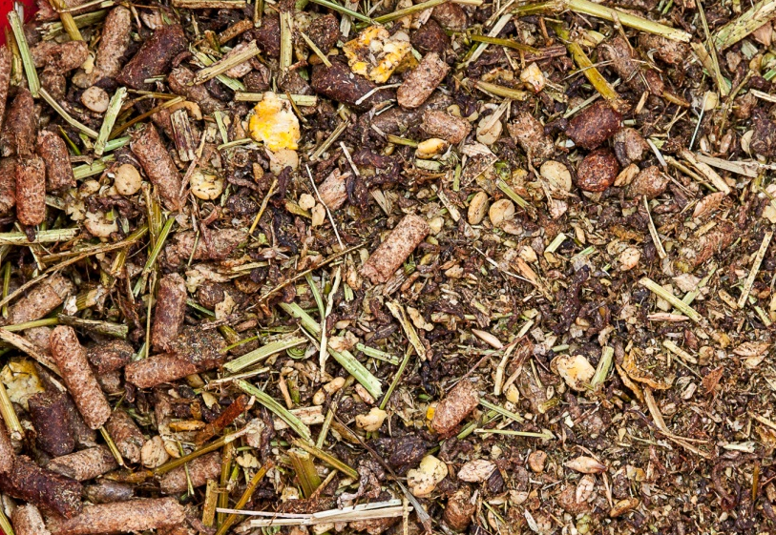
Types of bucket feed
Cubes
Ingredients have been compressed to form a pellet
Mix
Contains a mixture of grains, vitamins, minerals, cubes, carrots, peas and fibre
Notes:
Ask the group if they can identify the feed in the pictures
Discuss the basic differences between cubes and mix
There is space in the booklet for participants to write notes about each feed next to the picture

Slide 9
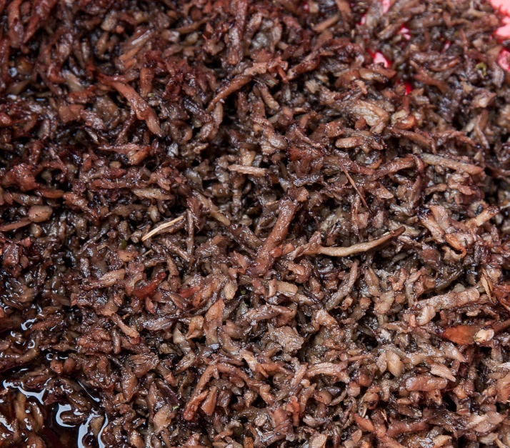
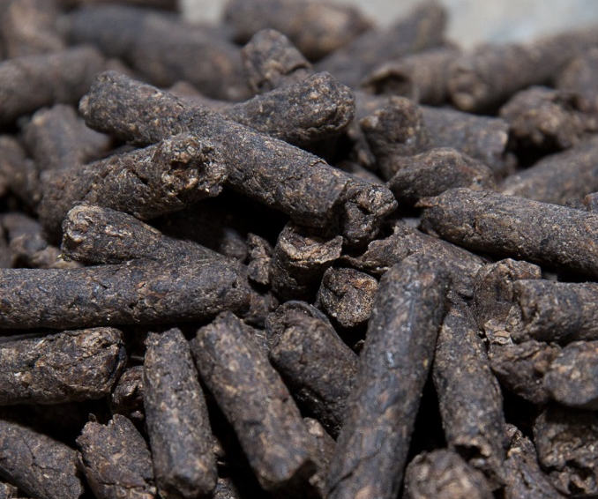
Types of bucket feed
Sugar beet
By product from sugar refining
Source of fibre
Must be soaked before feeding
Comes in cubes (shown below), flakes or shreds
Notes:
Ask the group if they can identify the feed in the picture and what is the difference between the pictures
Discuss how sugar beet cubes differ from normal cubes and what you should do if you are not sure

Slide 10
Quick quiz
List the parts of the digestive system
Why should you ask permission before feeding a horse
Name three treats suitable to feed horses
Why should grass cuttings not be fed to horses?
List three rules of feeding and give a reason for each
Why is chaff or alfalfa added to a bucket feed?
What is the main difference between mix and cubes?
What must you do to sugar beet before feeding it?
Notes:
This quiz is very informal and is not designed to be a test. Answers can be written or verbal and participants have space to write answers in the booklets.
Suggested answers:
Mouth, throat/oesophagus, stomach, intestines, rectum, anus
In case the horse has special dietary requirements, bites, isn’t allowed treats, or any other sensible answer
Any 3 treats from discussion in session or listed in booklet
It begins to ferment creating gas in the stomach which can cause colic
Any 3 from the rules given in the booklet and suitable reasons
To encourage the horse to chew, add fibre
Can’t see the content of a cube, mix tends to be molassed cubes aren’t or any other acceptable answer
Soak it for the recommended time (usually given on the bag)

