Slide 1
Horse Knowledge
Part One
Notes:
Add coach name to the text box
The slides are grouped by topic and can be delivered in any order
There are optional notes giving ideas for session plans or activities to go along with each presentation
There are optional handouts available to download from the BHS Cloud

Slide 2
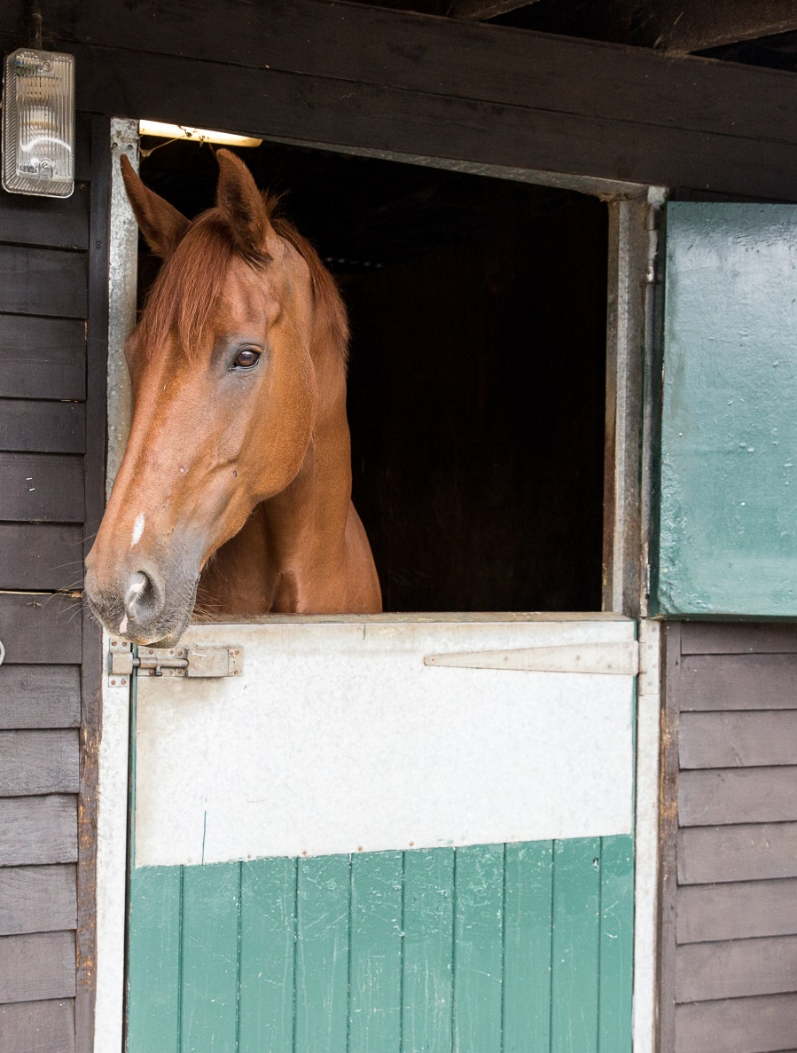
Introduction
Welcome
Housekeeping
Structure of course
Notes:
Welcome group and explain the structure of the course. The content covered is on the next slide
Any housekeeping such as location of fire exits, toilets, tea/coffee provisions

Slide 3
Horse Knowledge Part One
Safety on the yard
Horse behaviour
How to approach a horse
How to tie up
Identification
Points of the horse
The welfare needs of a horse
Stable care
Grooming
Notes:
Outline the main topics covered within the course. These are broken down further at the start of each section.
The slides have been grouped in topics that follow the layout of the booklet but can be delivered in any order.

Slide 4
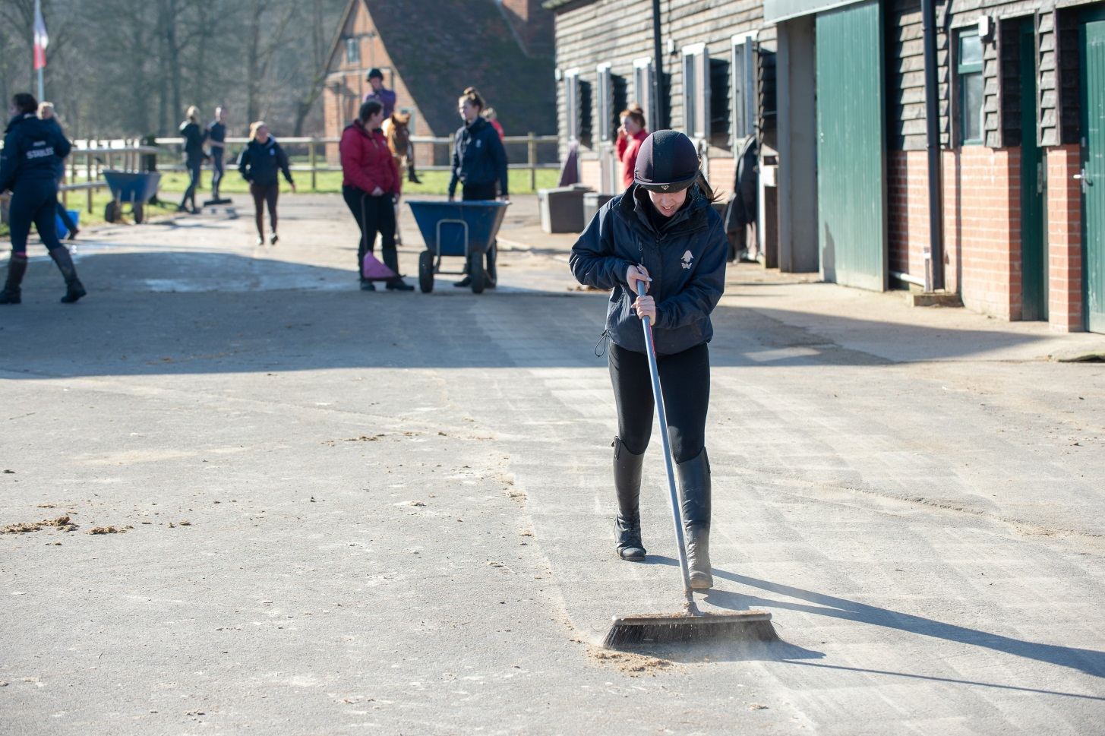
Horse Knowledge
Yard Safety
Notes:
Yard safety covers – PPE and appropriate clothing, hazards to be aware of when on the yard and procedures to follow including safe lifting

Slide 5
What is a hazard?
Something that has the potential to cause harm
Source: www.hse.gov.uk/risk/controlling-risks.htm
Notes:
What is a hazard?
Discuss as a group what they think is meant by hazard
Look around the room or suggest a yard/place known to the group and ask them to identify any hazards present
As a group or split into smaller groups come up with hazards you might find on a stable yard?
Feedback their suggestions to the rest of the group

Slide 6
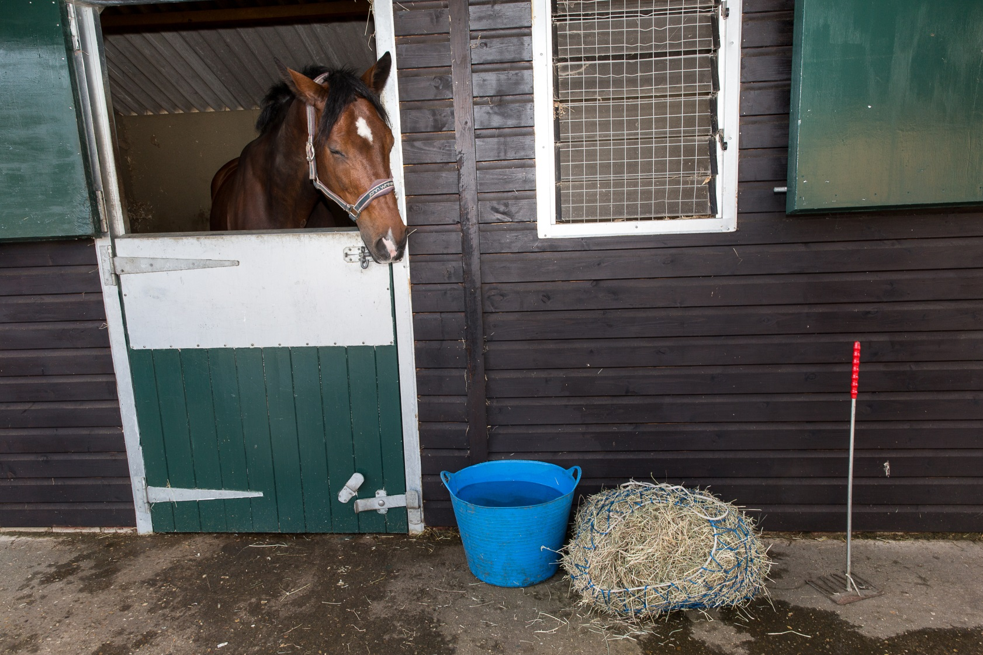
What potential hazards can you see in these pictures?
Notes:
Either as a group or split into smaller group discuss the picture on the slide and identify potential hazards
You can use these pictures or add your own to the slides

Slide 7
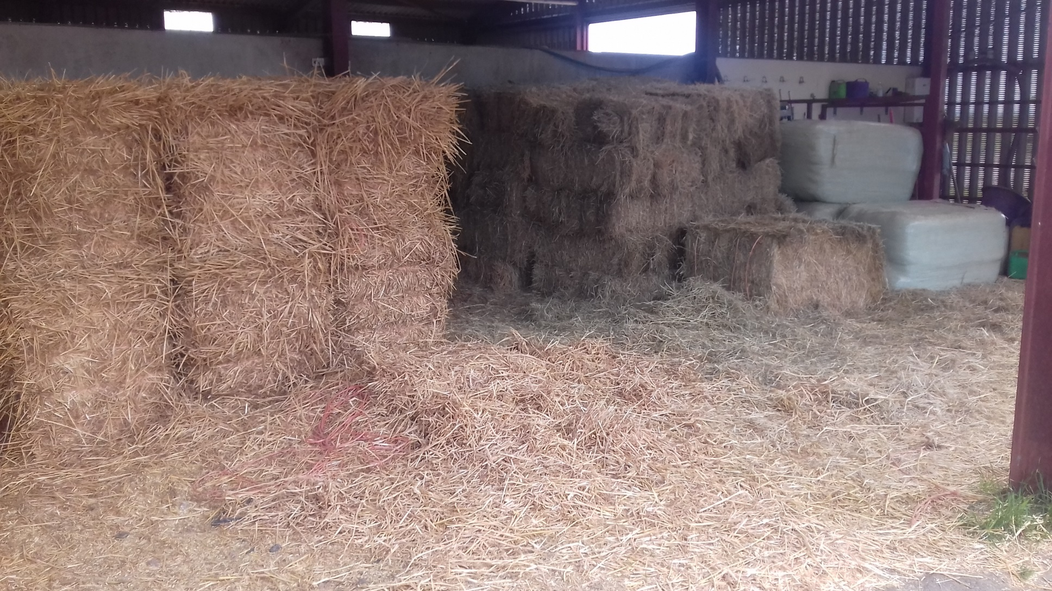
What potential hazards can you see in this picture?
Notes:
Either as a group or split into smaller group discuss the picture on the slide and identify potential hazards
You can use these pictures or add your own to the slides

Slide 8
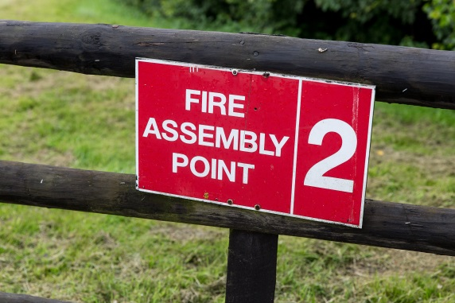
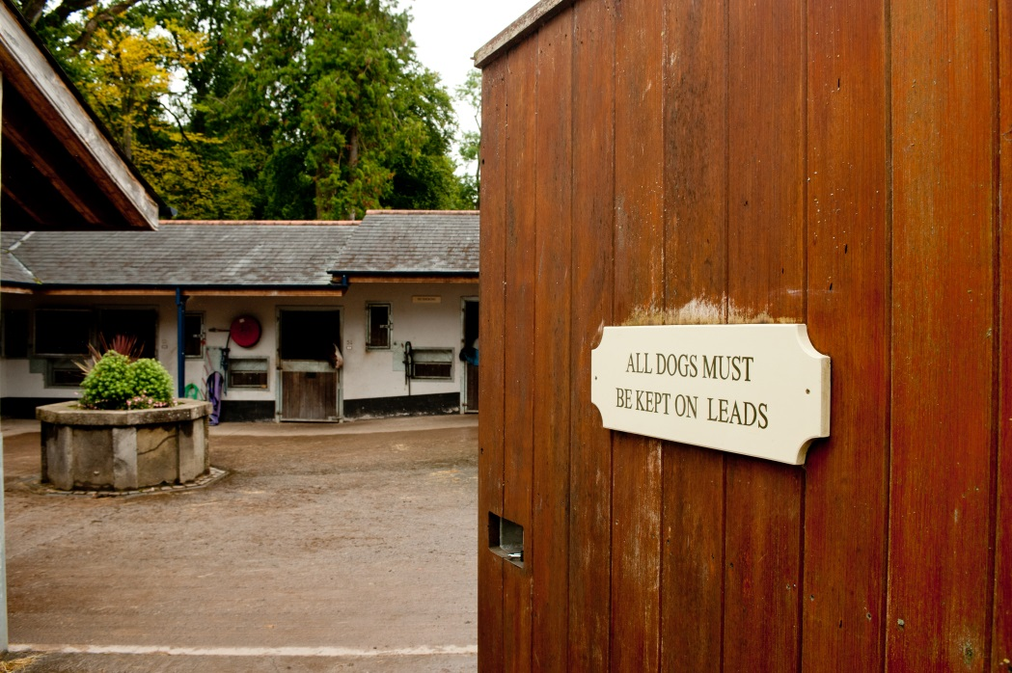
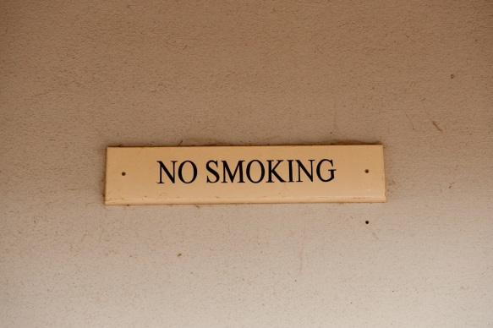
Yard rules
Notes:
Discuss as a group reasons for having rules on the yard.
Discuss as a group any rules that apply on a yard they are familiar with or to think up their own.
What might the reasons be for rules such as: reporting to the office on arrival, restricted access to stables/horses, not touching or feeding horses, no running on the yard.
What type of information signs would the group expect to see around the yard?

Slide 9
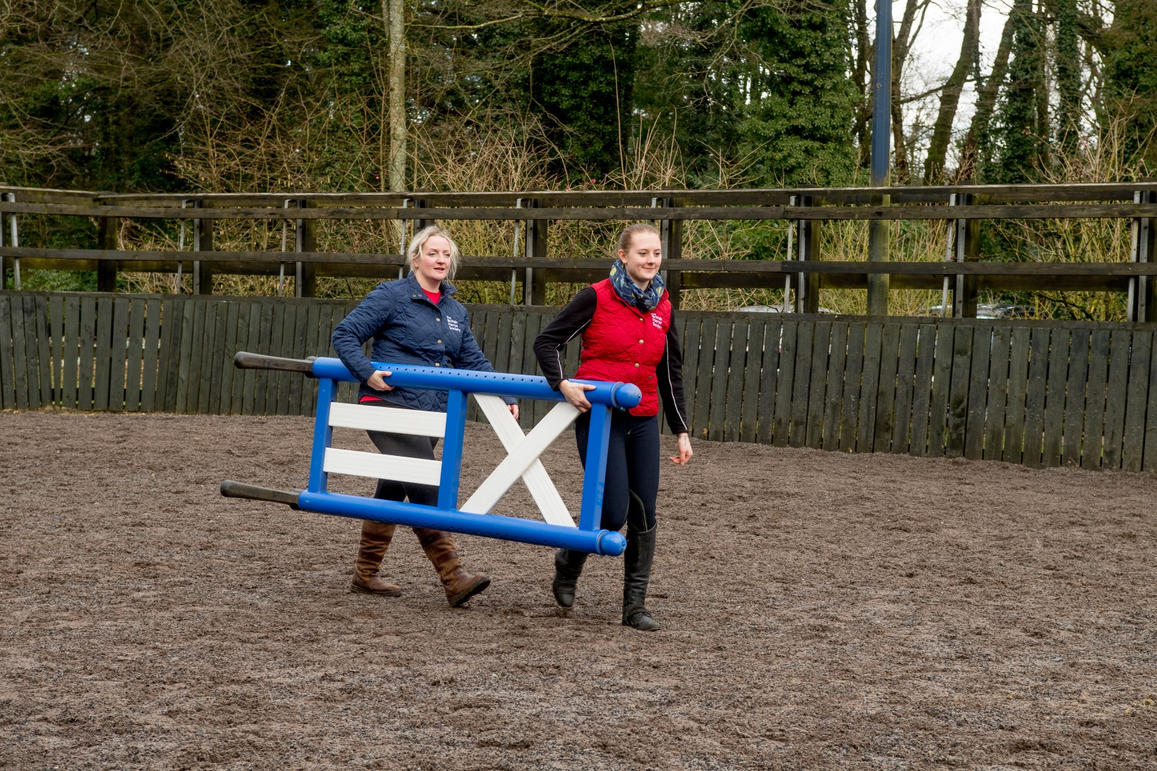
Safe lifting
Notes:
Discuss what kind of objects might have to lift on a yard
Discuss why safe lifting is important
Discuss methods of moving heavy/awkward objects – e.g. wheelbarrow

Slide 10
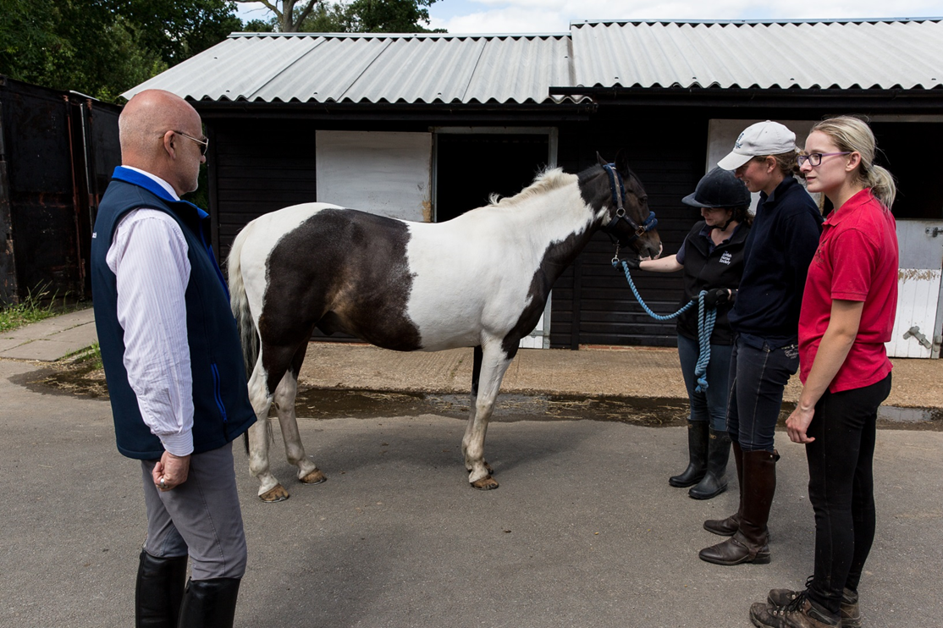
What to wear on the yard
Personal Protective Equipment (PPE)
Notes:
Ask the group if they are familiar with the term PPE or if they need to wear any PPE as part of their work/hobbies etc?
Why do people wear PPE? Discuss if the group think wearing PPE on the yard is as important as wearing it when riding?
Types of PPE:
Hat – highlight importance of current standard and it fits correctly. Reasons for not buying a second hand hat. When should it be replaced?
Footwear – discuss the various types of footwear available/marketed as riding boots. What is suitable and what isn’t
Gloves – should have grips, why woollen gloves with no grips not suitable.
Clothing in general – reasons for wearing close fitting, comfortable clothing.
Hi-Viz – out hacking/leading on roads. Why horse riders need to make themselves visible. Discuss difference between reflective and fluorescent.
Link to BHS what to wear page https://www.bhs.org.uk/advice-and-information/safety-advice-and-information/what-to-wear

Slide 11
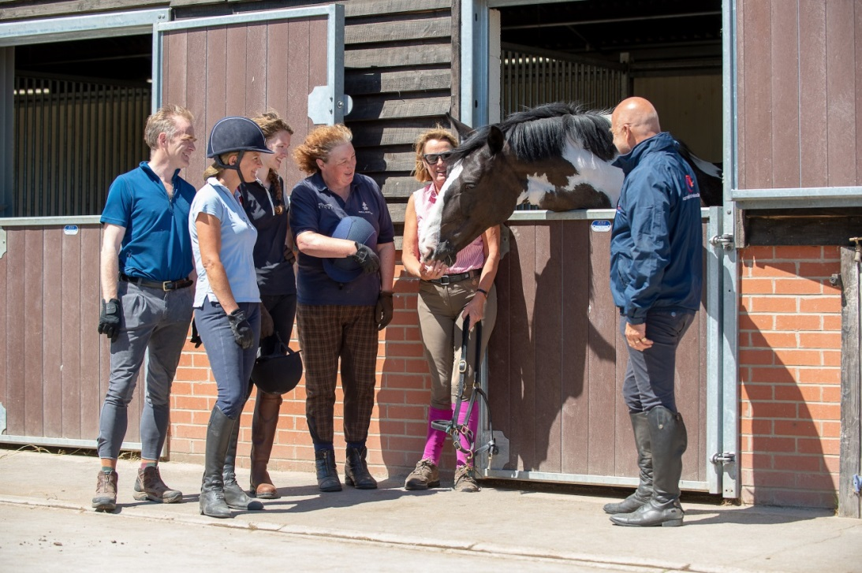
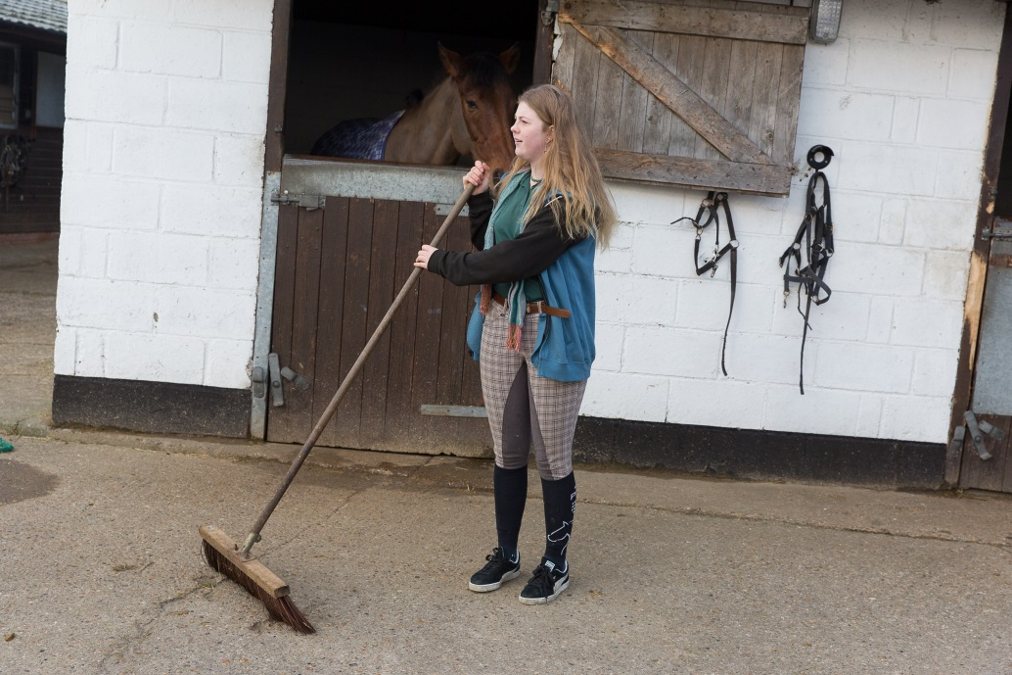
Notes:
Discuss the suitability of what the people in the pictures are wearing

Slide 12
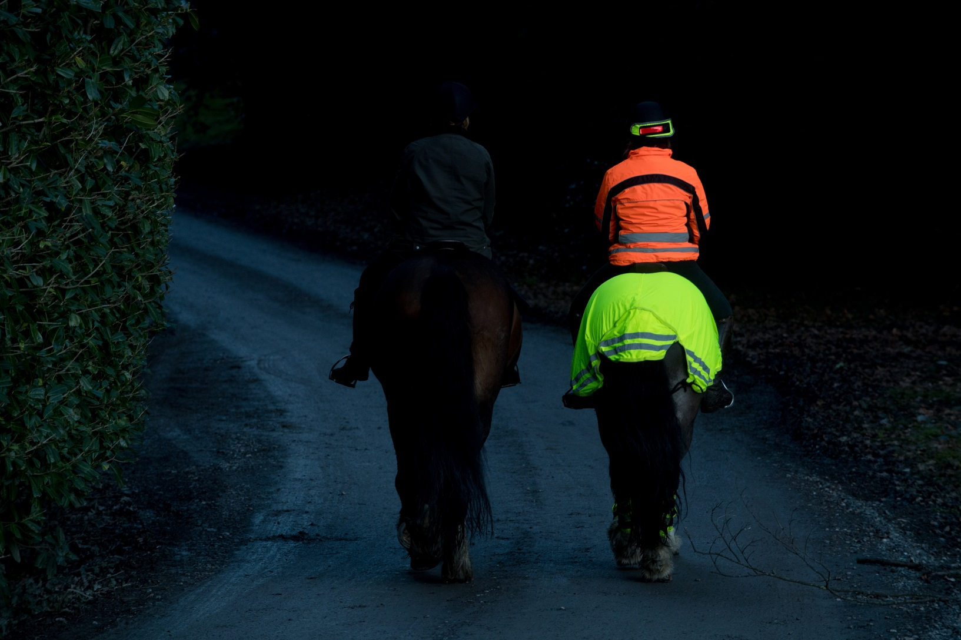
Hi-Viz
Notes:
This image highlights the difference wearing hi-viz can make.
Discuss dangers of riding on the road and the importance of making themselves as visible as possible. Why putting leg bands on is effective (movement)
Discuss the different colours of hi-viz available and which colour might be better in a variety of situations depending on time of year/leaf coverage. https://www.bhs.org.uk/advice-and-information/safety-advice-and-information/what-to-wear/hi-viz
Depending on audience you may want to include some information about the Be nice, say Hi! Campaign or Dead Slow https://www.bhs.org.uk/our-work/safety/dead-slow

Slide 13
Quick Quiz
What items of Personal Protective Equipment you would wear on the yard?
Why shouldn’t you wear flappy clothing on the yard?
List three hazards you might find on a yard
List two rules you should follow on the yard
Why should you wear hi-viz when riding on the road?
Notes:
This quiz is very informal and is not designed to be a test. Answers can be written or verbal and there is space for the participants to write answers in their booklet.
Suggested answers:
Suitable footwear, hat, gloves
The noise might scare the horses, get caught up
Any acceptable answers from the booklet or covered in the session
Any acceptable answer from the booklet or covered in the session
To make you more visible to other road users

