Slide 1
Horse Knowledge
Part One
Notes:
Add coach name to the text box
The slides are grouped by topic and can be delivered in any order
There are optional notes giving ideas for session plans or activities to go along with each presentation
There are optional handouts available to download from the BHS Cloud

Slide 2
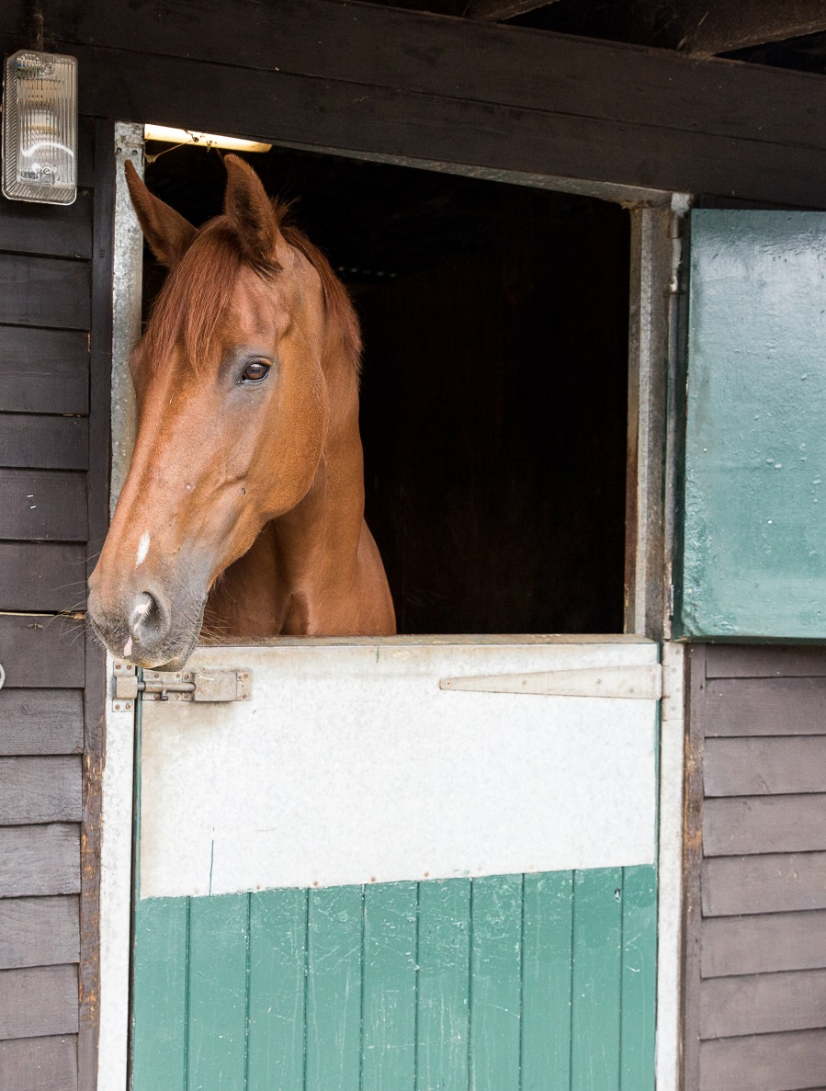
Introduction
Welcome
Housekeeping
Structure of course
Notes:
Welcome group and explain the structure of the course. The content covered is on the next slide
Any housekeeping such as location of fire exits, toilets, tea/coffee provisions

Slide 3
Horse Knowledge Part One
Safety on the yard
Horse behaviour
How to approach a horse
How to tie up
Identification
Points of the horse
The welfare needs of a horse
Stable care
Grooming
Notes:
Outline the main topics covered within the course. These are broken down further at the start of each section.
The slides have been grouped in topics that follow the layout of the booklet but can be delivered in any order.

Slide 4
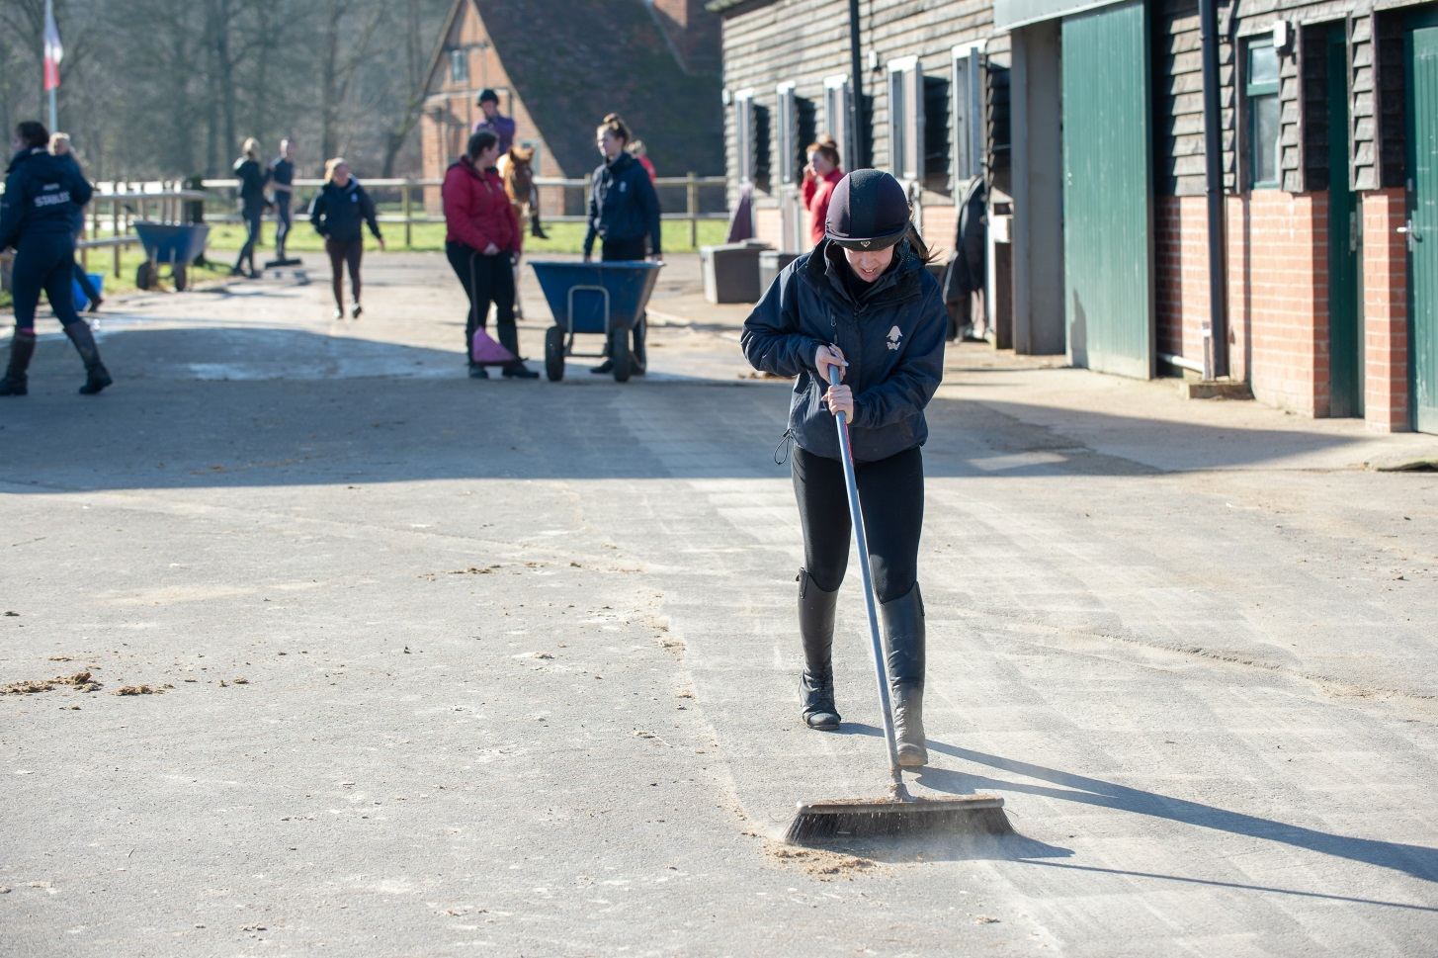
Horse Knowledge
Yard Safety
Notes:
Yard safety covers – PPE and appropriate clothing, hazards to be aware of when on the yard and procedures to follow including safe lifting

Slide 5
What is a hazard?
Something that has the potential to cause harm
Source: www.hse.gov.uk/risk/controlling-risks.htm
Notes:
What is a hazard?
Discuss as a group what they think is meant by hazard
Look around the room or suggest a yard/place known to the group and ask them to identify any hazards present
As a group or split into smaller groups come up with hazards you might find on a stable yard?
Feedback their suggestions to the rest of the group

Slide 6
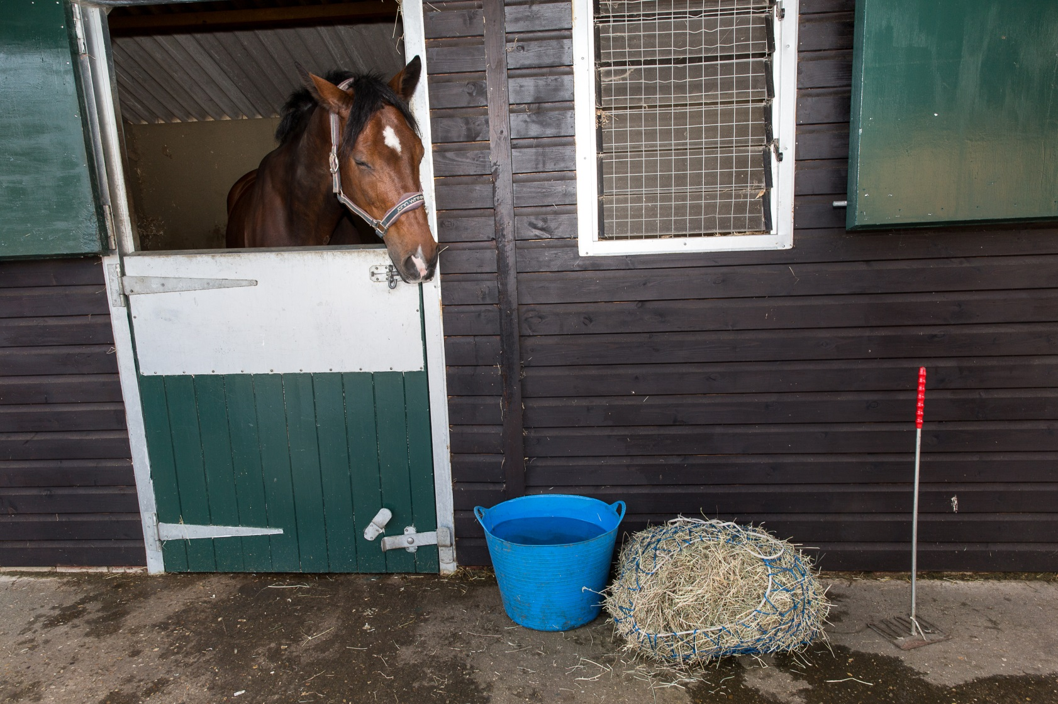
What potential hazards can you see in this picture?
Notes:
Either as a group or split into smaller group discuss the picture on the slide and identify potential hazards
You can use these pictures or add your own to the slides

Slide 7
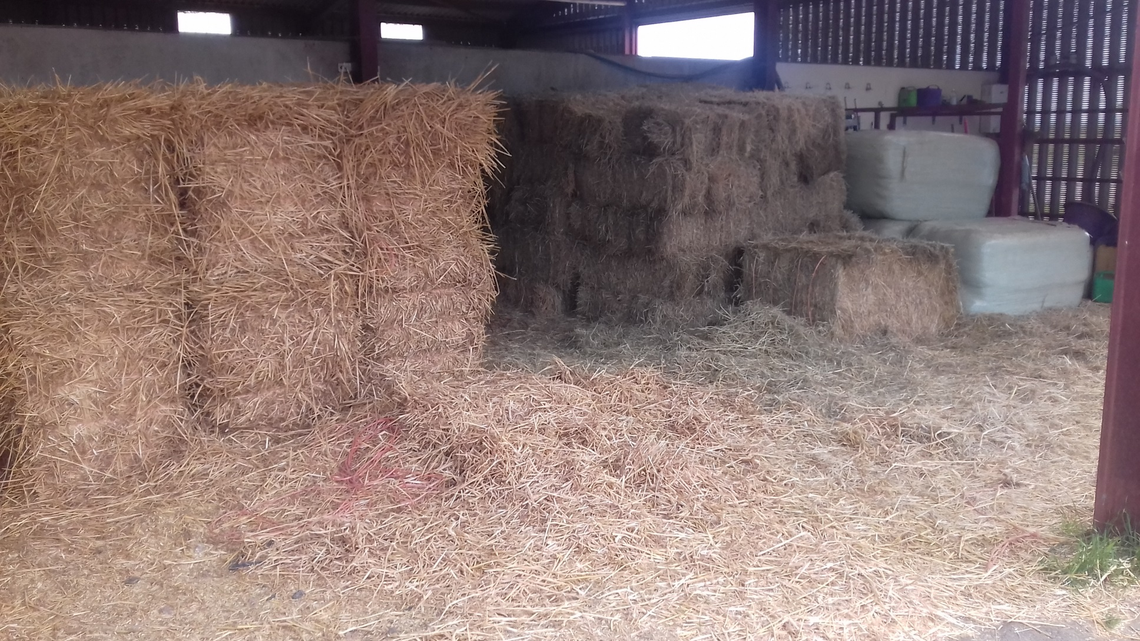
What potential hazards can you see in this picture?
Notes:
Either as a group or split into smaller group discuss the picture on the slide and identify potential hazards
You can use these pictures or add your own to the slides

Slide 8
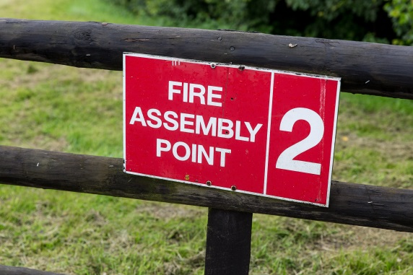
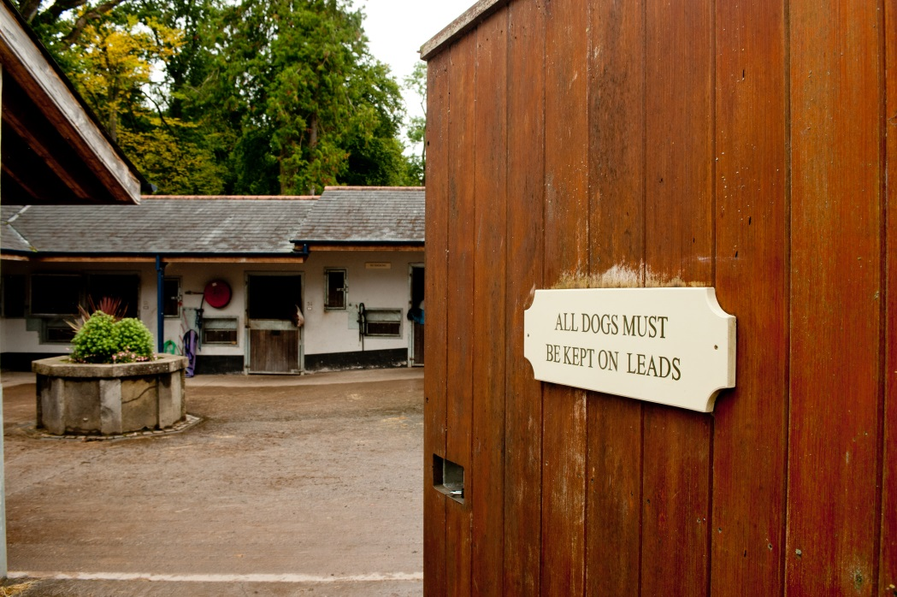
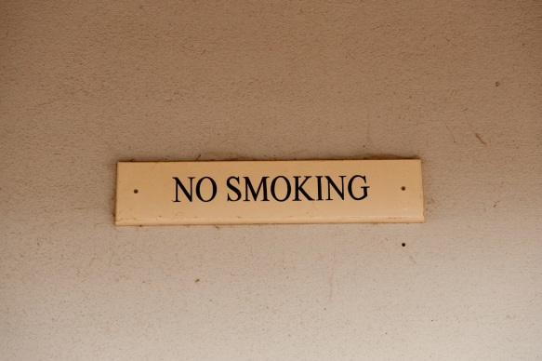
Yard rules
Notes:
Discuss as a group reasons for having rules on the yard.
Discuss as a group any rules that apply on a yard they are familiar with or to think up their own.
What might the reasons be for rules such as: reporting to the office on arrival, restricted access to stables/horses, not touching or feeding horses, no running on the yard.
What type of information signs would the group expect to see around the yard?

Slide 9
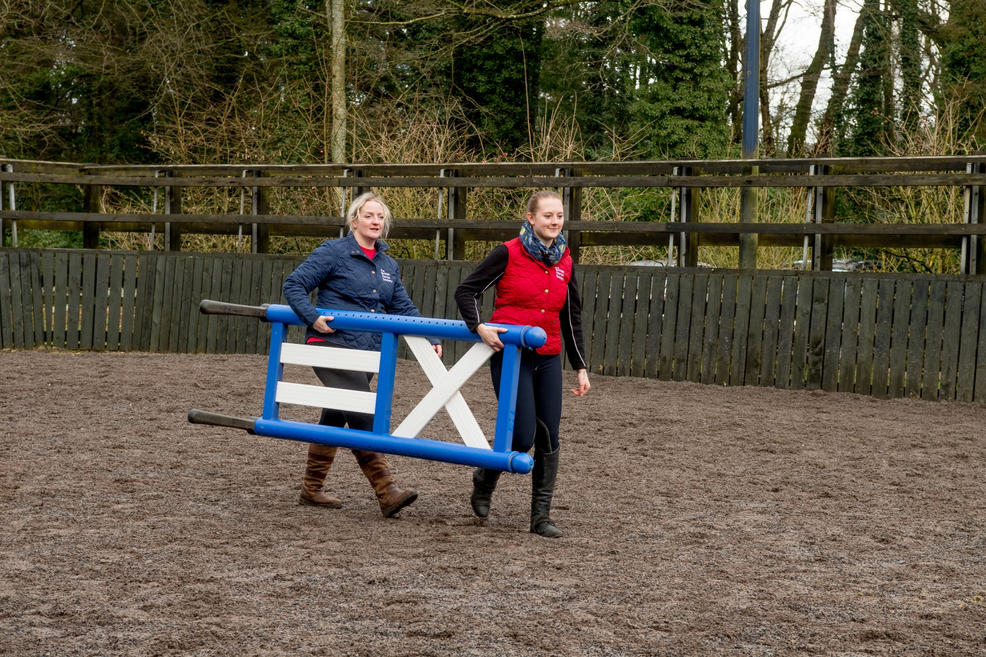
Safe lifting
Notes:
Discuss what kind of objects might have to lift on a yard
Discuss why safe lifting is important
Discuss methods of moving heavy/awkward objects – e.g. wheelbarrow

Slide 10
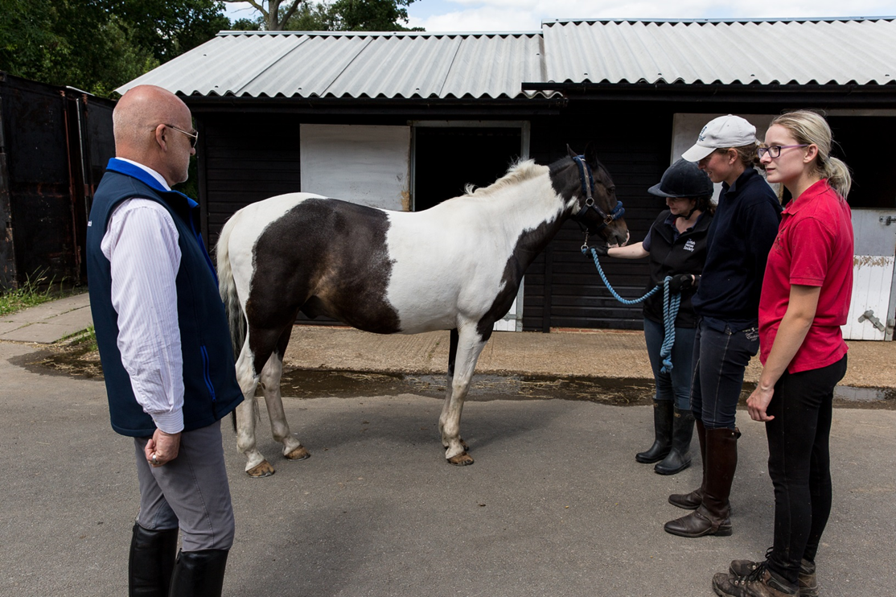
What to wear on the yard
Personal Protective Equipment (PPE)
Notes:
Ask the group if they are familiar with the term PPE or if they need to wear any PPE as part of their work/hobbies etc?
Why do people wear PPE? Discuss if the group think wearing PPE on the yard is as important as wearing it when riding?
Types of PPE:
Hat – highlight importance of current standard and it fits correctly. Reasons for not buying a second hand hat. When should it be replaced?
Footwear – discuss the various types of footwear available/marketed as riding boots. What is suitable and what isn’t
Gloves – should have grips, why woollen gloves with no grips not suitable.
Clothing in general – reasons for wearing close fitting, comfortable clothing.
Hi-Viz – out hacking/leading on roads. Why horse riders need to make themselves visible. Discuss difference between reflective and fluorescent.
Link to BHS what to wear page https://www.bhs.org.uk/advice-and-information/safety-advice-and-information/what-to-wear

Slide 11
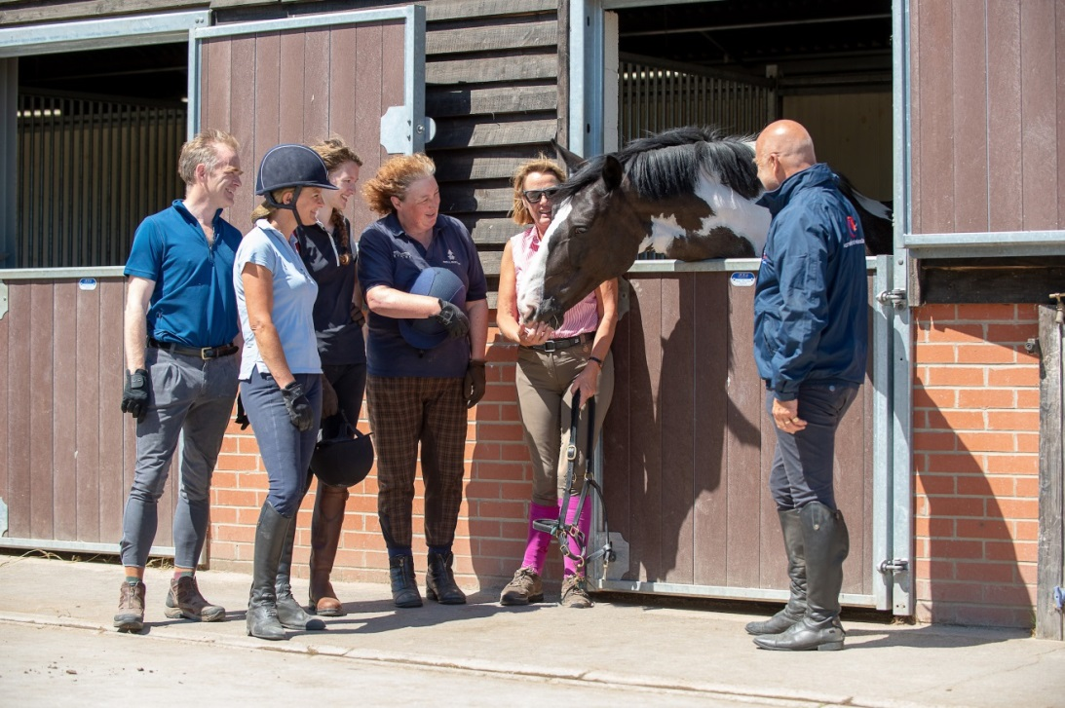
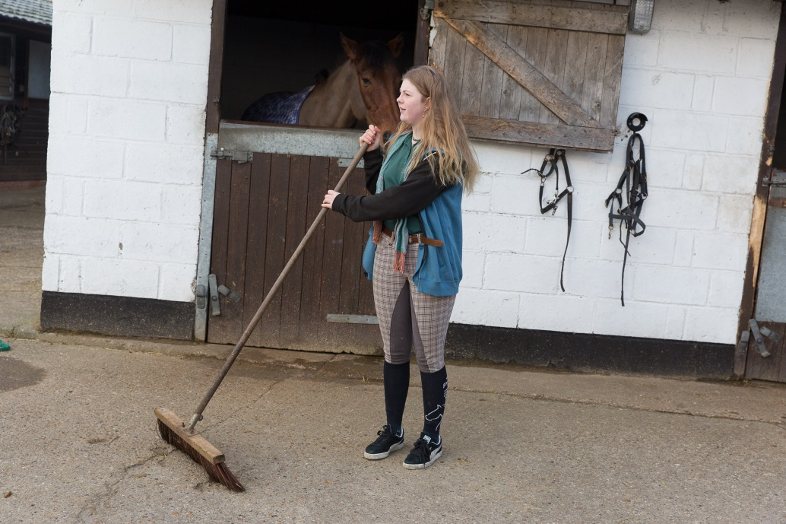
Notes:
Discuss the suitability of what the people in the pictures are wearing

Slide 12
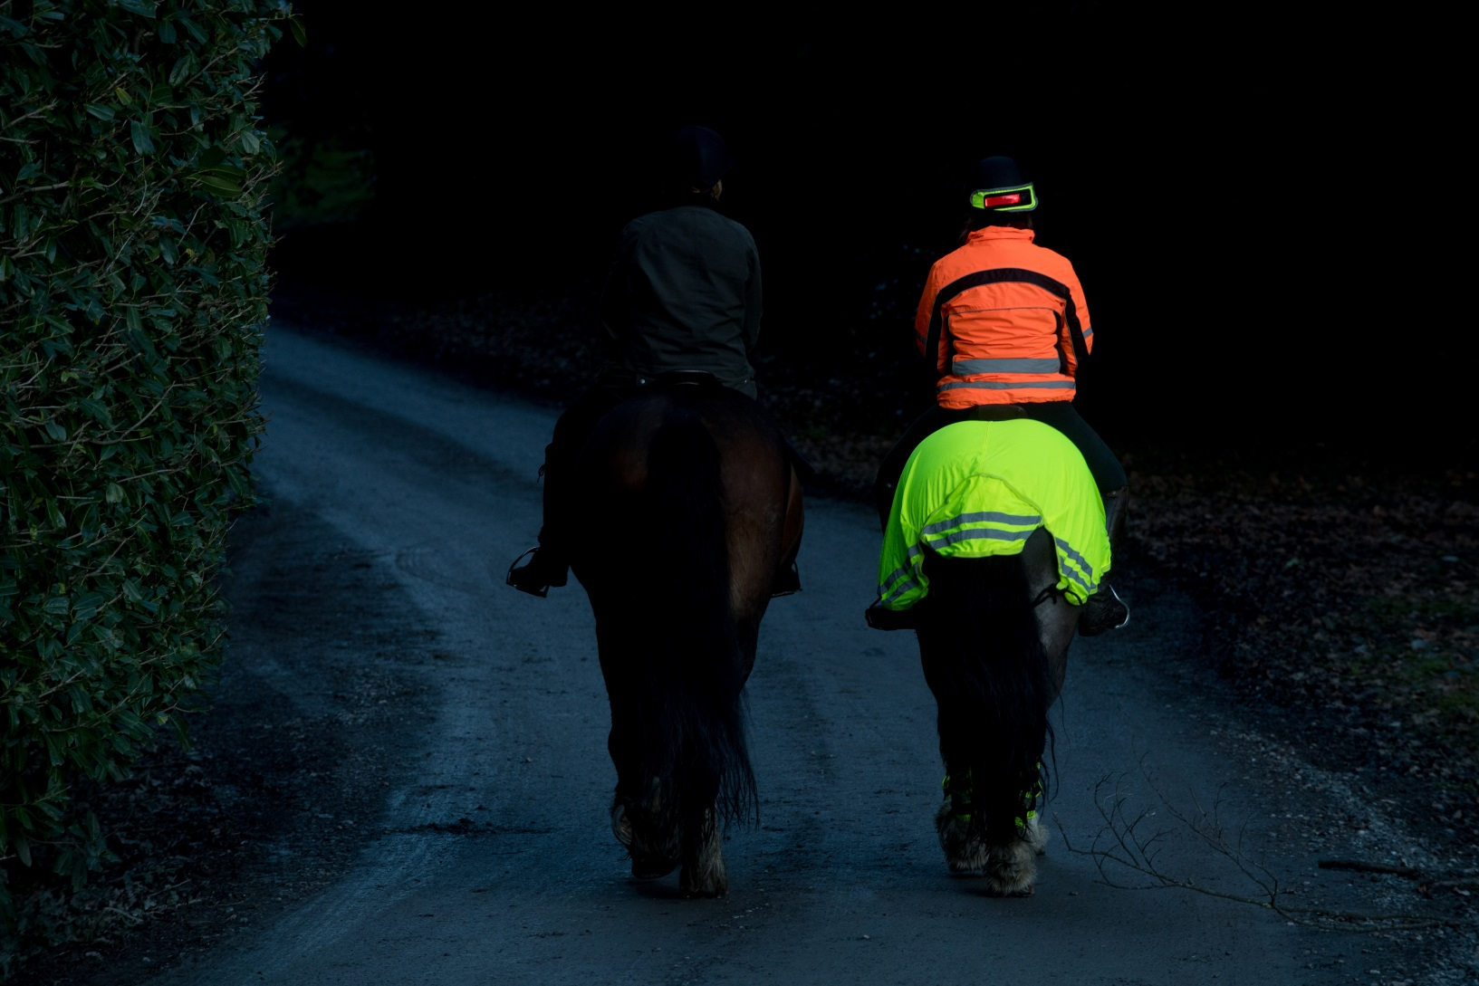
Hi-Viz
Notes:
This image highlights the difference wearing hi-viz can make.
Discuss dangers of riding on the road and the importance of making themselves as visible as possible. Why putting leg bands on is effective (movement)
Discuss the different colours of hi-viz available and which colour might be better in a variety of situations depending on time of year/leaf coverage. https://www.bhs.org.uk/advice-and-information/safety-advice-and-information/what-to-wear/hi-viz
Depending on audience you may want to include some information about the Be nice, say Hi! Campaign or Dead Slow https://www.bhs.org.uk/our-work/safety/dead-slow

Slide 13
Quick Quiz
What items of Personal Protective Equipment you would wear on the yard?
Why shouldn’t you wear flappy clothing on the yard?
List three hazards you might find on a yard
List two rules you should follow on the yard
Why should you wear hi-viz when riding on the road?
Notes:
This quiz is very informal and is not designed to be a test. Answers can be written or verbal and there is space for the participants to write answers in their booklet.
Suggested answers:
Suitable footwear, hat, gloves
The noise might scare the horses, get caught up
Any acceptable answers from the booklet or covered in the session
Any acceptable answer from the booklet or covered in the session
To make you more visible to other road users

Slide 14
Horse Behaviour
Think about how horses live in the wild live
  Natural instincts
  Protection
  Nourishment
  Activity
Notes:
Discuss what the group know about the natural lifestyle of the horse use the headings on the slide to help with the discussion. Consider splitting them into small groups for discussion and then feedback to the rest of the group.
Discuss with the group why they need to know this and how it affects how we behave around horses
If possible show some video clips of horses in the wild or freely grazing and discuss the types of behaviour you can see
Flight or fight response

Slide 15
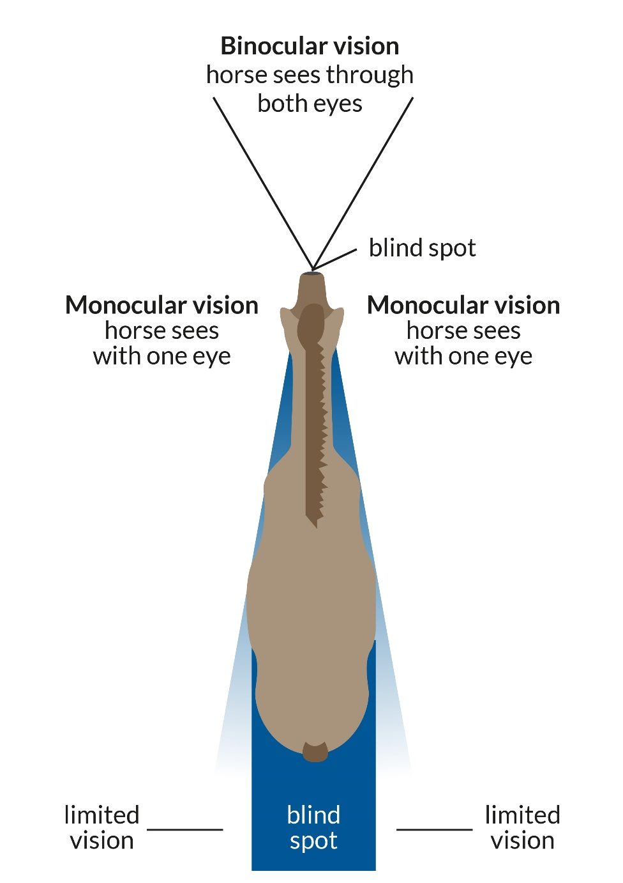
Horse vision
Notes:
Discuss how the horses vision differs from ours and how this affects how we handle them
Ask Alex W to cut the picture from Caring Bronze to use on this slide and in the booklet

Slide 16
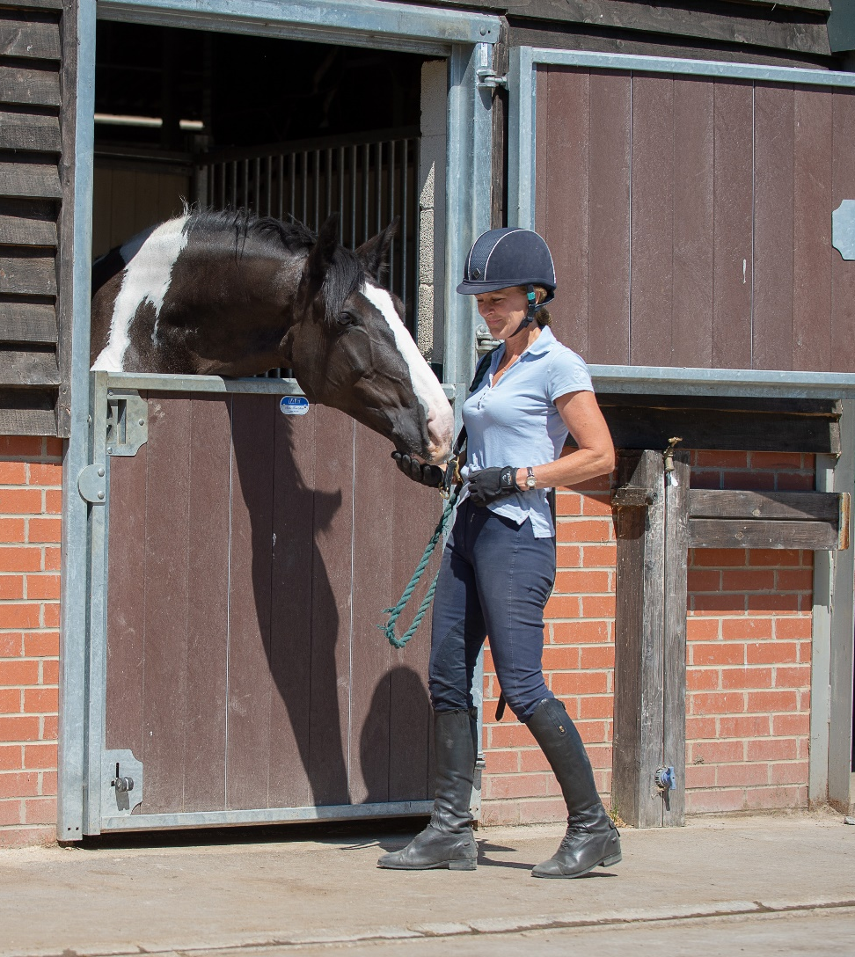
How to approach a horse safely
What should you consider before approaching a horse?
Notes:
Discuss as a group what you need to take into consideration when approaching a horse
- Relate back to flight or fight instinct, position of horse’s eyes and what was discussed in the behaviour section
Discuss PPE
Discuss when it is not safe to approach a horse?

Slide 17
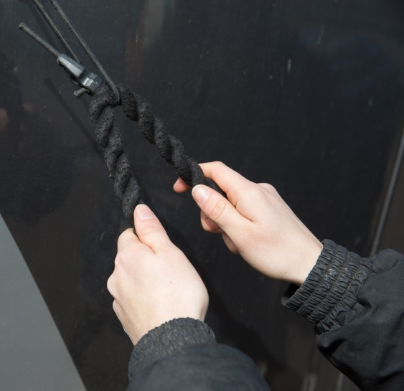
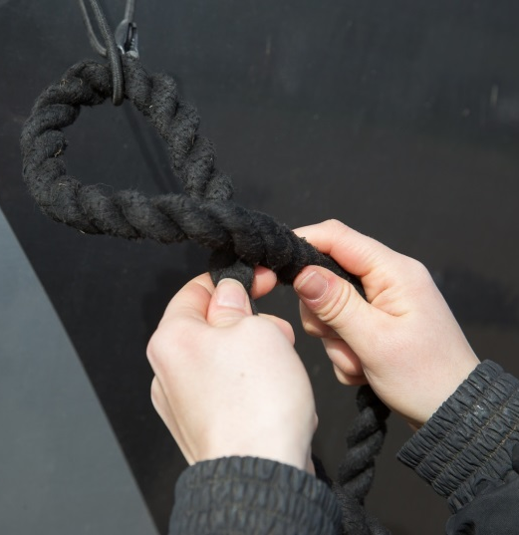
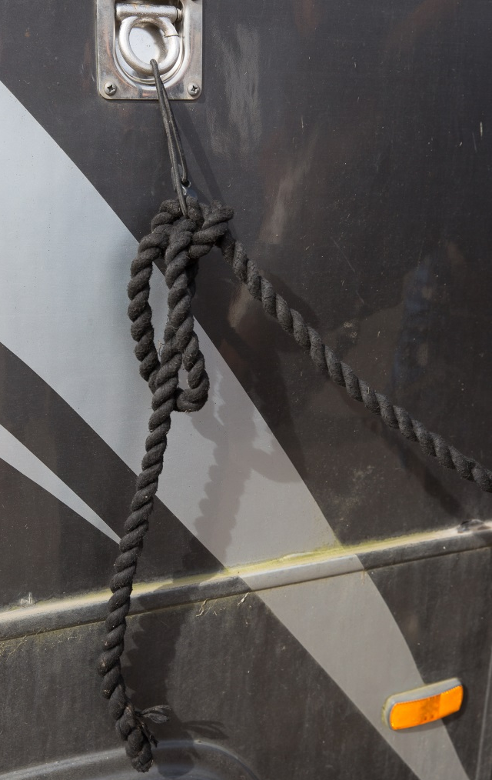
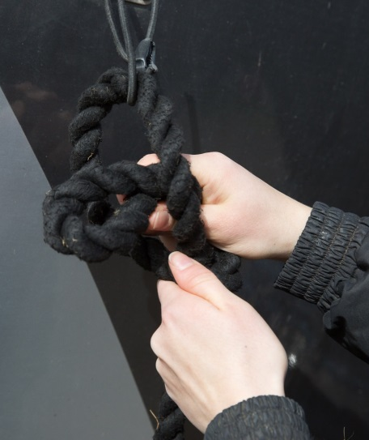
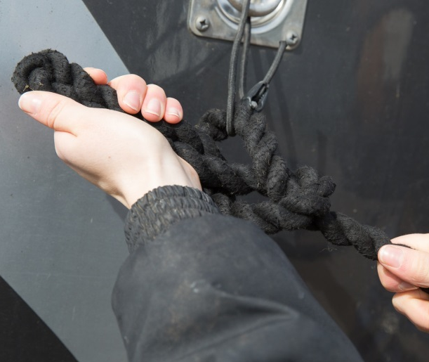
Quick release knot
5. Thread the end of the rope through the loop
1. Place the rope through the string
2. Cross the tail of the rope over
3. Make a loop with the tail end and thread it through
4. Pull the loop tight
Notes:
Discuss reasons for tying up when working around a horse
Safety considerations – area safe, horse calm, movement of other people/horses, suitable tie ring
As a group discuss why tie the lead rope to piece of string? What can happen if the string is too thick/thin? Can also include the use of break away clips/lead ropes clips
Split group into pairs – hand out lead ropes and string. One pair holds the string loop while the second follows the procedure to tying a quick release knot. Swap between pairs and practice each technique. Show both methods of tying a quick release knot.
Discuss why tuck end of rope through the loop

Slide 18
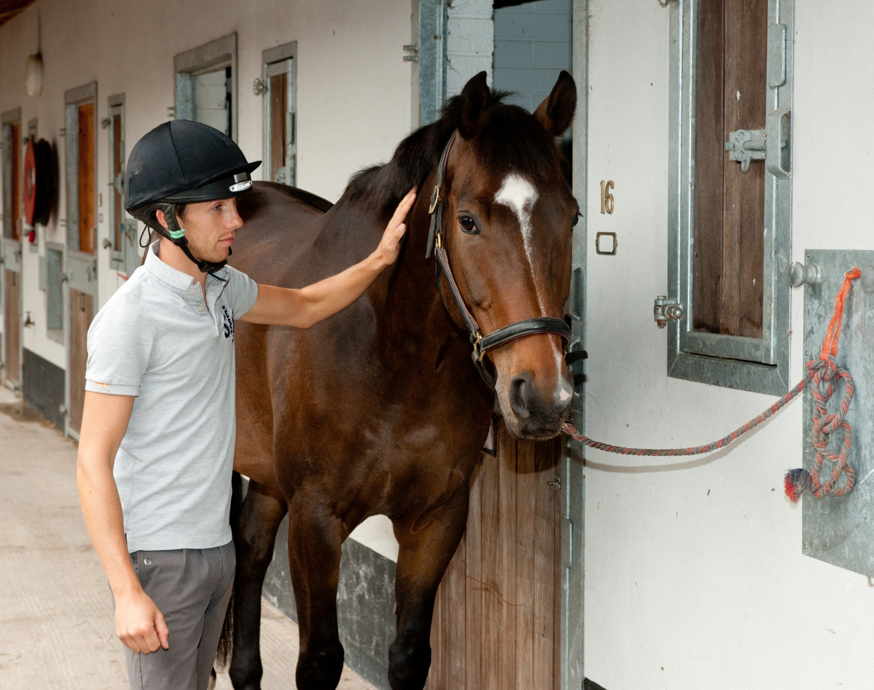
Notes:
Discuss the correct length to tie a horse up. What do the group think might happen if the rope is too short or too long?

Slide 19
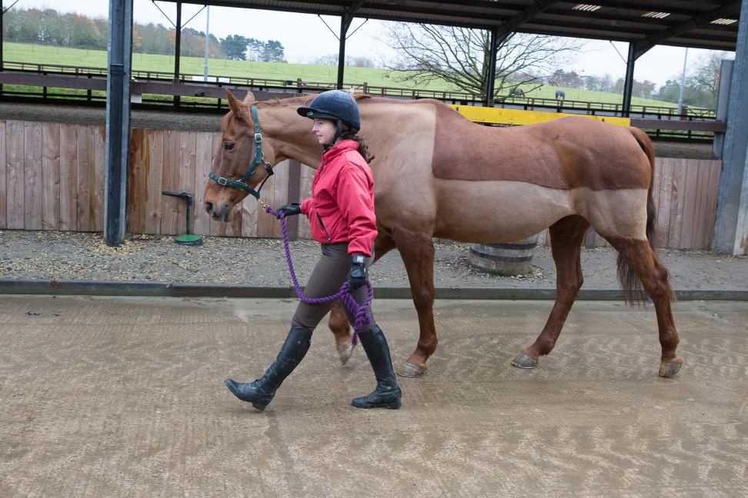
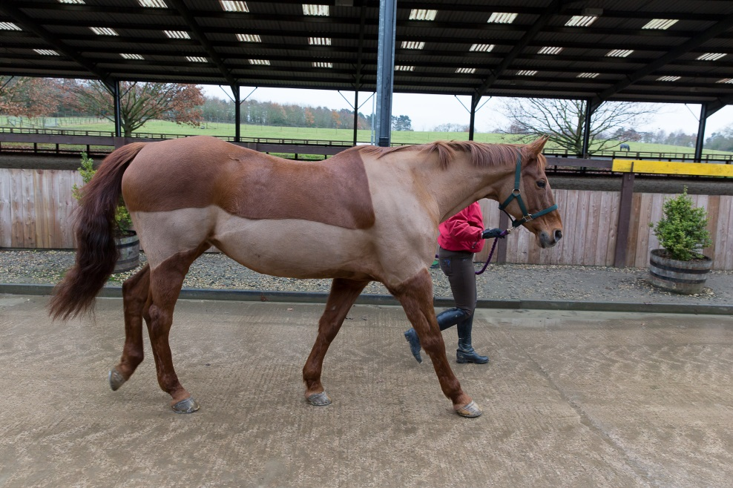
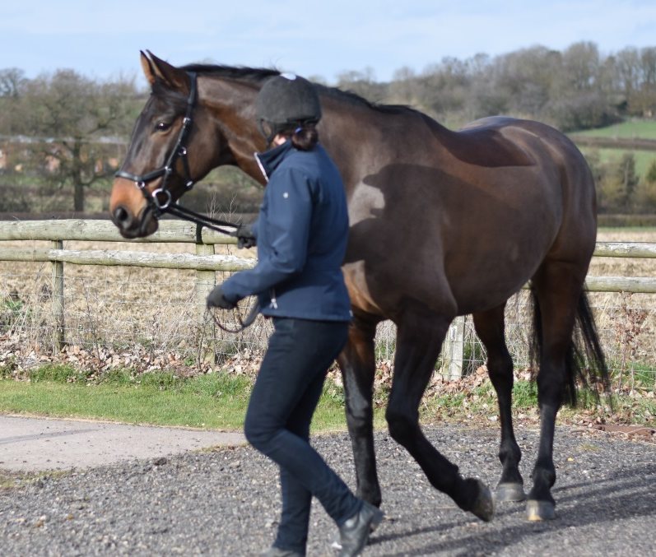
Leading
Notes:
As a group discuss use of PPE when leading. What potential dangers can they think of?
In pairs using the lead ropes demonstrate how to hold the rope when leading. Demonstrate (gently!)what can happen if you wrap the lead rope around your hand.
Discuss how the position of the handler can influence the horse. What can happen if you get in front of horse or left behind?
How to control the horse – voice commands and body language.
Demonstrate with the group - the difference between standing up tall/shoulders back/head up and slouching/rounded shoulders/head down.
Discuss how to turn the horse – how to control the size of the turn.

Slide 20
Quick Quiz
What are the horses natural instincts?
How does the horse vision differ from ours?
Why should you approach a horse from the side?
What type of knot is used to tie a horse up?
Why is this knot used?
Why should you tie the lead rope to a piece of string?
Where should you position yourself when leading a horse?
Why should you turn the horse away from you?
Notes:
This quiz is very informal and is not designed to be a test. Answers can be written or verbal and there is space for the participants to write answers in their booklet.
Suggested answers:
Fight, flight
Their eyes are positioned on the side of their head, giving them good vision to the sides, blind spot immediately infront and behind
To make sure they see you
Quick release knot
It can undone quickly in emergency
To provide a breaking point, reduce the risk of injury if horse panics
By the horses shoulder
Control the size of the turn, stop horse from standing on you

Slide 21
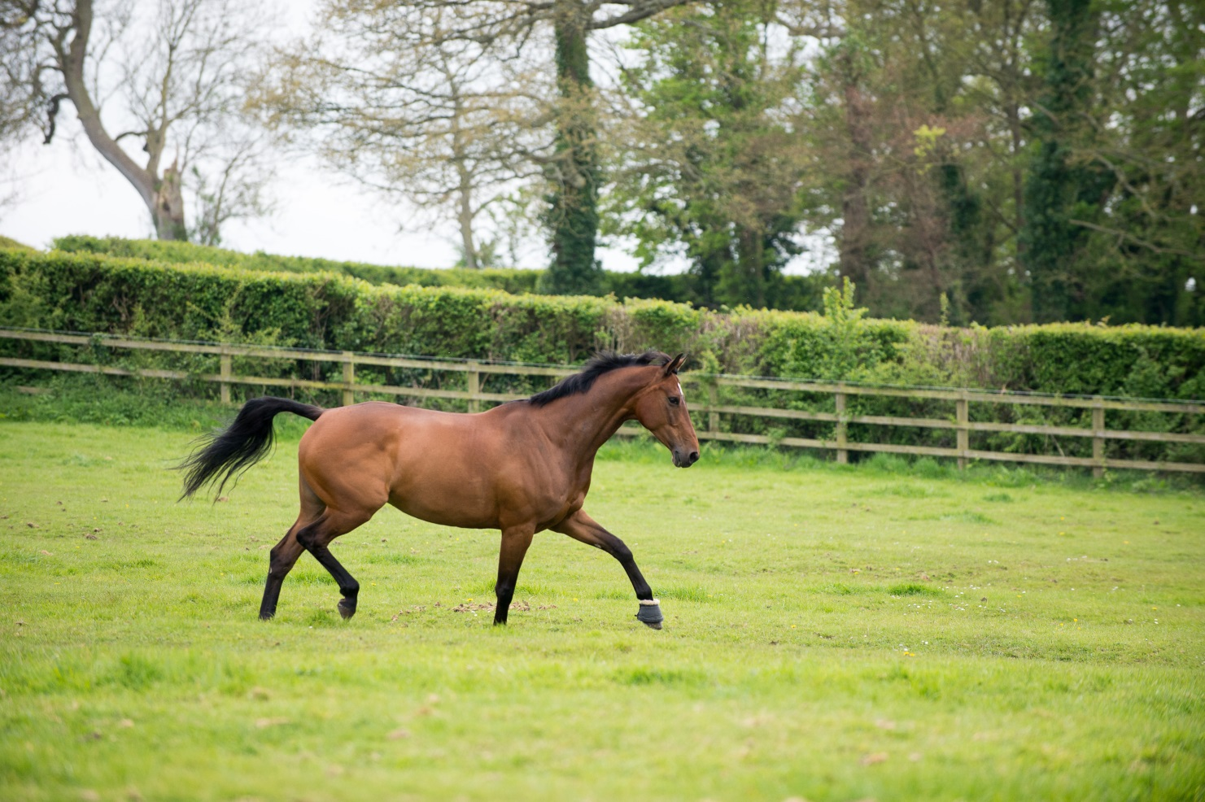
Horse Care
Horse Welfare
Notes:
Horse Welfare covers the basic needs of the horse
These can be applied to all animals not just horses

Slide 22
What are the basic needs of any animal?
1. Shelter
2. Company
3. Freedom to exhibit normal behaviour
4. Food and Water
5. Be free from pain, suffering, injury and disease
Notes:
Split the group up into smaller groups and ask them to discuss what they think are the basic needs for any animals and make a list.
Each group feedback to the main group
Create a master list and compare it to the guidelines on the slide

Slide 23

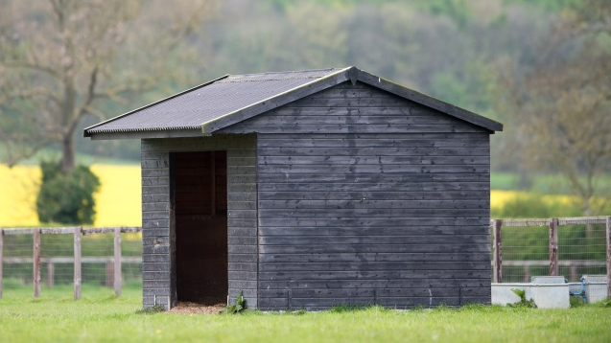
Shelter
From the elements
trees
bushes
purpose built shelter
stable
rug
high wall/side building
Notes:
Discuss each item on the list – what does it mean for horses and suggest ways it can be provided

Slide 24
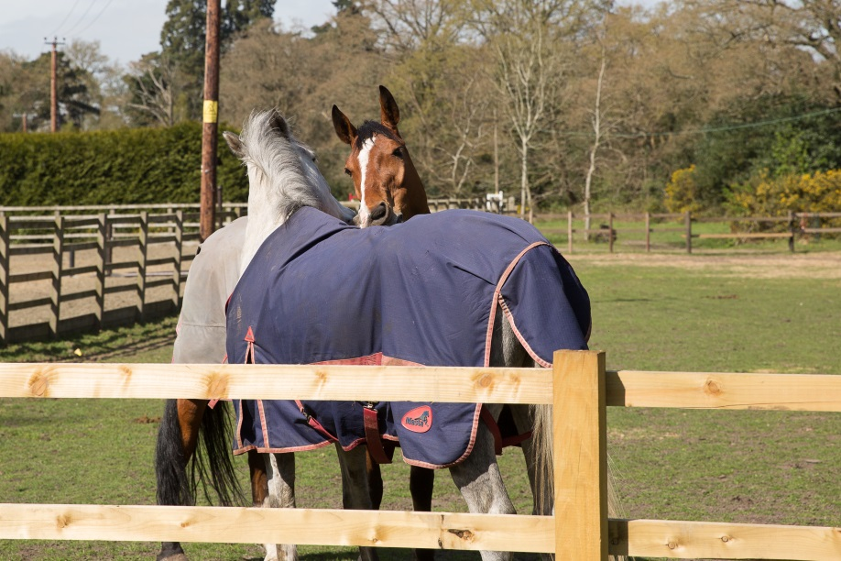
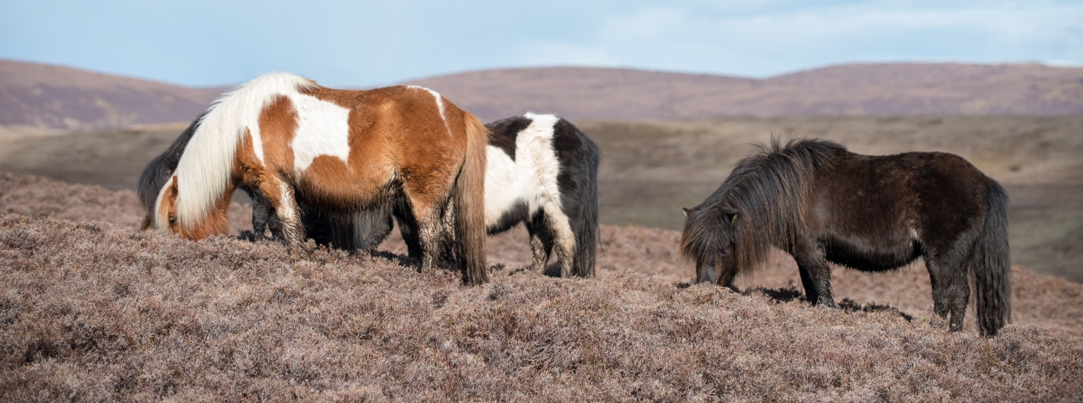
Company
Evolved to live in herds
with other horses or ponies
Notes:
Discuss what animals make suitable company for horses.
Discuss what can happen if a horse doesn’t have suitable company?

Slide 25
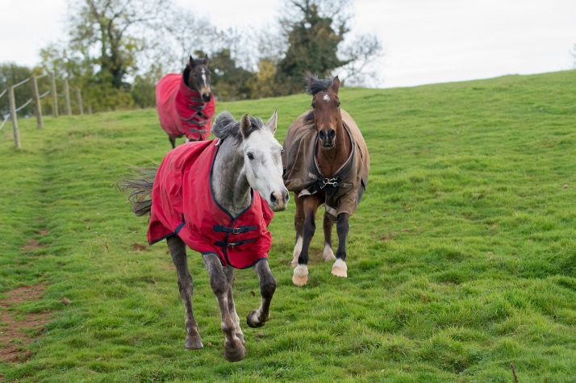
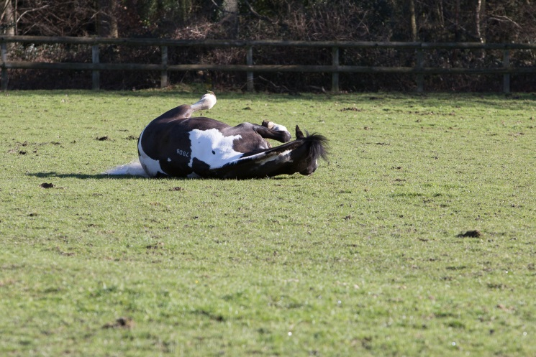
Freedom to exhibit normal behaviour
What does this mean?
Let the horse be a horse!
Turnout allows them to choose what they do and when they do it
Notes:
Discuss what is meant by normal behaviour patterns?
Discuss what can happen if horses are not able to do this? What type of situation may mean a horse cannot do this – box rest, long periods of no turn out (weather, ground, yard restrictions)

Slide 26
Food and Water
Horse is a herbivore
Digestive system evolved for a high fibre diet
Feeding wrong type of feed cause digestive upset
Water is required for all bodily functions and processes
Horses can be fussy drinkers
Notes:
Discuss what a herbivore is
Discuss what the horse is designed to eat – grass in the field/hay or haylage in stable. More about feeding is covered after this section
Discuss what can happen if the horse is fed the wrong type of diet
The importance of providing free access to fresh, clean water (80% of the horse is made up of water)

Slide 27
Free from pain, suffering, injury and disease
Recognising normal behaviour
Recognising behaviour changes
Routine health care (preventative procedures)
Industry professionals who can help e.g.
    Vet
    APC
    BHS Welfare advisor
Notes:
Discuss normal behaviour patterns for horse – eating/drinking etc
What can make these behaviours change?
Discuss what kind of routine health care is required for horses – vaccinations, worming, farriery, dentistry, saddler…..
Discuss who horse owners can turn to for help or advice if they need to?

Slide 28
Quick Quiz
List the 5 welfare needs of the horse
Give a reason why you need to meet these needs
List a way you can ensure you meet each one of these needs
Notes:
This quiz is very informal and is not designed to be a test. Answers can be written or verbal and there is space for the participants to write answers in their booklet.
Suggested answers:
Company, shelter, food and water, free from pain, disease and suffering, exercise normal behaviour
Any acceptable reason covered in the booklet or the session
Any acceptable method/suggestion covered in booklet or session

Slide 29
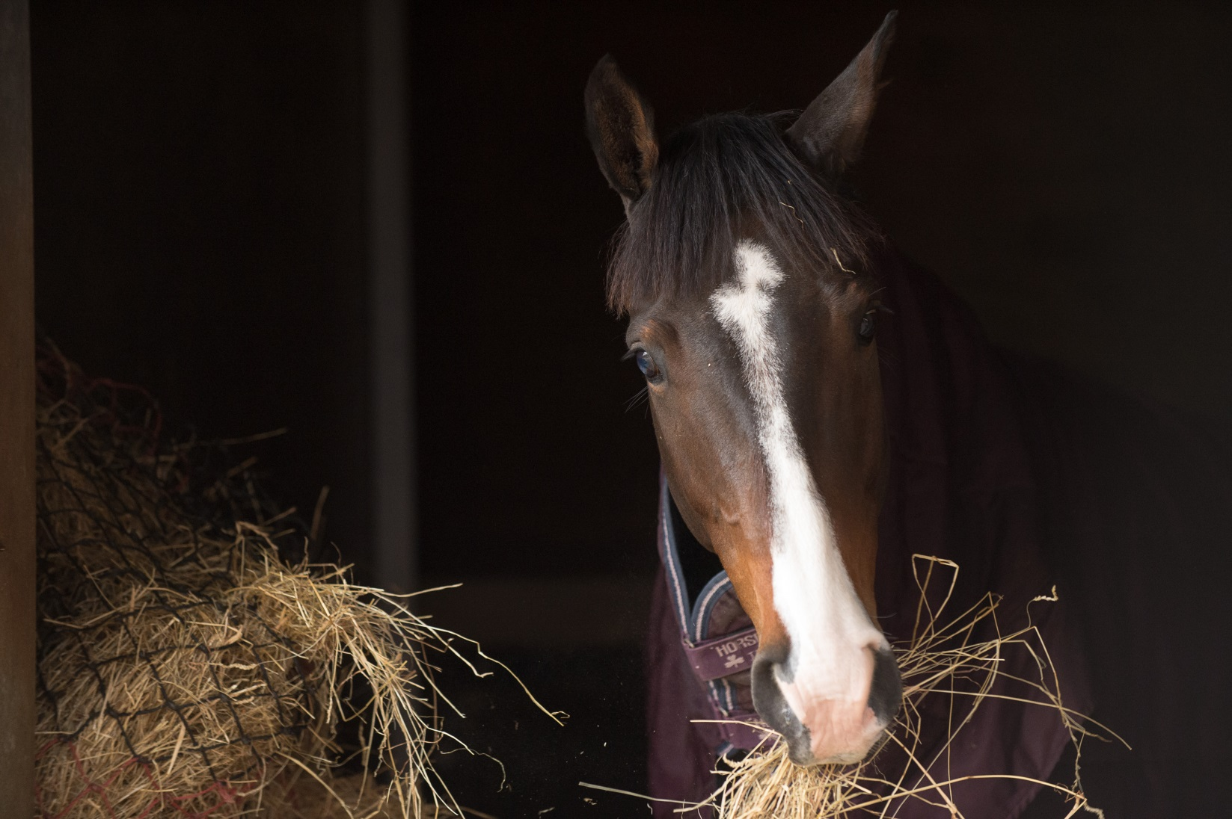
Feeding
Notes:
Picking up on the Food and water element of the basic needs this section goes into a bit more detail about fibre
Discuss the term trickle feeder and what it means. Refer back to the natural behaviour of the horse
The horse has evolved to live on fibre

Slide 30
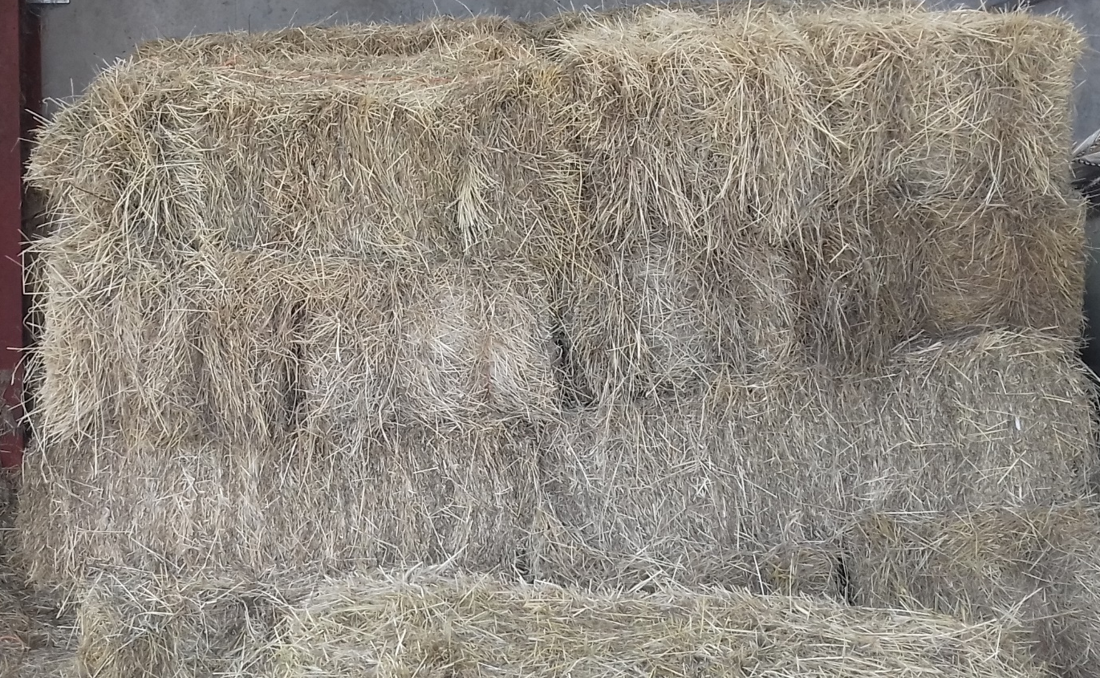
Hay
Notes:
Fibre = grass, hay or haylage
Discuss the different types of hay and the main differences between hay and haylage.
Common types of grasses found in hay

Slide 31
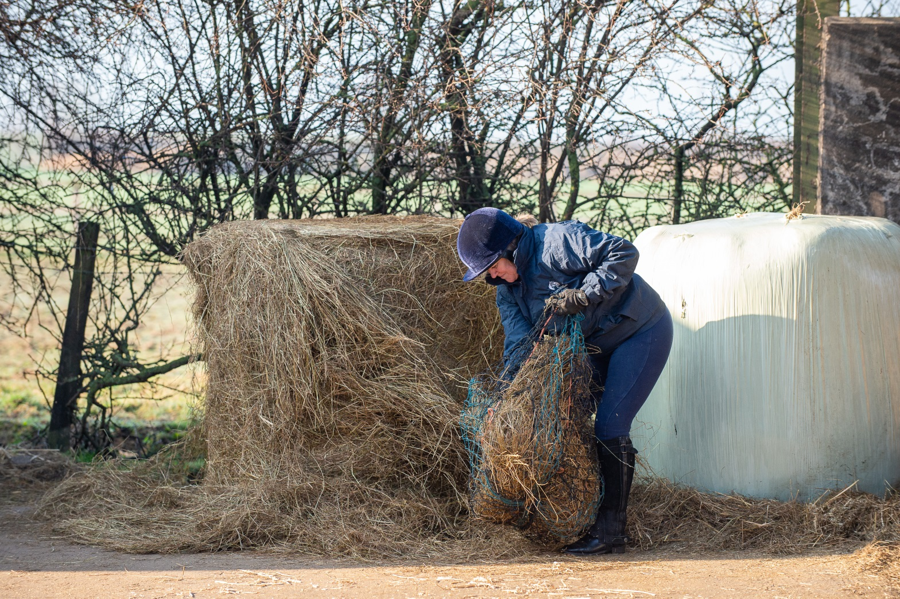
Haylage
Notes:
Haylage – how it is made. Why it is wrapped in plastic. What happens if the bale is pierced?

Slide 32
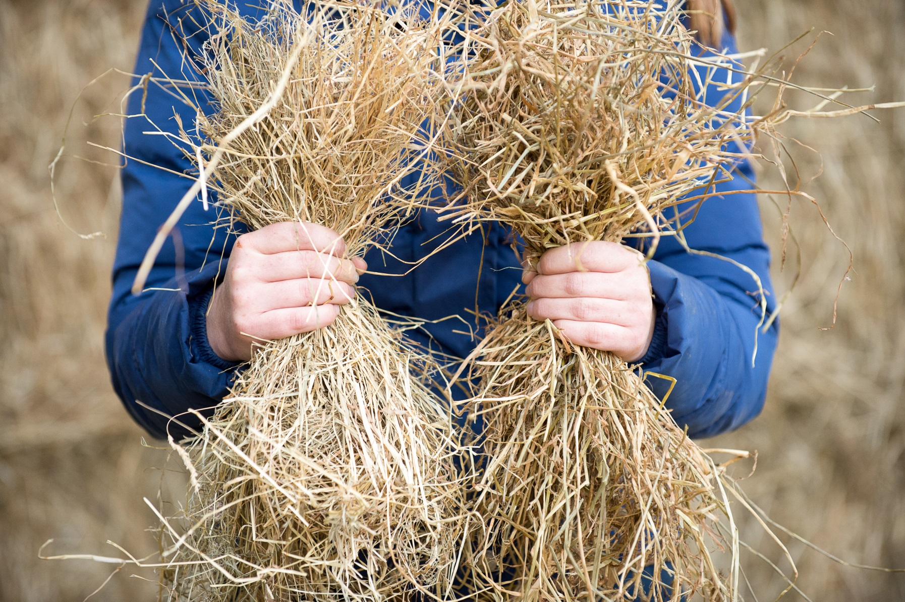
HAY
HAYLAGE
Notes:
Discuss with the group the differences you can see between the two fibre sources on the picture
Ask the group to vote on which one is hay and which one is haylage.
Consider bringing in a sample of each so the group can see, feel and smell the difference between the two.
Answers will come up if click on slide

Slide 33
Quick quiz
What has the horse evolved to eat?
Name three types of fibre
What is the main difference between hay and haylage?
Name two types of hay?
Why is haylage wrapped in plastic?
What can happen to the haylage if the wrap is pierced or damaged?
Notes:
This quiz is very informal and is not designed to be a test. Answers can be written or verbal and there is space for the participants to write answers in their booklet.
Suggested answers:
Fibre based diet
Hay, haylage, grass
Hay is baled dry, haylage baled damp
Seed, meadow
To make it airtight and allow bacteria to breakdown sugars
Air can get in, cause haylage to go mouldy

Slide 34
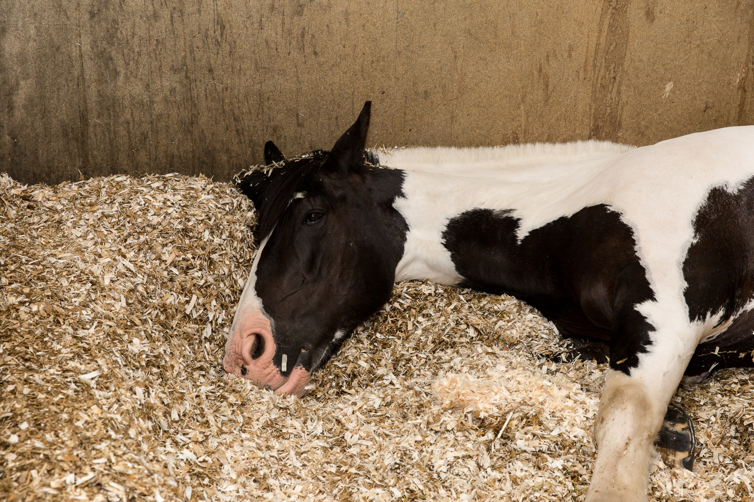
Stable Care
Notes:
This section introduces the participants to the basics of looking after a stable kept horse. Topics covered include: types of bedding, providing water and a basic skipping out procedure
Ask the group to come up with some reasons why horses are kept in stables
If they have seen horses in stables did they notice what the horse was standing on?

Slide 35
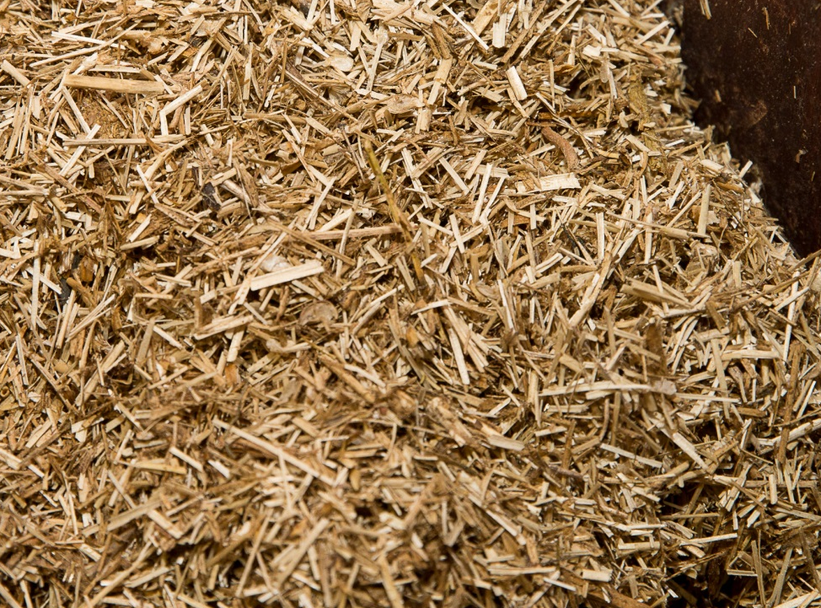
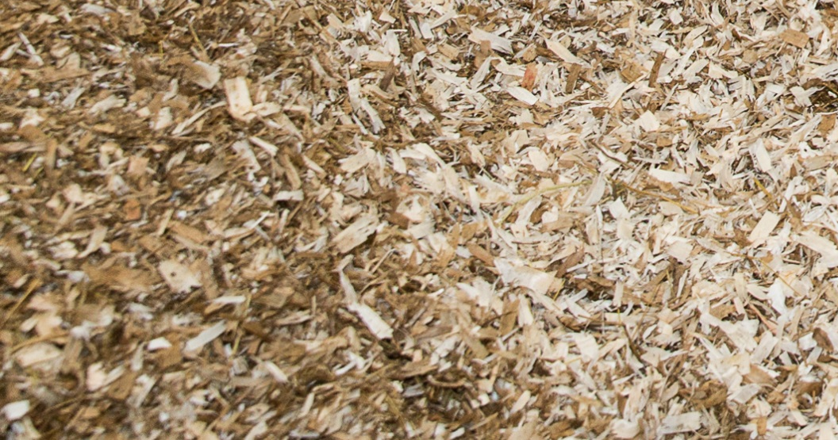
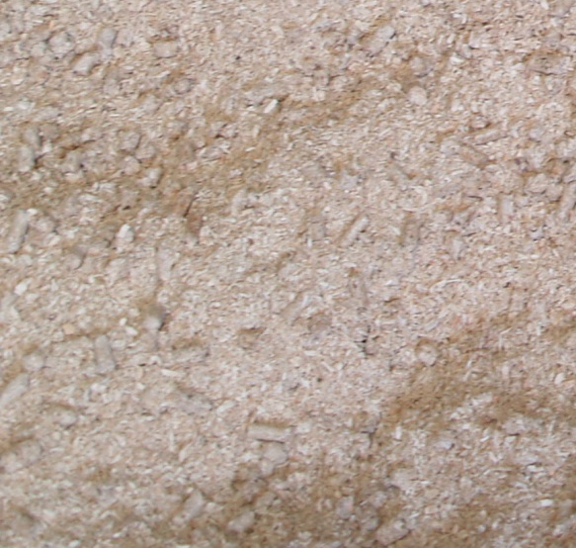
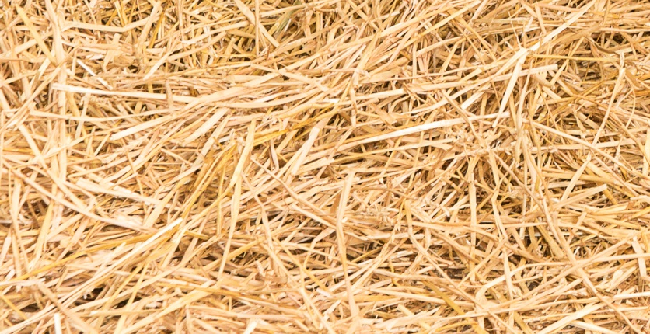
Types of Bedding
Notes:
Discuss as a group any reasons they can think of why bedding is used
What types of bedding are the group familiar with? Can they identify the bedding in the pictures?
Discuss each type, write a description in the booklets and list some pros and cons of each. Banks could be discussed here or in the skipping out section.
There is a welfare bedding leaflet available to download. www.bhs.org.uk/wealfareleaflet for further information

Slide 36
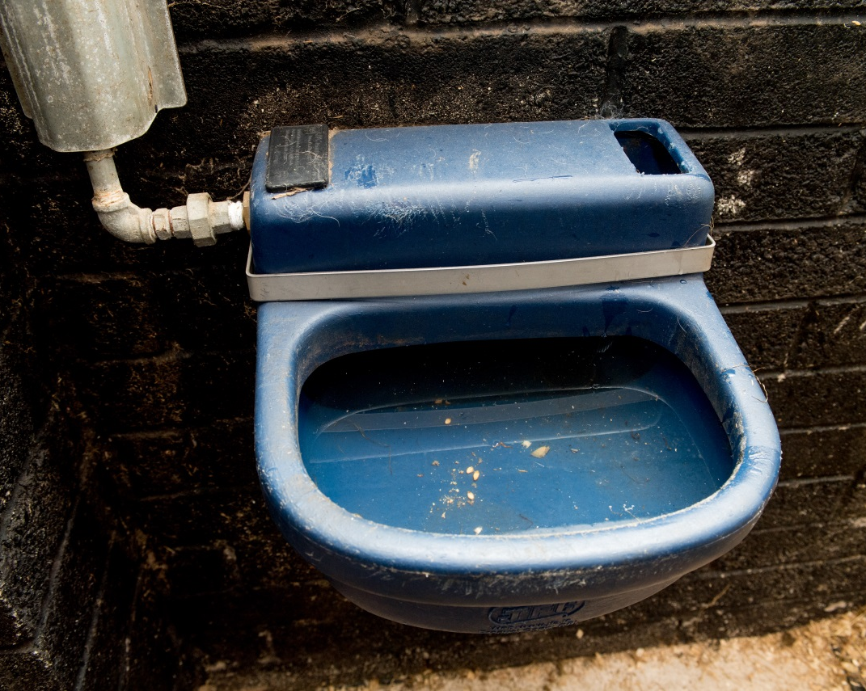

Water
Notes:
Link water back to welfare needs in earlier slides. How much water can an average horse drink per day? (30-70litres/53-123pints)
Discuss ways of supplying water in the stable – water buckets/drinkers.
Why do they need to be changed regularly?
Safety – why movable handles should be positioned against the wall

Slide 37
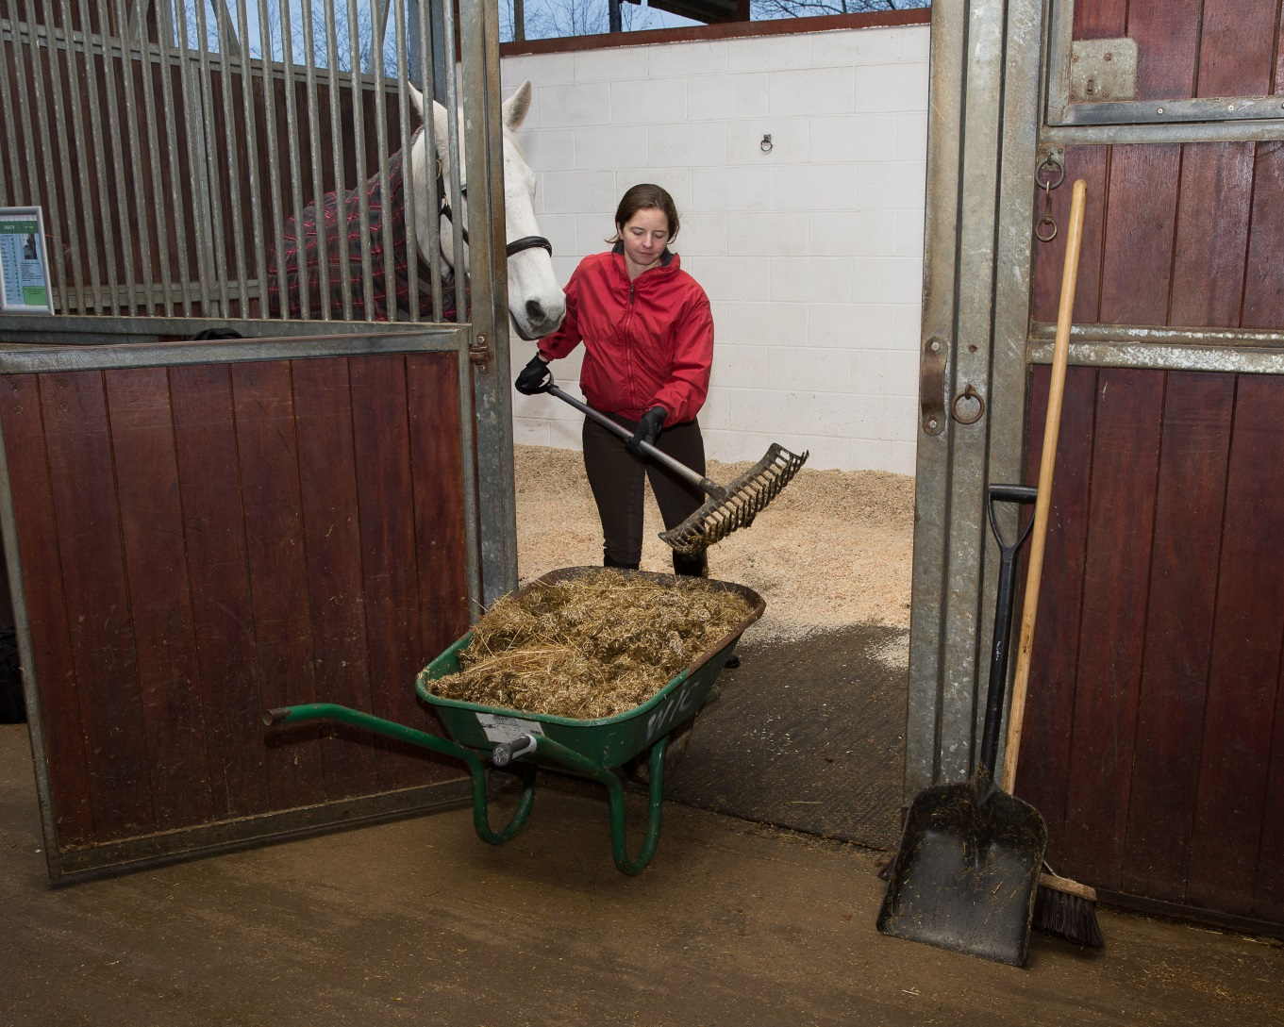
Skipping out
Notes:
Discuss as a group reasons for keeping a stable clean. Participants to write reasons in booklet

Slide 38
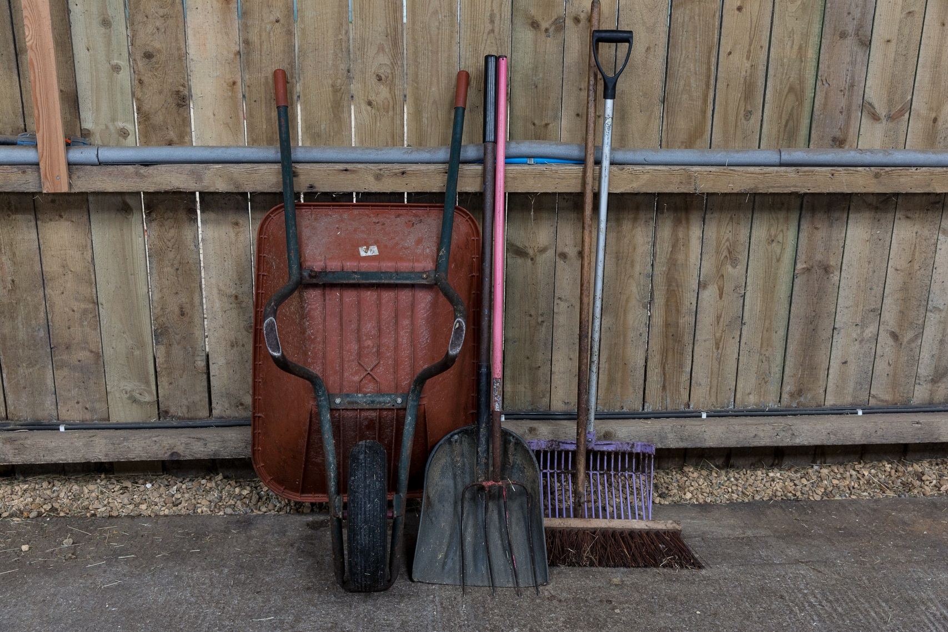
Tools required
Notes:
Fork suitable for bedding type – what are the differences between shavings and straw fork
Skip bucket or wheel barrow
Broom
Shovel or scoop

Slide 39
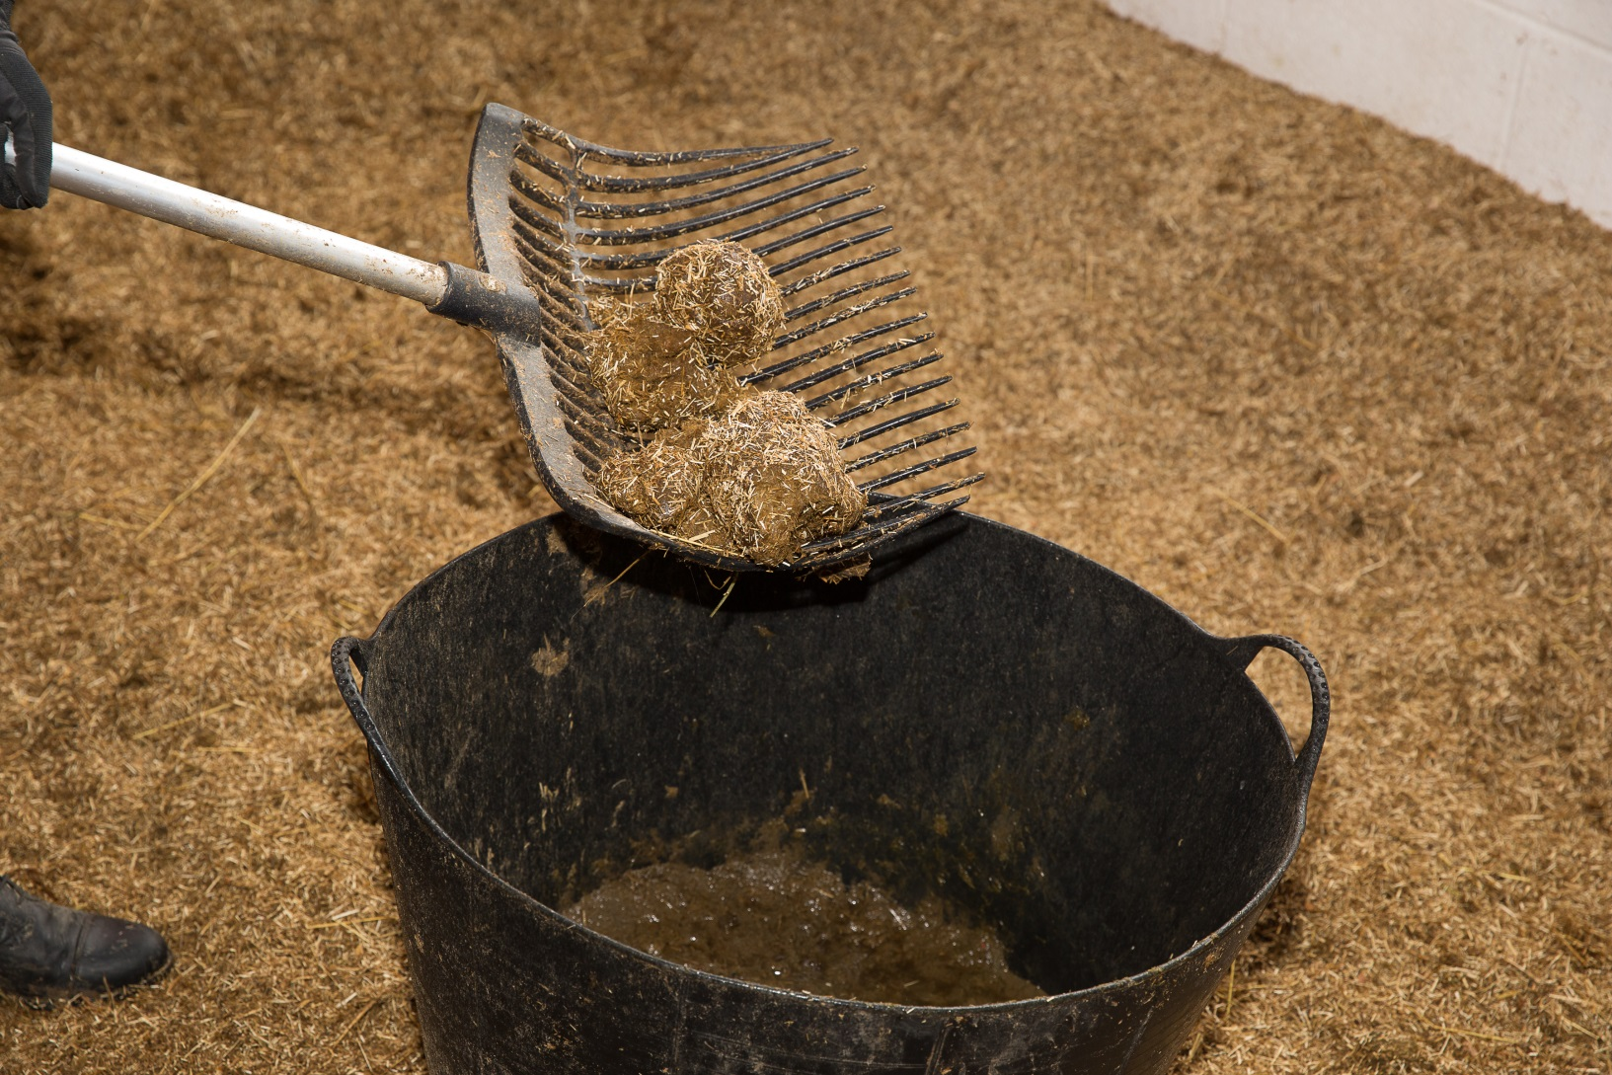
Skipping out
Notes:
Talk through a procedure for skipping out.
Highlight aims: remove droppings but not clean bedding, reshape bed, reshape banks (talk about use of banks here if not mentioned before), sweep bed back from door, reasons for cleaning water buckets/drinkers each time. What to do with muck

Slide 40
Quick quiz
Name two types of bedding suitable for horses
Name two methods of providing water to horses in stables
List three reasons for keeping a stable clean
List the tools you might need to skip out
What do you need to make sure of when you remove droppings?
Notes:
This quiz is very informal and is not designed to be a test. Answers can be written or verbal and there is space for the participants to write answers in their booklet.
Suggested answers:
shavings, straw, flax, wood pellets, carboard, paper or any other acceptable answer
Buckets, drinker, tub
Reduce risk of disease/illness, keep bed clean, reduce waste bedding, pleasant environment or other acceptable answer
Fork, skip, barrow, shovel, broom, poo skip and fork or any other acceptable answer
Sieve the bedding, don’t remove too much bedding

Slide 41
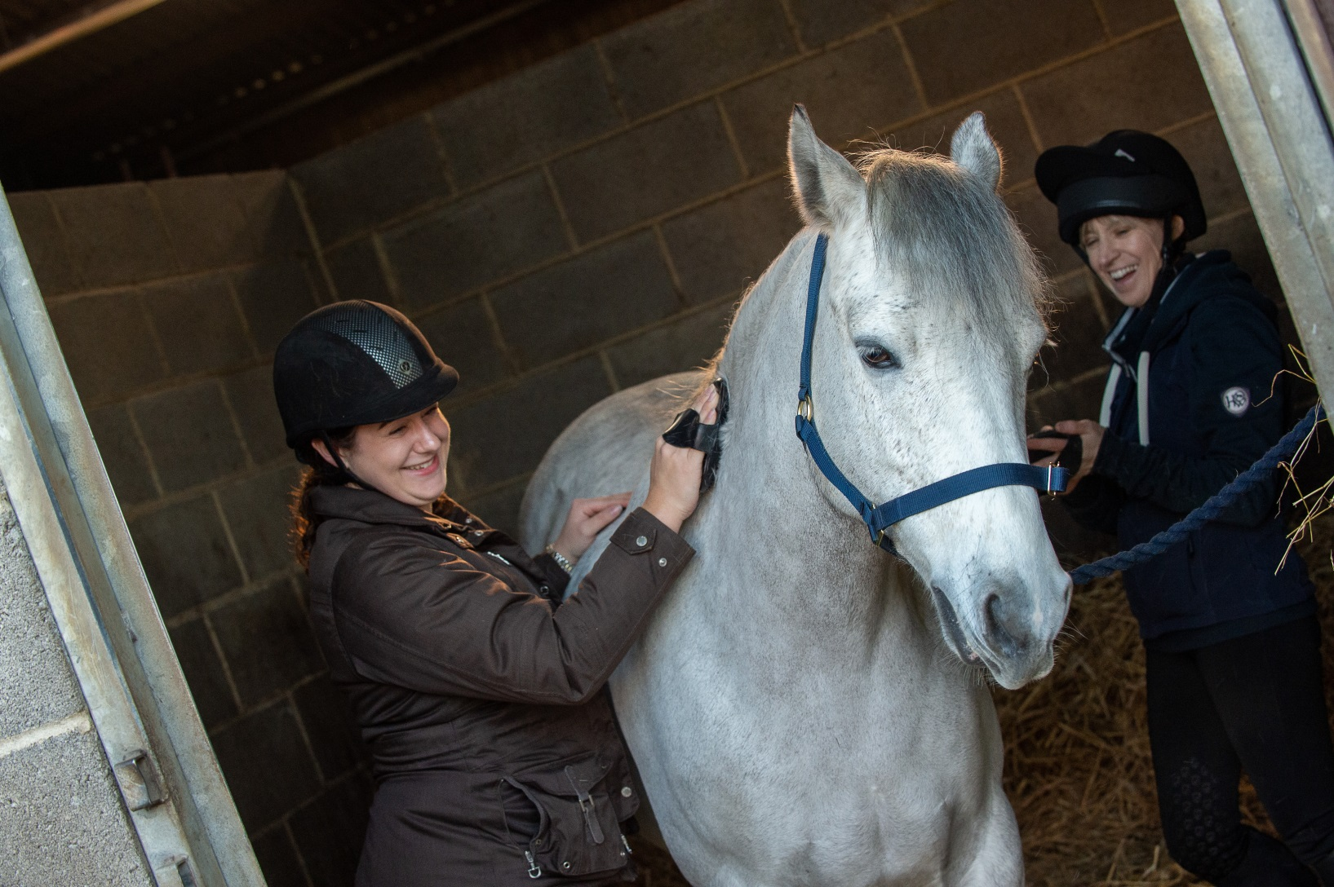
Horse Knowledge
Grooming
Notes:
This section focuses on grooming – the brushes required and basic technique.
Discuss reasons for grooming and reasons for not grooming!
Have a grooming kit or selection of brushes for the participants to look at.
Split into small groups and give each group a brush or several brushes
Ask them to look and feel the bristles of each brush. Discuss each brush but don’t include where you would use them on a horse. Suggest various parts of the horse e.g. body, face, leg and ask the participants if they think the brush they have is suitable.
Talk about the brushes in more detail and participants can fill in their booklet with the names and make notes. Pictures of brushes on next slides if required, can be used for identification.
Demonstrate how to use the brushes

Slide 42
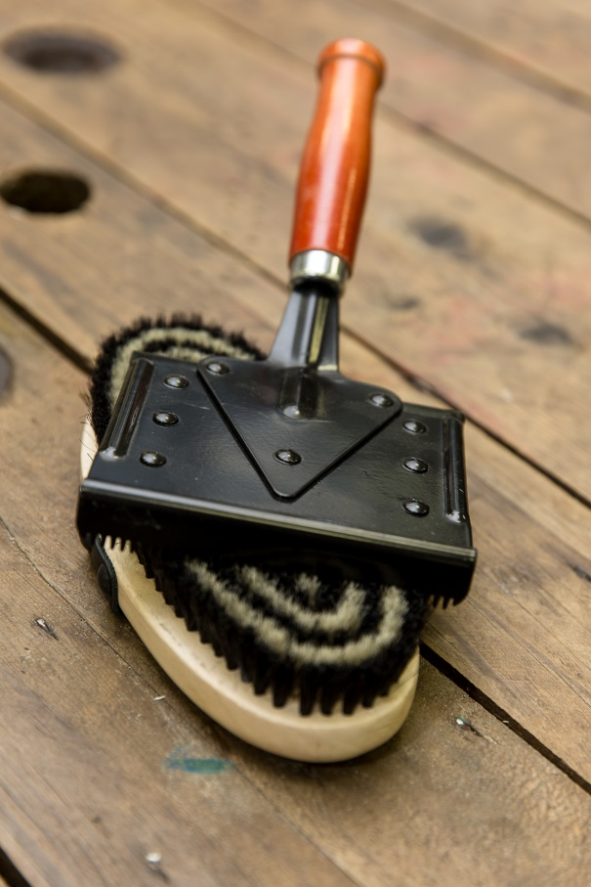
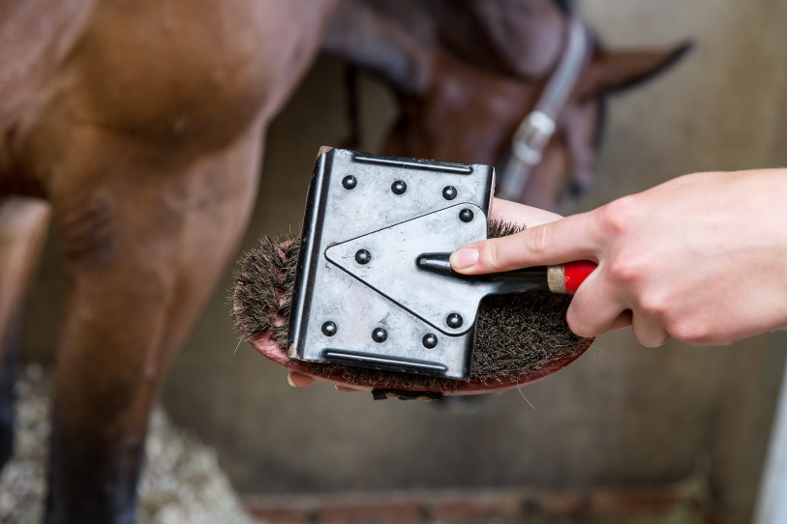
Grooming brushes
Notes:
Body brush and metal curry comb. Demonstrate how to use the two together.
Discuss areas of the horses body they can be used on.

Slide 43
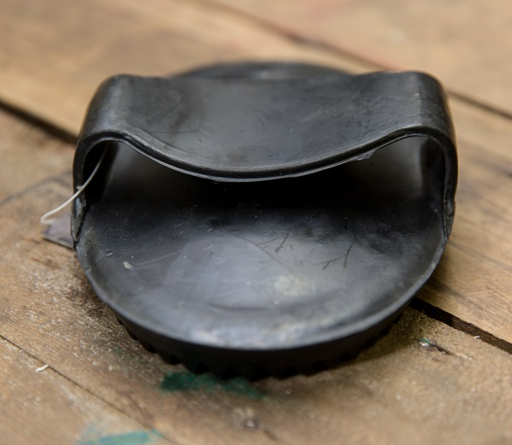
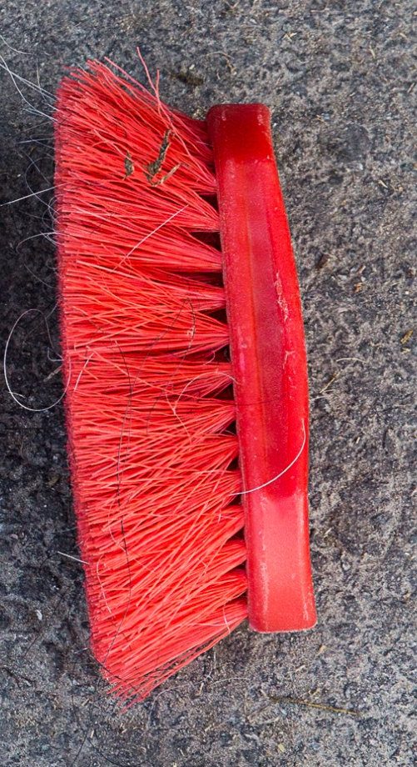
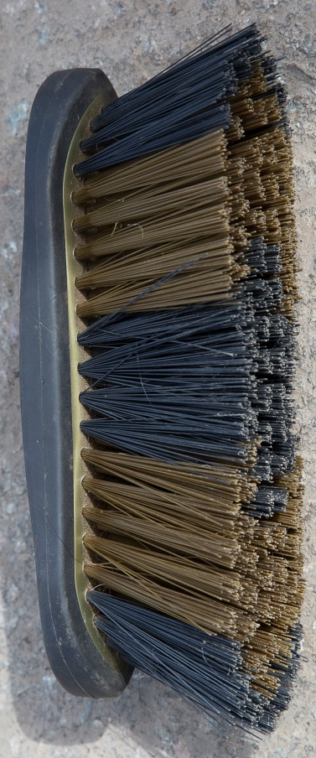
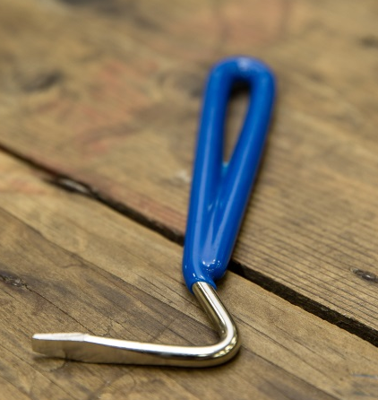
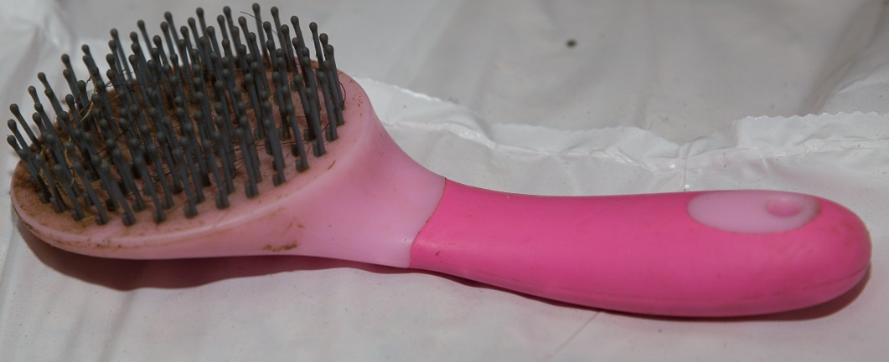
Notes:
A selection of brushes – can be used for identification or to see how many the group are able to recognise

Slide 44



Picking up a front leg
Notes:
Discuss method

Slide 45


Picking up hind leg
Notes:
Discuss method and how it differs from front leg and why

Slide 46

Notes:
Discuss the frog

Slide 47
How to groom
6 steps
to grooming
1.Start by picking the feet out
2.Remove any dirt or mud with the dandy brush or plastic curry comb
3.Next use the rubber curry comb to bring up all the dirt, grease and loose hair to the surface
4.It is a good idea to brush through the mane now rather than at the end, so dirt doesn’t end up back on your clean horse
5.Remove all the dirt brought to the surface by brushing all over the horse with the body brush or flick brush
6.Brush out the tail with the mane and tail brush or your fingers
Notes:
This is a guide to a grooming process. Discuss each step with the group.

Slide 48
Quick quiz
Name three grooming brushes
Which brush would you use on the horses face?
What is a metal curry comb used for?
Describe how to pick up a front leg
Which part of the hoof do you have to be careful to avoid when picking out the feet?
Why should you use your fingers to brush out a knotted tail?
Notes:
This quiz is very informal and is not designed to be a test. Answers can be written or verbal and there is space for the participants to write answers in their booklet.
Suggested answers:
Any three brushes listed in booklet or covered in session
A body brush, face brush, brush with soft bristles
To clean other brushes
Safe procedure described
Frog
To prevent pulling hairs out

Slide 49

Horse Knowledge
Identification
Notes:
This section covers describing horses beginning with the terms used for male and female horses of various ages and some common colours and face and leg markings. Points of the horse and how horses are measured are also included.

Slide 50

Describing horses
Notes:
Ask the group what terms they have heard used to describe male and female horse
Discuss the following terms:
Foal
Filly
Mare
Colt
Gelding
Stallion

Slide 51

Colours
Brown body with black mane and tail, knees, hocks, lower limbs and tips of the ears
Notes:
There is space to fill in the name of the description in the booklet
Discuss each colour and fill in the blanks.

Slide 52

Ginger or red coat. Sometimes the mane is the same colour or it can be lighter which is known as flaxen

Slide 53

Coat is completely black

Slide 54

White and black hairs throughout the coat
Notes:
Although at this level participants are only required to know a white horse is actually called a grey horse you can include the different colours of grey.

Slide 55

Patches of black and white all over the body

Slide 56

Patches of white and any other colour except black all over the body

Slide 57

Face markings
Small patch of
white hair on
the forehead
Notes:
There is space in the booklets for participants to fill in the blanks

Slide 58

Wide stripe of white hair running down centre of face

Slide 59

Thin strip of white hair running down centre of the face

Slide 60

White marking covering the forehead, nose and muzzle

Slide 61

Leg Markings
White to mid cannon
White to knee
Notes:
Can also include terms: Socks, Stockings
Ermine mark

Slide 62

Injury markings
Notes:
Discuss how the withers are a common sight for pressure marks due to ill fitting rugs or saddles.

Slide 63
Measuring height
Horses and ponies are measured in:
Hands and Inches
One hand equals:
4 Inches or 10cms
Written as:
16.2hh
Notes:
If possible have a measuring stick, tape measure or rulers available to use
Split into pairs and start by estimating each others height in hands. Then using just width of hand measure each others height and make a note
Convert it to hands and inches
Measure each other with a measuring stick to see how accurate the hand measurement was
Using the tape or ruler convert the hands and inches into CMs

Slide 64

Points of the horse
Notes:
This picture is in the booklet with space for the points to be filled in.

Slide 65


Quick quiz
Name the colours and markings shown in the pictures:
Notes:
This quiz is very informal and is not designed to be a test. Answers can be written or verbal and there is space for the participants to write answers in their booklet.

Slide 66



Slide 67
Quick quiz cntd
2. What is the height measurement used for horses and ponies
3. What is the maximum height to be classed as a pony?
Notes:
This quiz is very informal and is not designed to be a test. Answers can be written or verbal and there is space for the participants to write answers in their booklet.
Suggested answers:
As per pictures
Hands and inches, centimetres
14.2hh

Slide 68

Can you identify the following points of the horse?

Slide 69

Can you identify the following points of the horse?
Neck
Withers
Quarters
Knee
Fetlock
Hoof

Slide 70
Congratulations you have completed Horse Knowledge part one.

Slide 71
Notes:
This slide has been left blank intentionally, for coaches to fill in their next steps. E.g. progress to Part Two or The Introduction to About the Horse award

