Slide 1
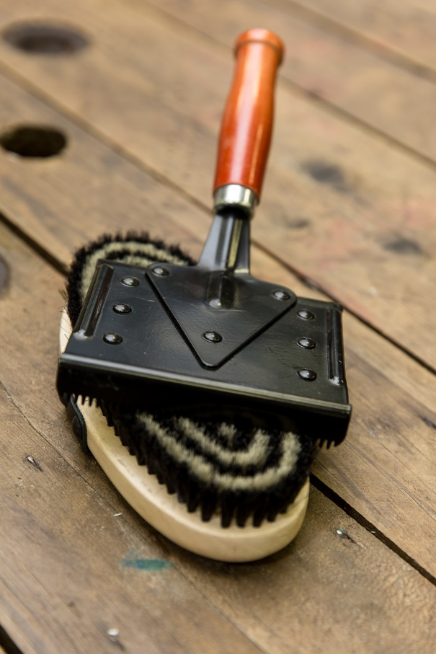
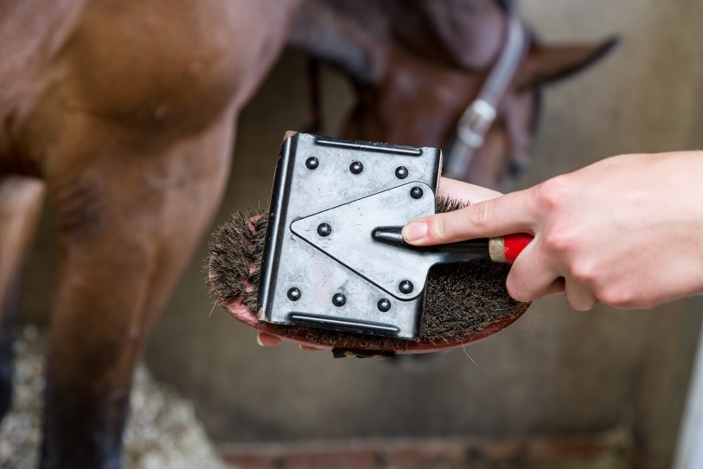
Grooming brushes
Notes:
Body brush and metal curry comb. Demonstrate how to use the two together.
Discuss areas of the horses body they can be used on.

Slide 2
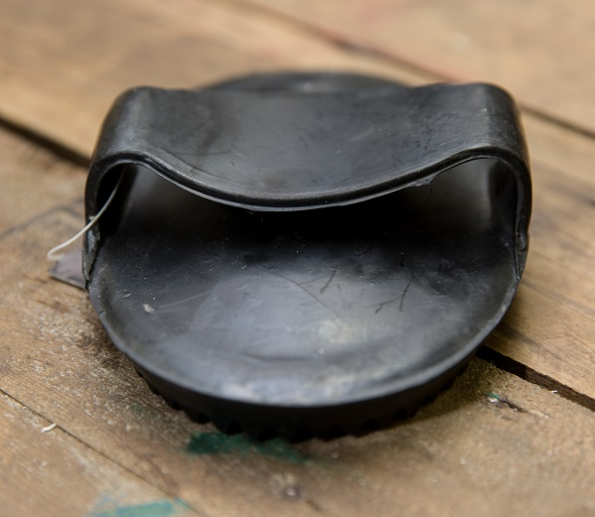
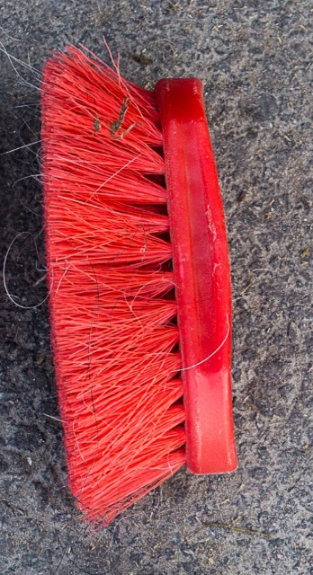
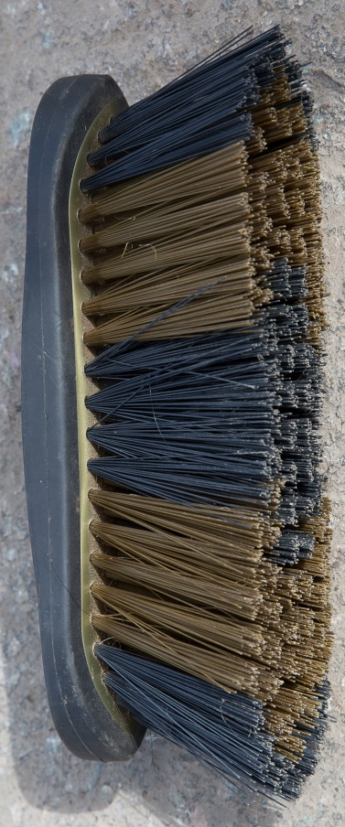
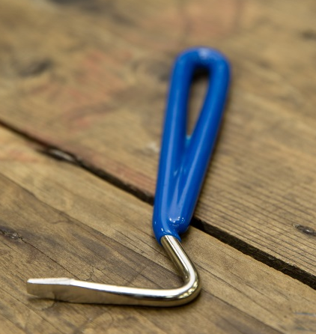
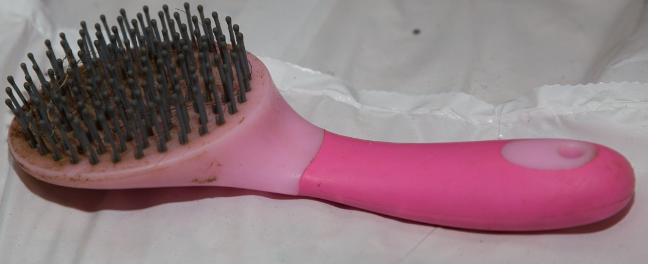
Notes:
A selection of brushes – can be used for identification or to see how many the group are able to recognise

Slide 3
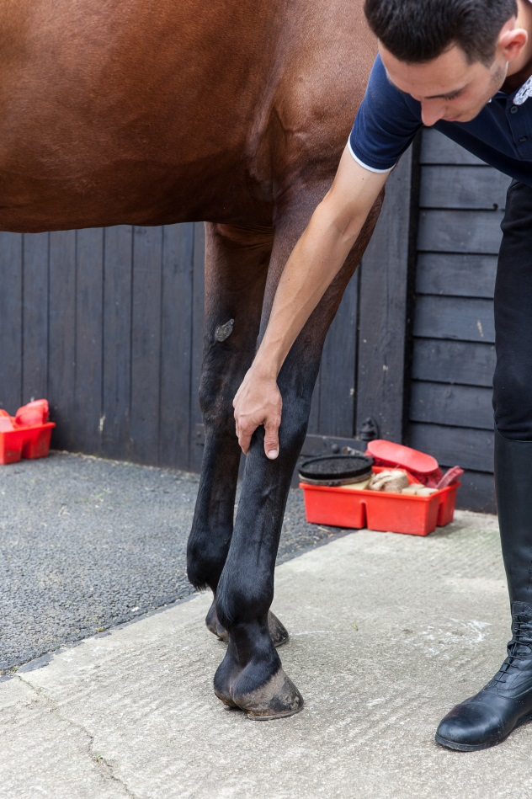
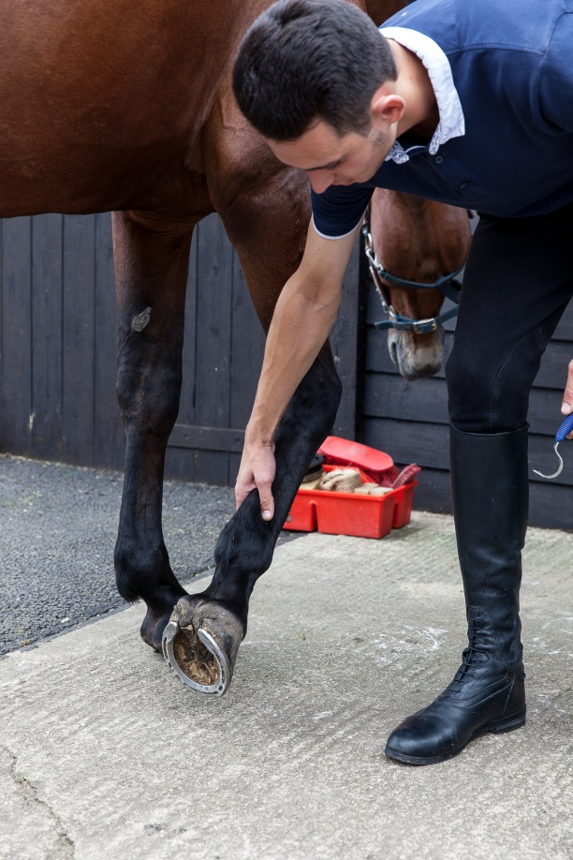
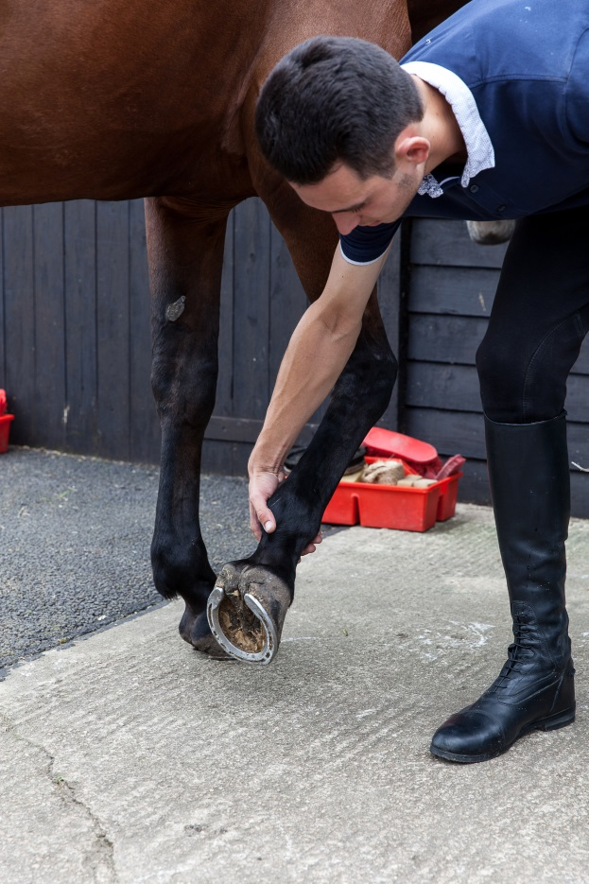
Picking up a front leg
Notes:
Discuss method

Slide 4
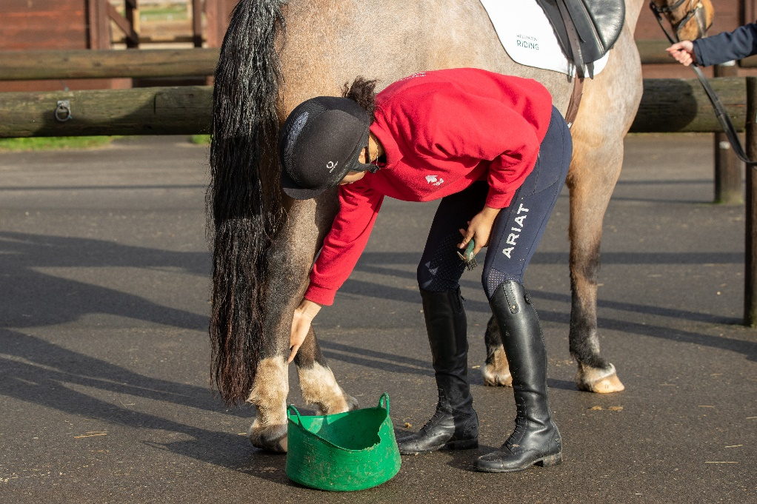
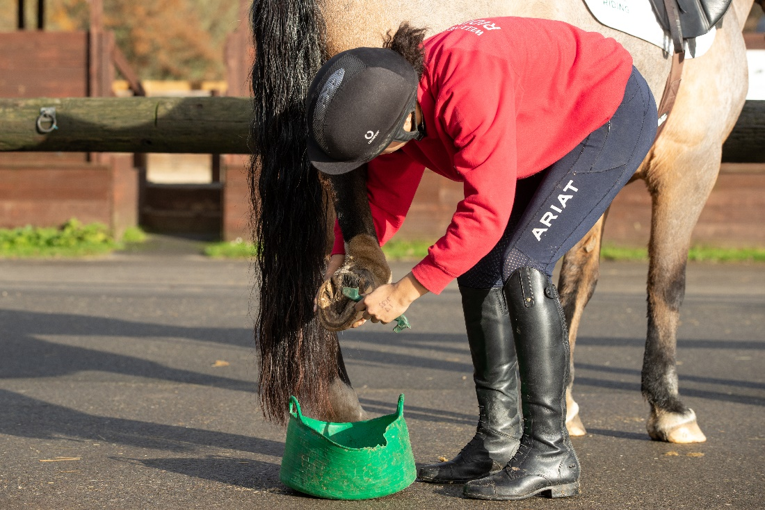
Picking up hind leg
Notes:
Discuss method and how it differs from front leg and why

Slide 5
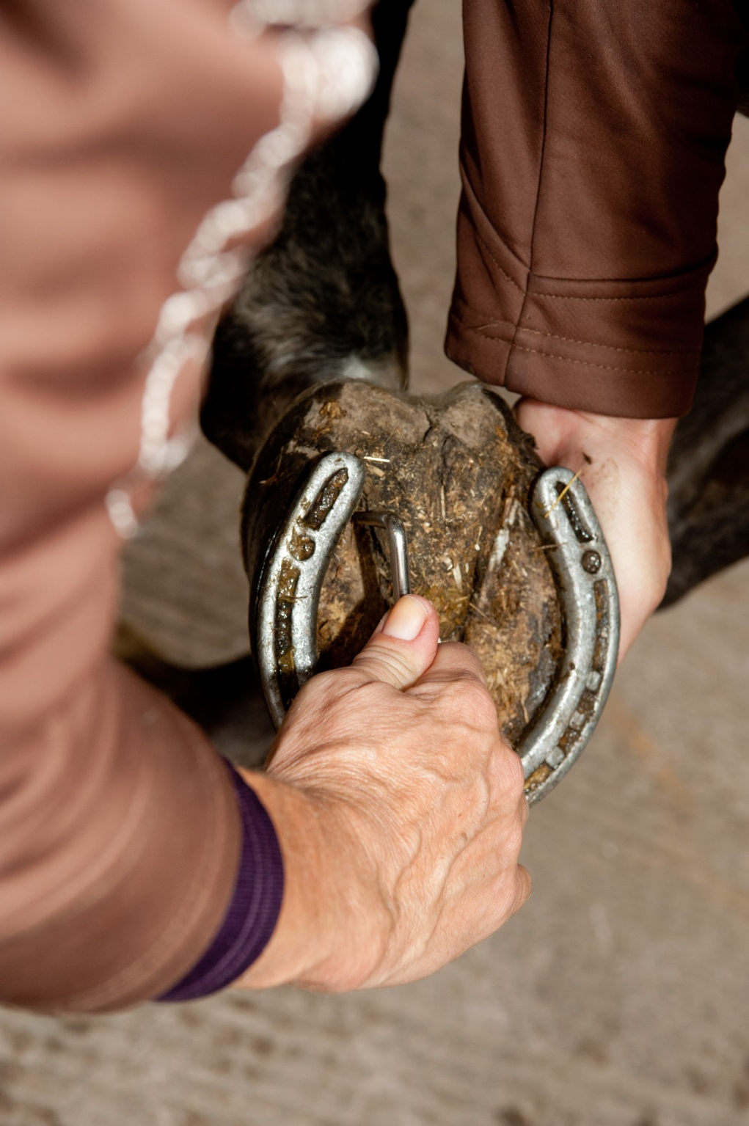
Notes:
Discuss the frog

Slide 6
How to groom
6 steps
to grooming
1.Start by picking the feet out
2.Remove any dirt or mud with the dandy brush or plastic curry comb
3.Next use the rubber curry comb to bring up all the dirt, grease and loose hair to the surface
4.It is a good idea to brush through the mane now rather than at the end, so dirt doesn’t end up back on your clean horse
5.Remove all the dirt brought to the surface by brushing all over the horse with the body brush or flick brush
6.Brush out the tail with the mane and tail brush or your fingers
Notes:
This is a guide to a grooming process. Discuss each step with the group.

Slide 7
Quick quiz
Name three grooming brushes
Which brush would you use on the horses face?
What is a metal curry comb used for?
Describe how to pick up a front leg
Which part of the hoof do you have to be careful to avoid when picking out the feet?
Why should you use your fingers to brush out a knotted tail?
Notes:
This quiz is very informal and is not designed to be a test. Answers can be written or verbal and there is space for the participants to write answers in their booklet.
Suggested answers:
Any three brushes listed in booklet or covered in session
A body brush, face brush, brush with soft bristles
To clean other brushes
Safe procedure described
Frog
To prevent pulling hairs out

