Slide 1
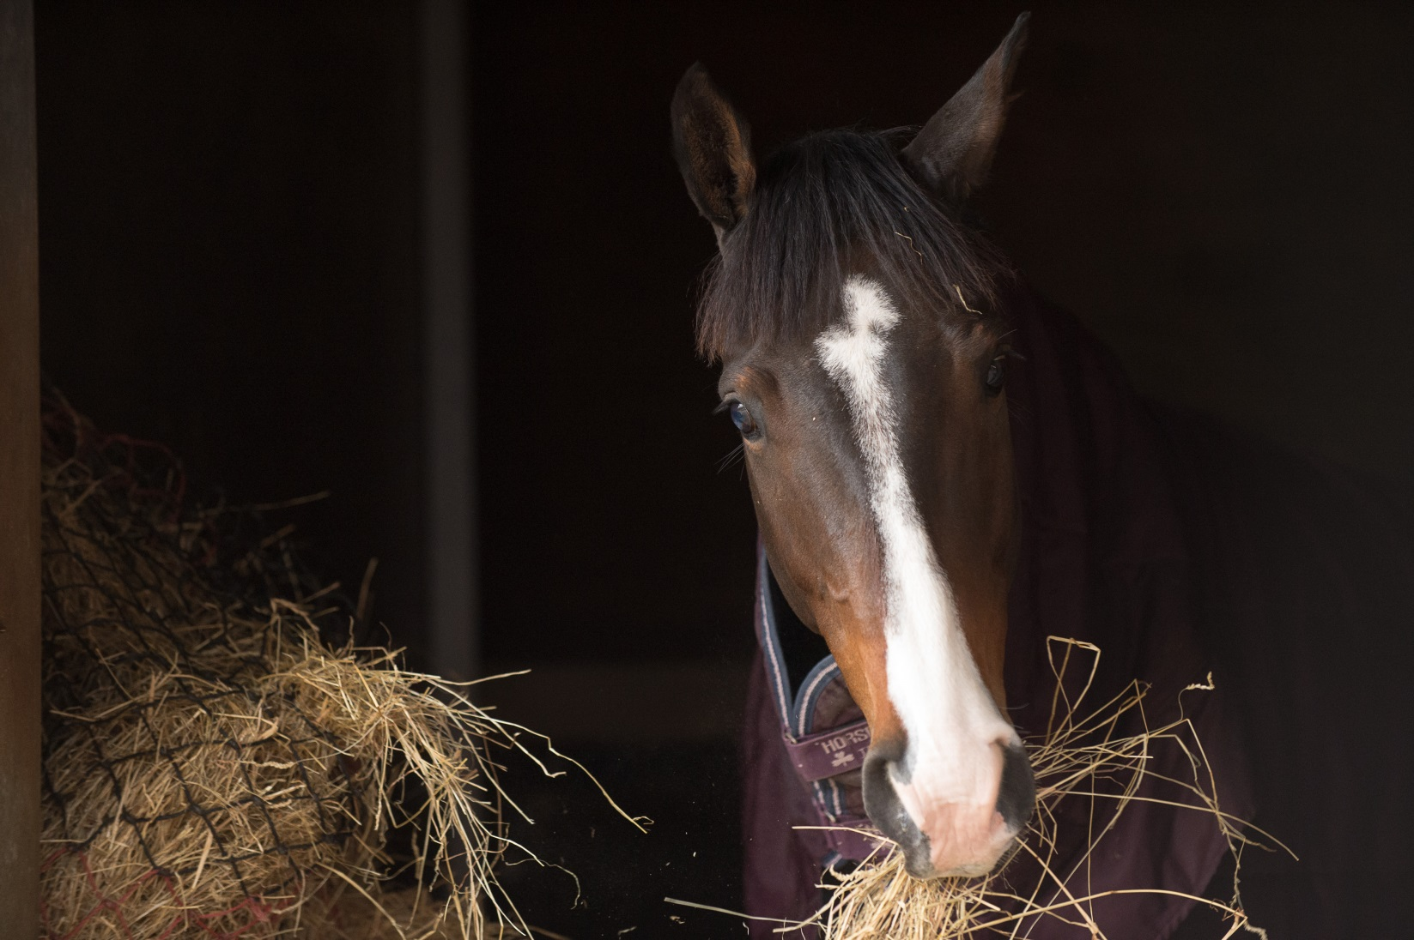
Feeding
Notes:
Picking up on the Food and water element of the basic needs this section goes into a bit more detail about fibre
Discuss the term trickle feeder and what it means. Refer back to the natural behaviour of the horse
The horse has evolved to live on fibre

Slide 2
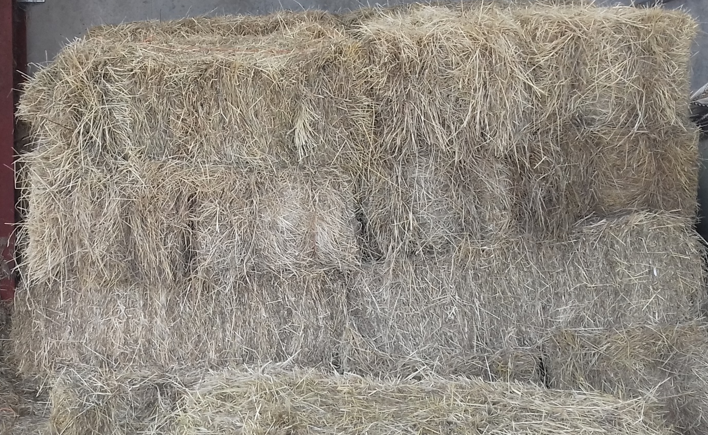
Hay
Notes:
Fibre = grass, hay or haylage
Discuss the different types of hay and the main differences between hay and haylage.
Common types of grasses found in hay

Slide 3
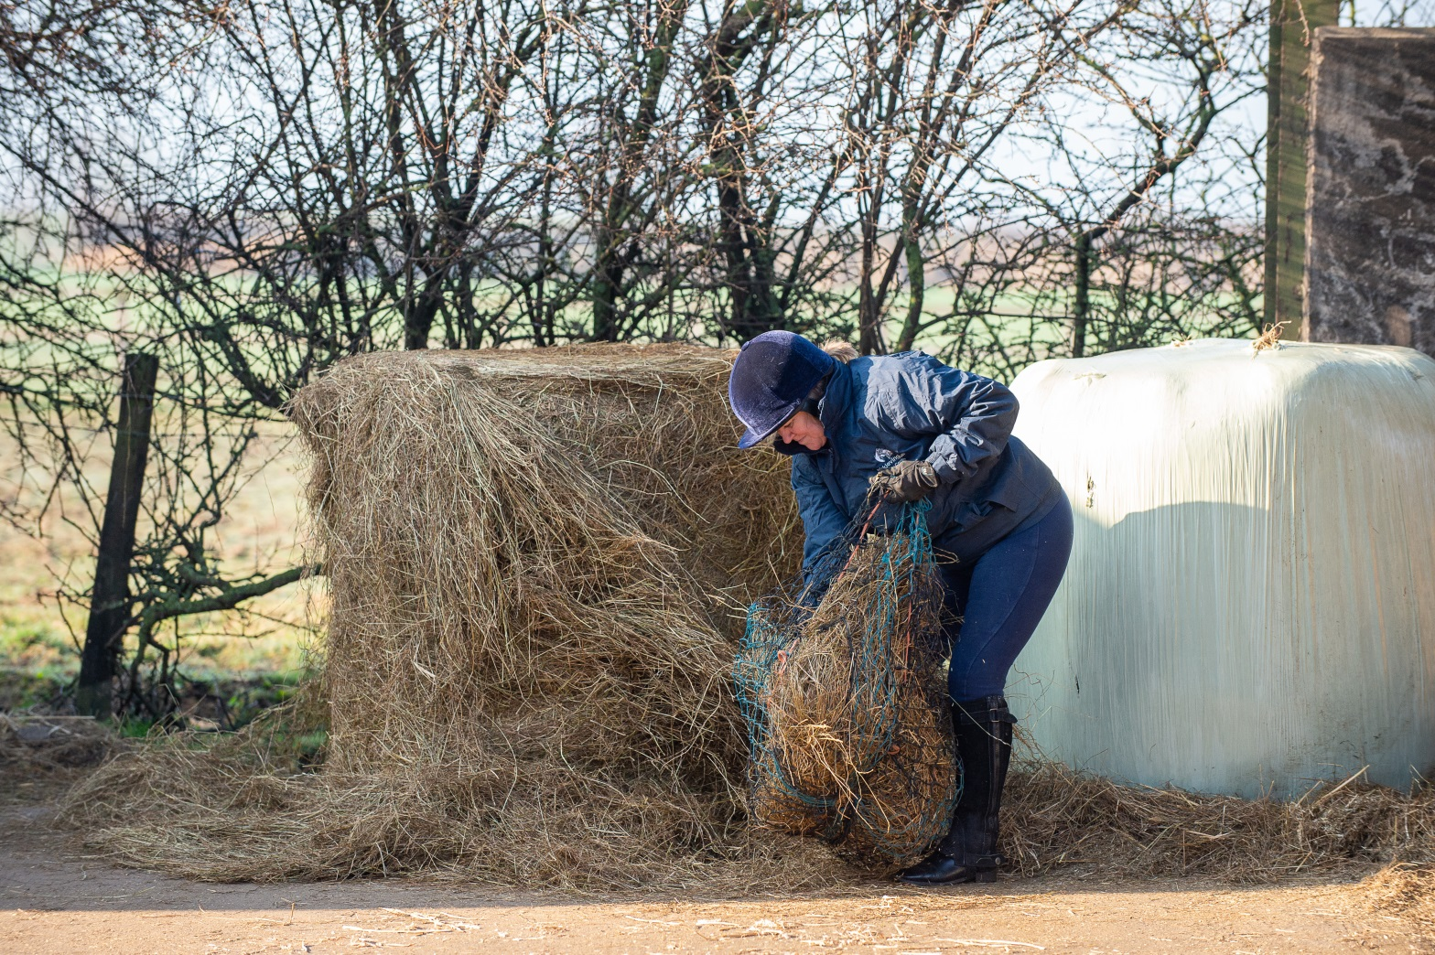
Haylage
Notes:
Haylage – how it is made. Why it is wrapped in plastic. What happens if the bale is pierced?

Slide 4
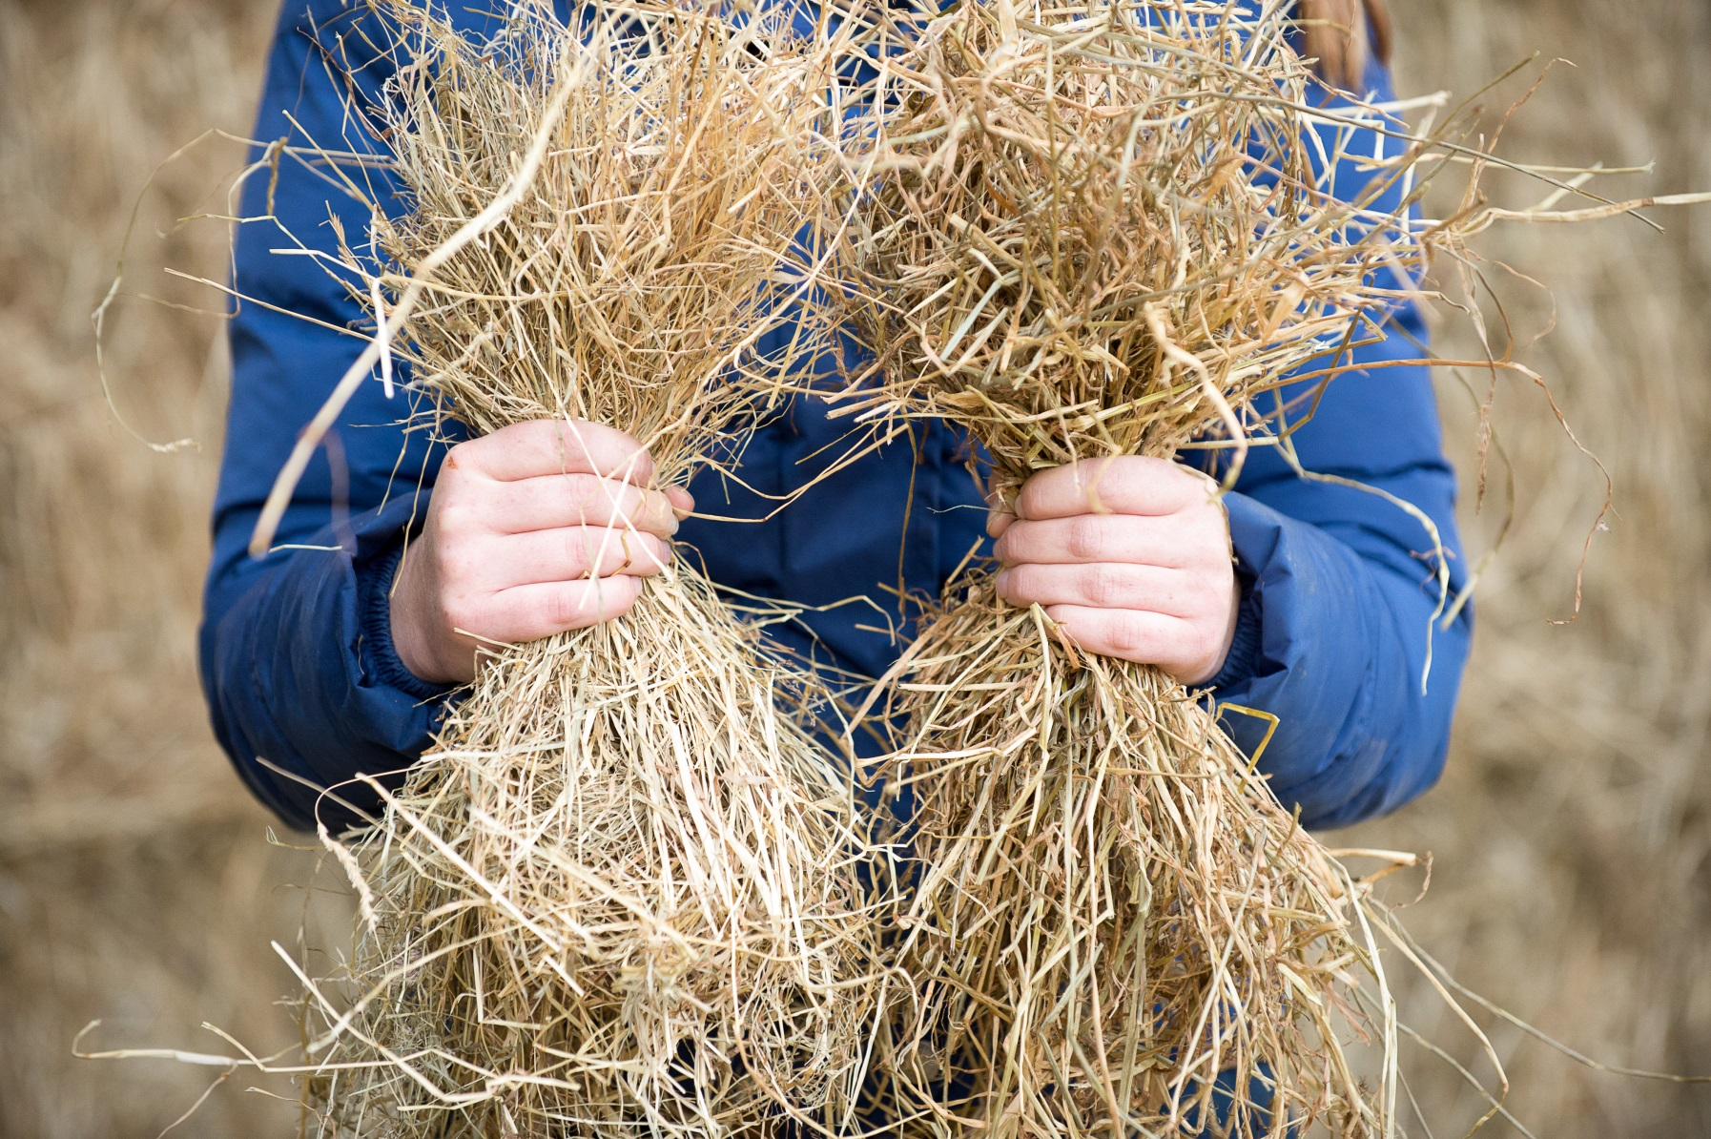
HAY
HAYLAGE
Notes:
Discuss with the group the differences you can see between the two fibre sources on the picture
Ask the group to vote on which one is hay and which one is haylage.
Consider bringing in a sample of each so the group can see, feel and smell the difference between the two.
Answers will come up if click on slide

Slide 5
Quick quiz
What has the horse evolved to eat?
Name three types of fibre
What is the main difference between hay and haylage?
Name two types of hay?
Why is haylage wrapped in plastic?
What can happen to the haylage if the wrap is pierced or damaged?
Notes:
This quiz is very informal and is not designed to be a test. Answers can be written or verbal and there is space for the participants to write answers in their booklet.
Suggested answers:
Fibre based diet
Hay, haylage, grass
Hay is baled dry, haylage baled damp
Seed, meadow
To make it airtight and allow bacteria to breakdown sugars
Air can get in, cause haylage to go mouldy

