Slide 1
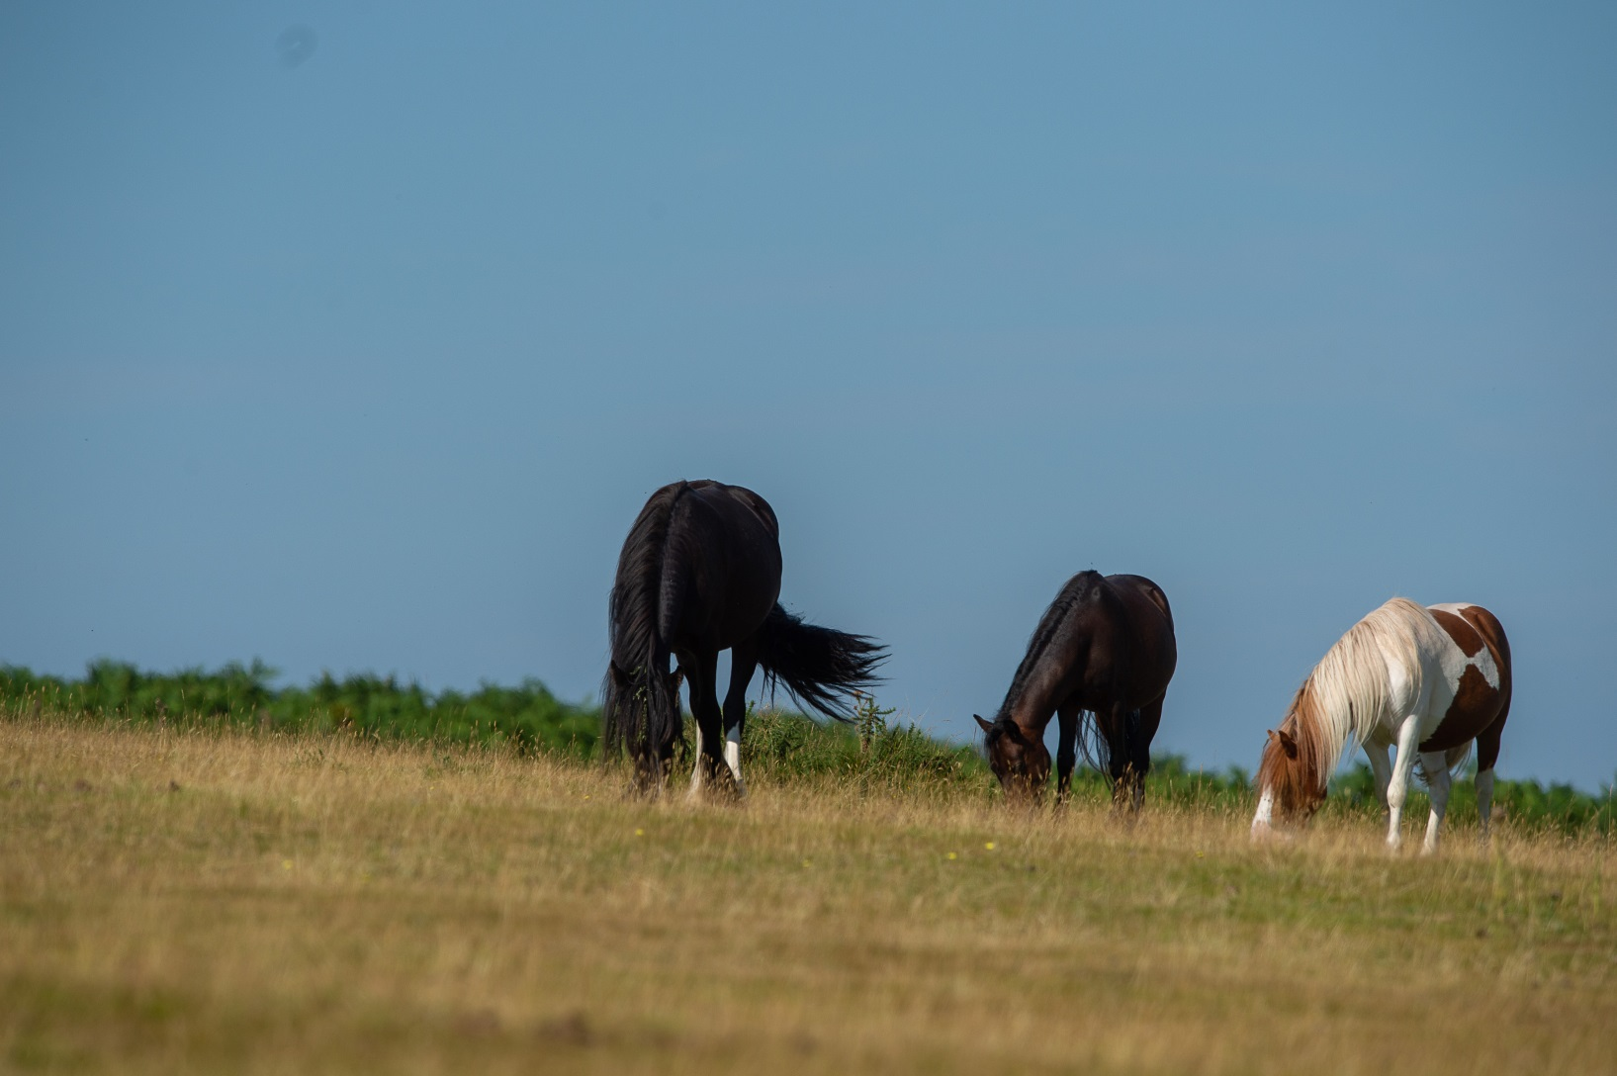
Horse Knowledge
Horse Care
Notes:
This section covers passports and microchipping.
Discuss as a group reasons for needing to keep records and identification documents for horses and how this might be done
Can the group think of any potential issues?

Slide 2
Microchipping
Tiny chip the size of a grain of rice
Inserted into the ligament running down the top of the neck
Has to be carried out by a vet
Read by handheld scanner
Notes:
Discuss the reasons for Microchipping – horses, dogs, cats…… any other animals?
Discuss why they are used and if the group think they are a good idea?
Can they think of any issues with using microchips?

Slide 3
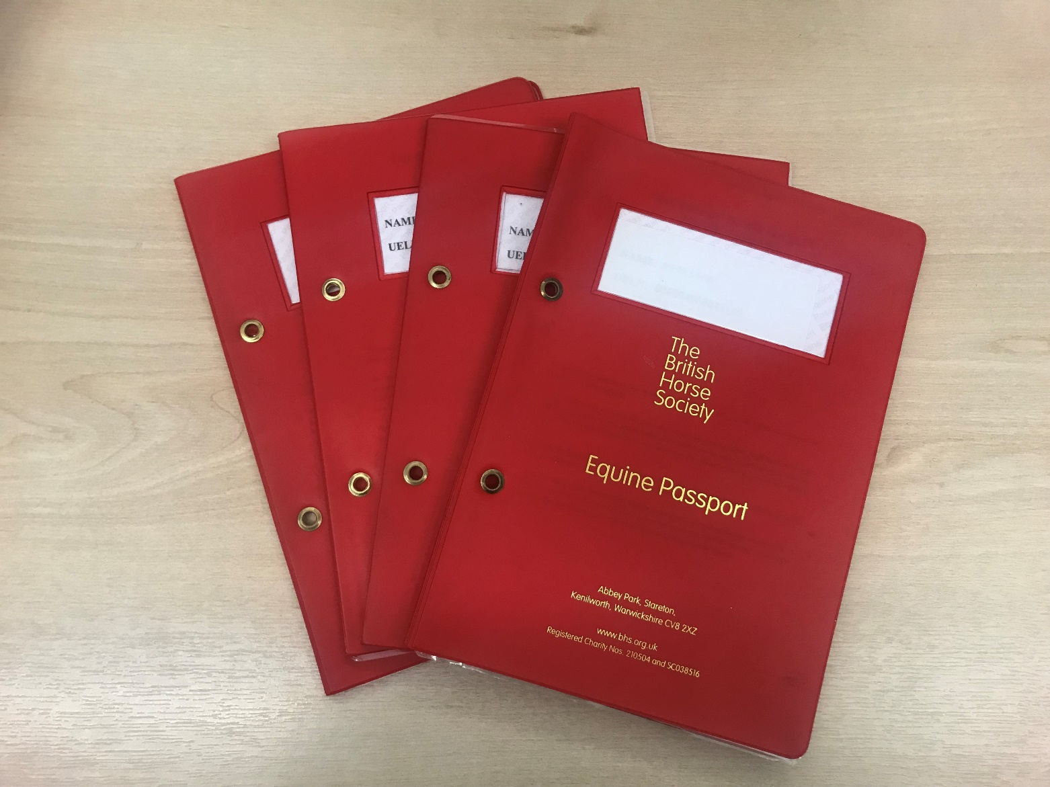
Passports
Notes:
Discuss equine passport and what it is.
If possible have a passport to show the group and go through each section, look at the vaccination page, not intended for human consumption page, silhouette page (an example is shown on the next page)
Discuss as a group some white face and leg markings (revision from part one)
Discuss how some injuries can damage the hair and cause it to grow back white
Ask the group if they can describe what a whorl is?
Ask your local vets or download a silhouette of the horse used in a passport for the participants to complete. Give out pictures of a horse to copy – could award a prize for the best one!

Slide 4
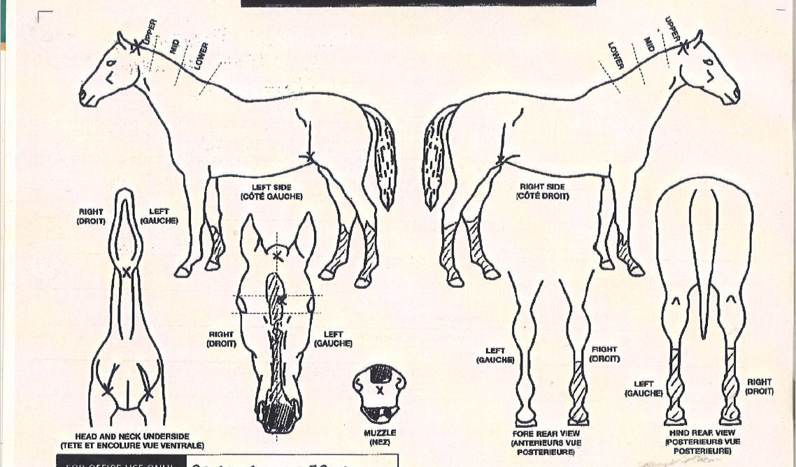

Slide 5
Freeze Marking
Freeze marks
  Used as a visual deterrent against theft
  Relatively pain free to apply but causes the horse stress
  Permanently damage the pigments cells to turn the hair white
Notes:
Discuss horse theft and methods of deterrent link back to microchip
What can owners do to help deter theft or make it easier to identify their horse
Discuss the process of freeze marking

Slide 6
Brand marking
  Brand marks
    Used to identify some breeds or studs
    Painful for the horse
    Not recommended or supported by the BHS
Notes:
Discuss the process of branding. Do the group think it is ethical as it is known to cause horses pain?

Slide 7
Quick Quiz
What is a microchip?
What details can be obtained from a microchip
Does every horse require a passport?
List two things that are recorded in a passport
List three markings the vet would record on the passport diagram of the horse
What is a freeze mark?
Why might an owner have their horse freeze marked?
Notes:
This quiz is very informal and is not designed to be a test. Answers can be written or verbal and there is space in the booklet for participants to write their answers.
Suggested answers:
A small chip the size of a grain of rice
The horse’s unique number, details of horse and owner
Such as: name, oner details, breeding details, vaccination details, silhouette, markings, unique life number, declaration for food chain, or any other information
Colour, markings, scars, brand/freeze mark, whorls
A unique combination of symbols, letters or numbers applied to a horse’s back/shoulder or neck by a cold iron
As a visual deterrent to theft

