Slide 1
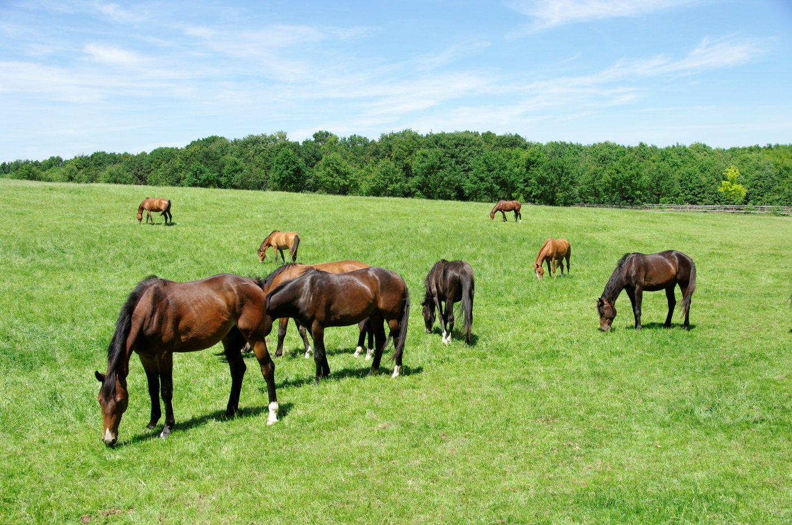
Horse Knowledge
Identification
Notes:
This section covers describing horses beginning with the terms used for male and female horses of various ages and some common colours and face and leg markings. Points of the horse and how horses are measured are also included.

Slide 2
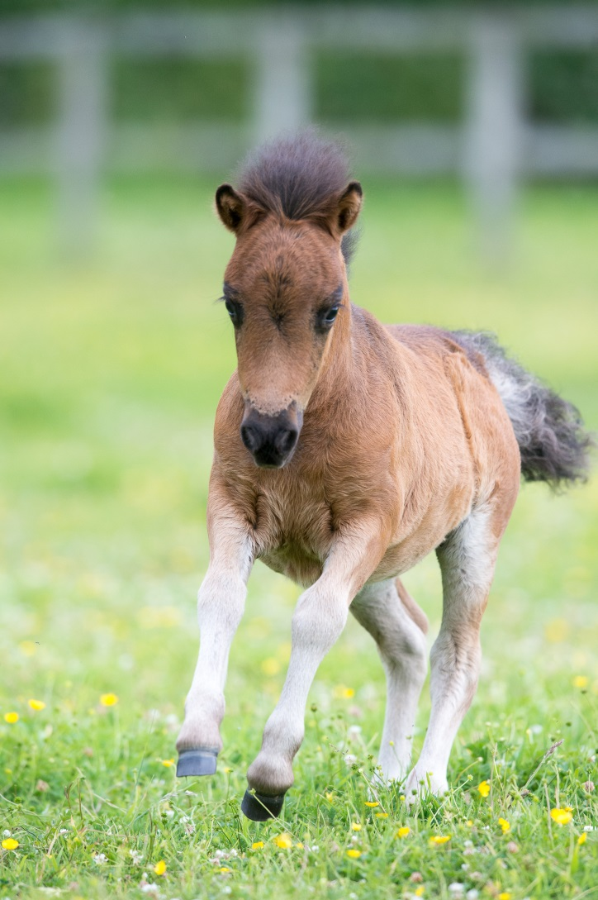
Describing horses
Notes:
Ask the group what terms they have heard used to describe male and female horse
Discuss the following terms:
Foal
Filly
Mare
Colt
Gelding
Stallion

Slide 3
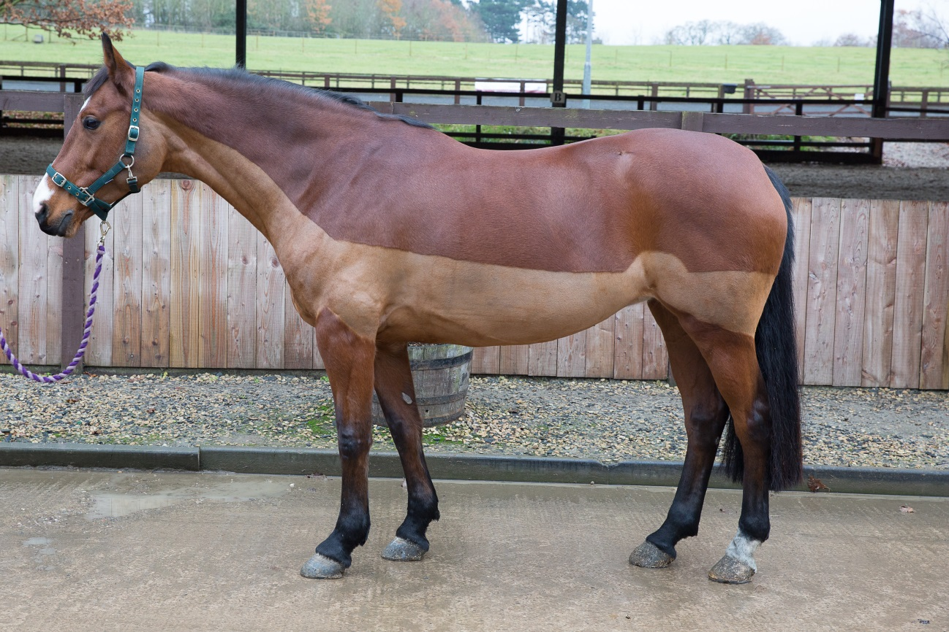
Colours
Brown body with black mane and tail, knees, hocks, lower limbs and tips of the ears
Notes:
There is space to fill in the name of the description in the booklet
Discuss each colour and fill in the blanks.

Slide 4
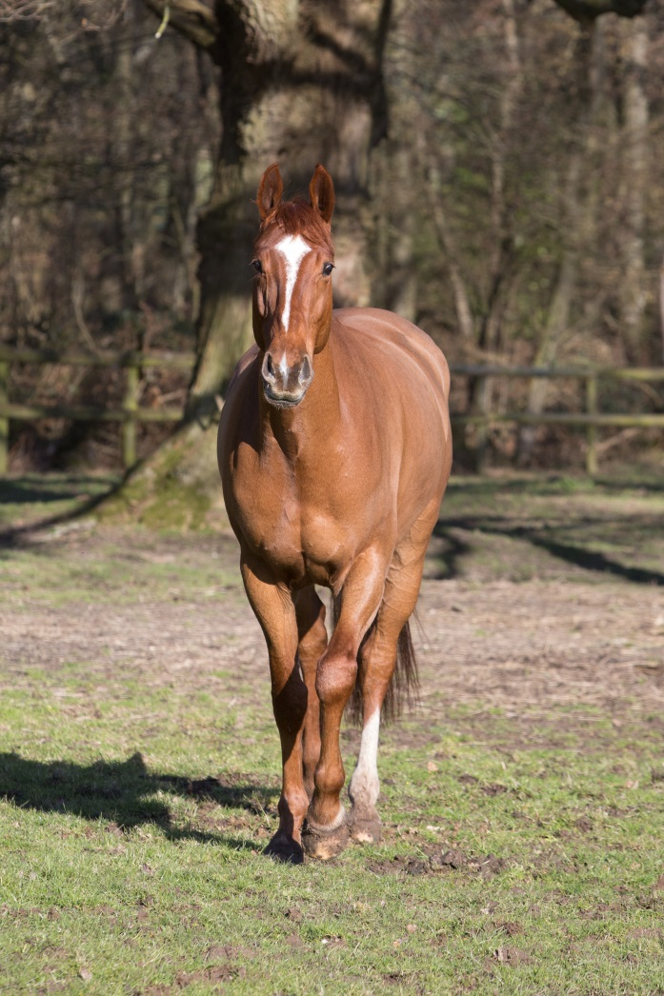
Ginger or red coat. Sometimes the mane is the same colour or it can be lighter which is known as flaxen

Slide 5
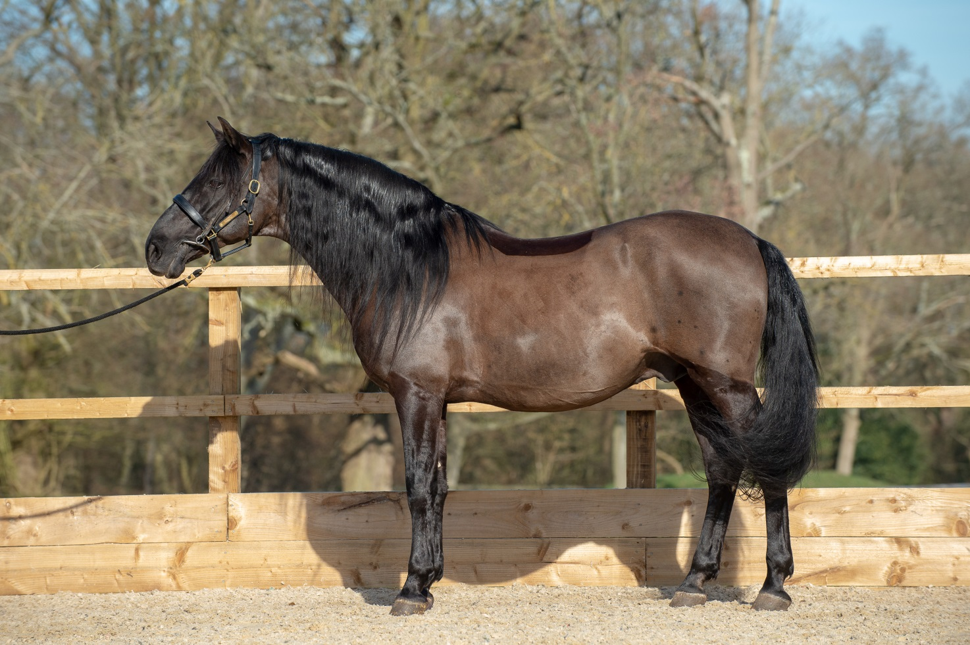
Coat is completely black

Slide 6
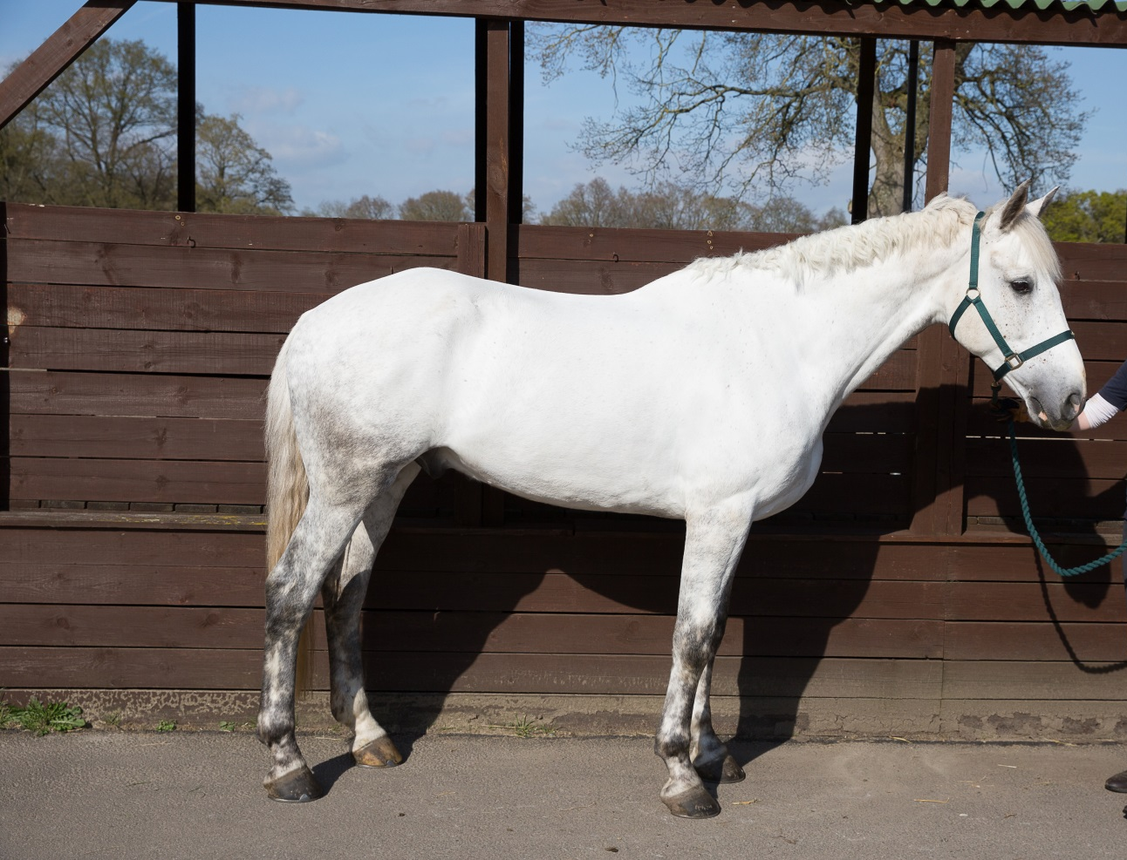
White and black hairs throughout the coat
Notes:
Although at this level participants are only required to know a white horse is actually called a grey horse you can include the different colours of grey.

Slide 7
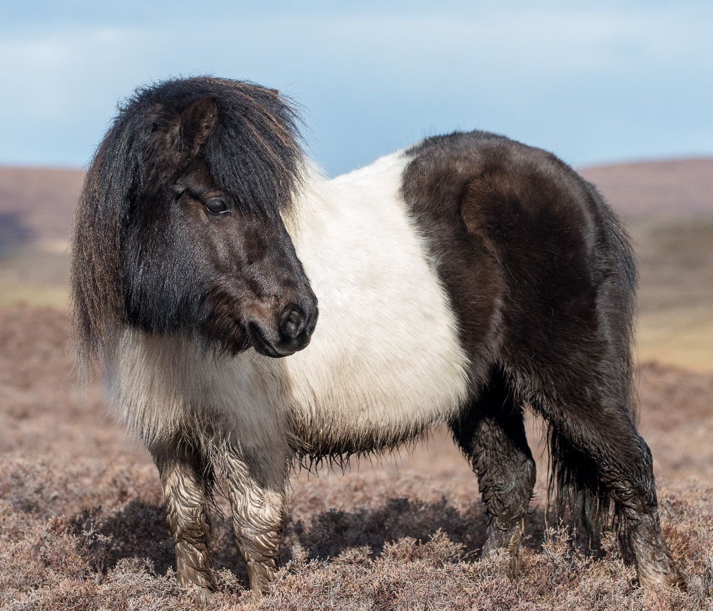
Patches of black and white all over the body

Slide 8
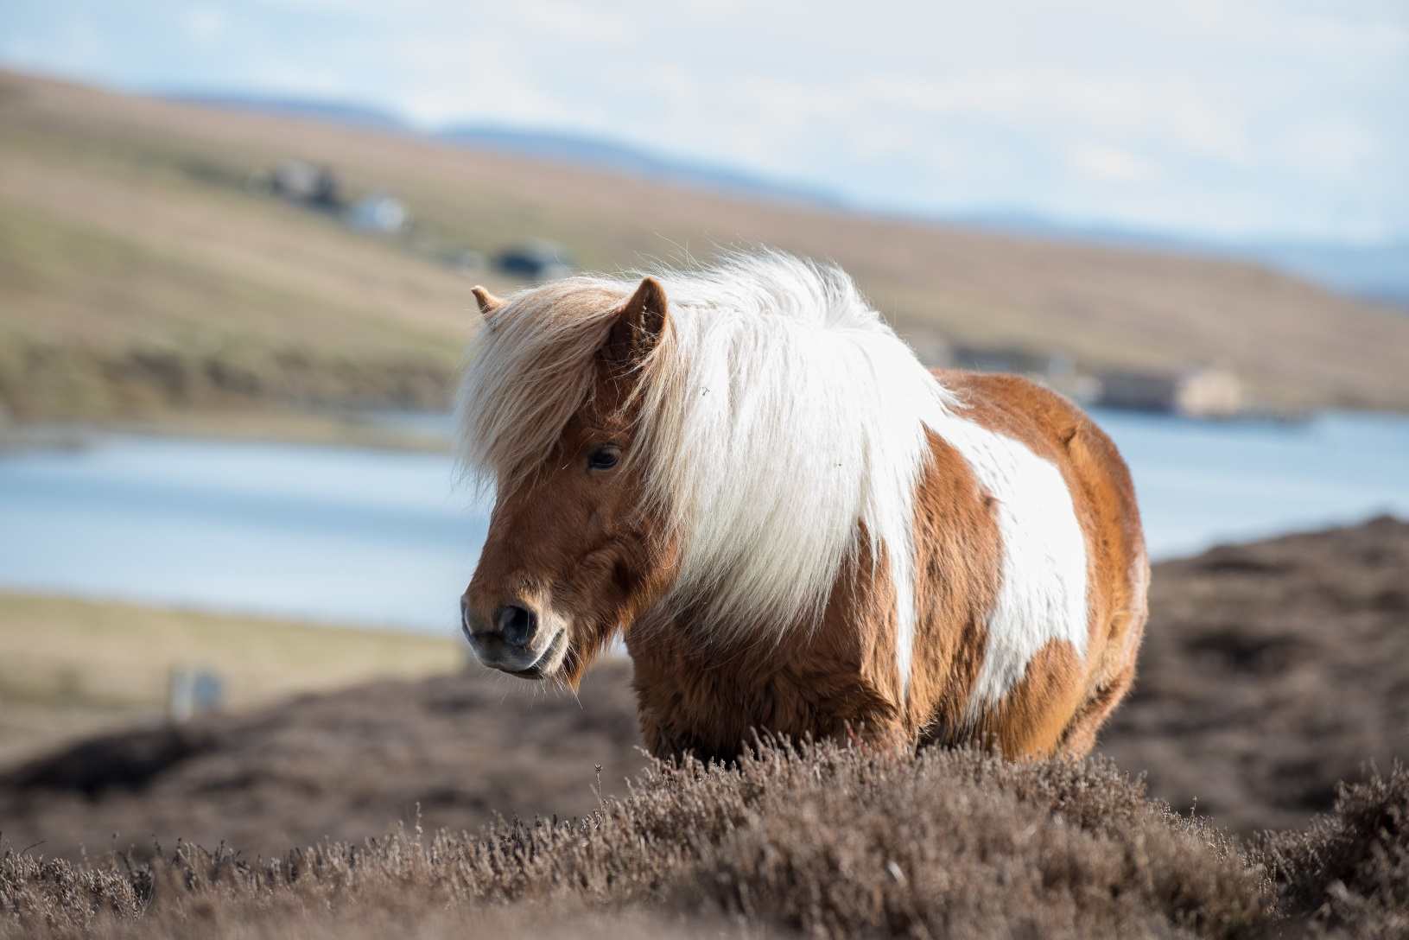
Patches of white and any other colour except black all over the body

Slide 9
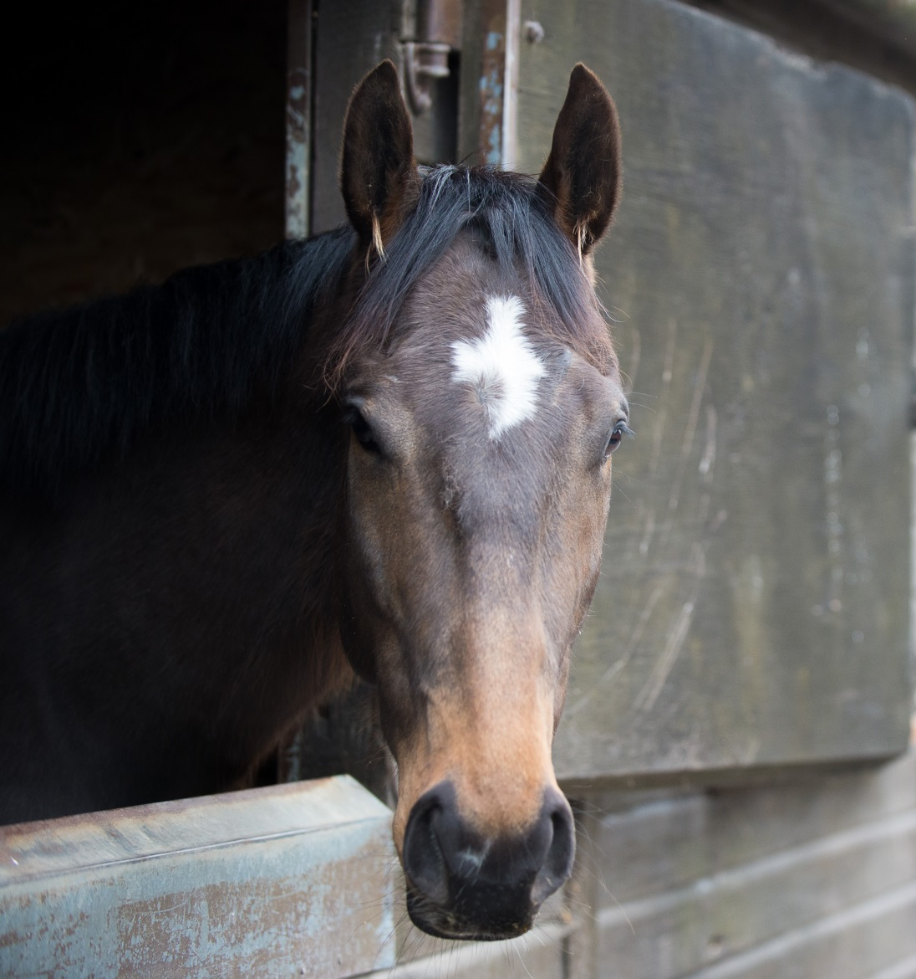
Face markings
Small patch of
white hair on
the forehead
Notes:
There is space in the booklets for participants to fill in the blanks

Slide 10
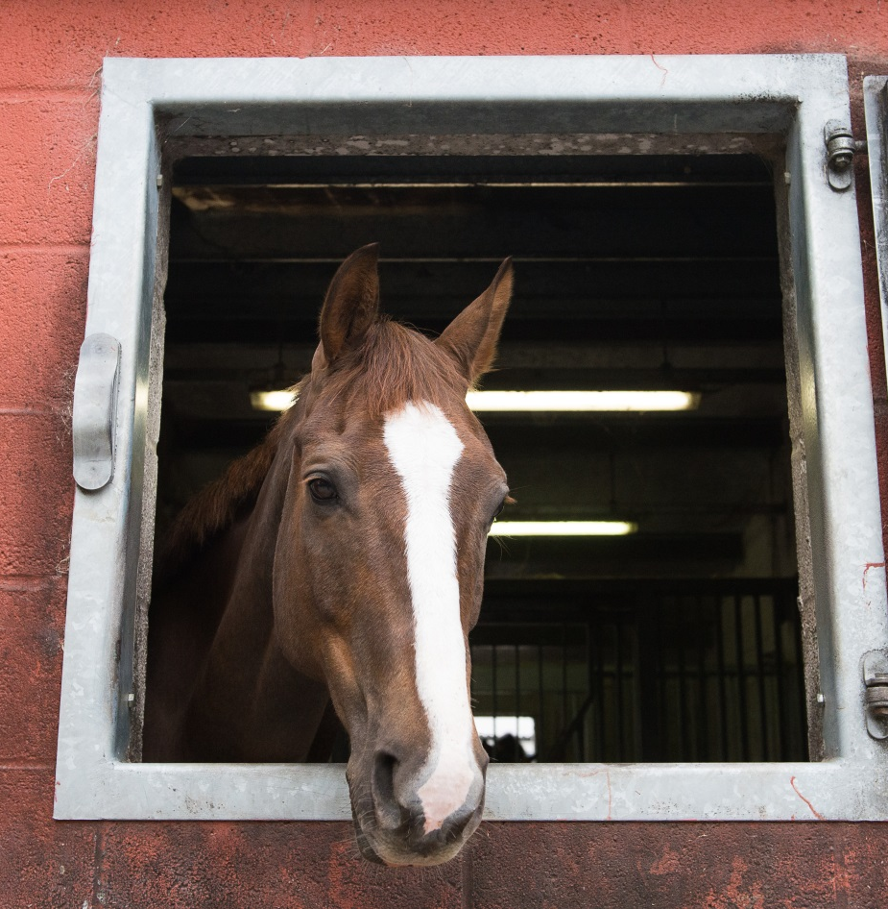
Wide stripe of white hair running down centre of face

Slide 11
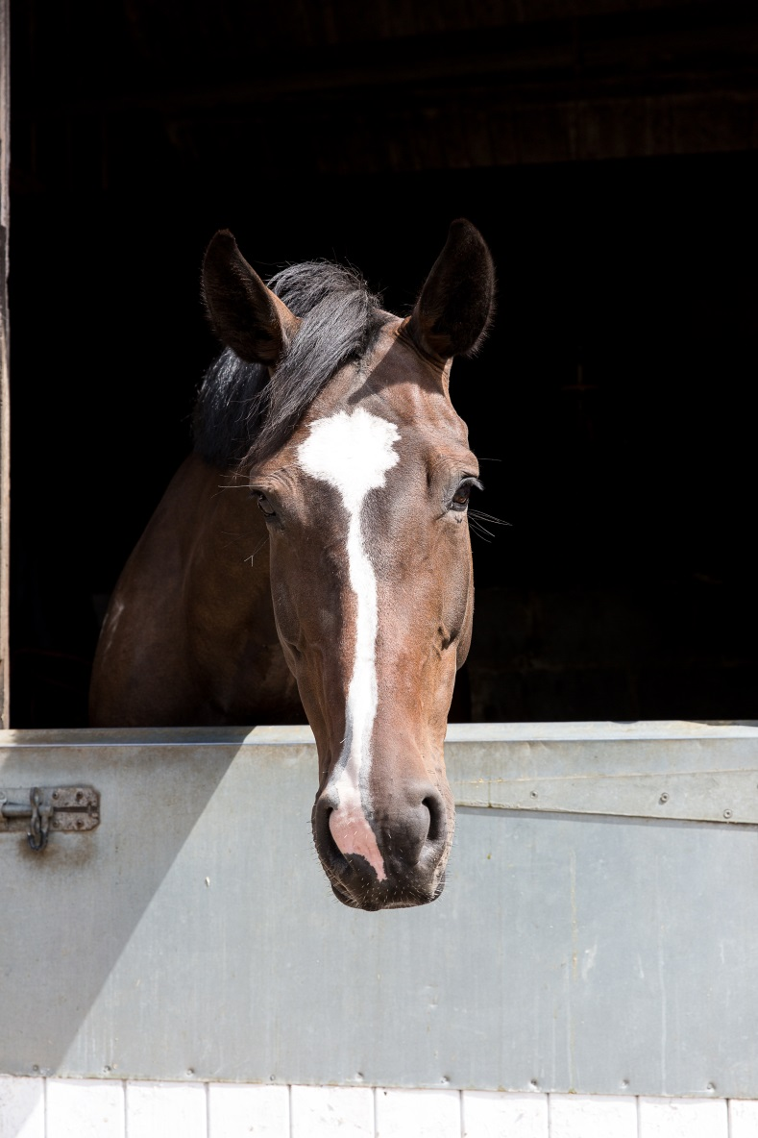
Thin strip of white hair running down centre of the face

Slide 12
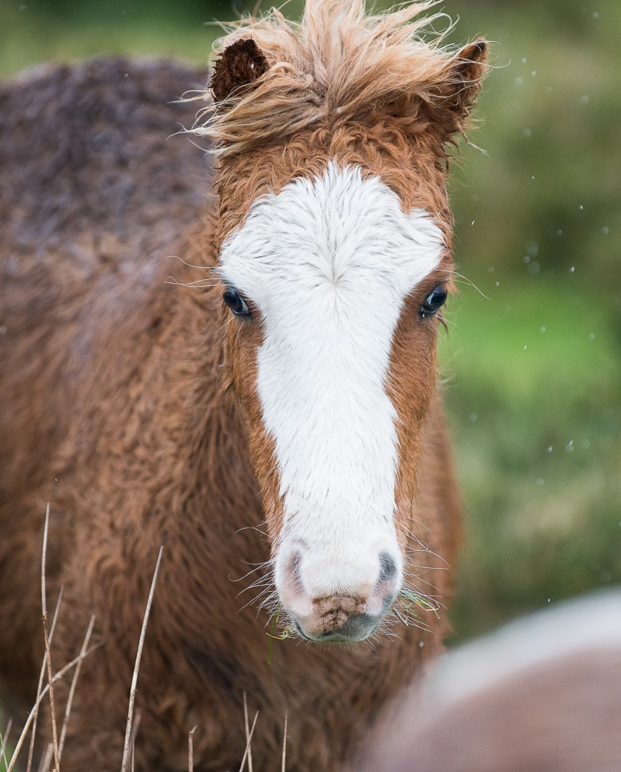
White marking covering the forehead, nose and muzzle

Slide 13
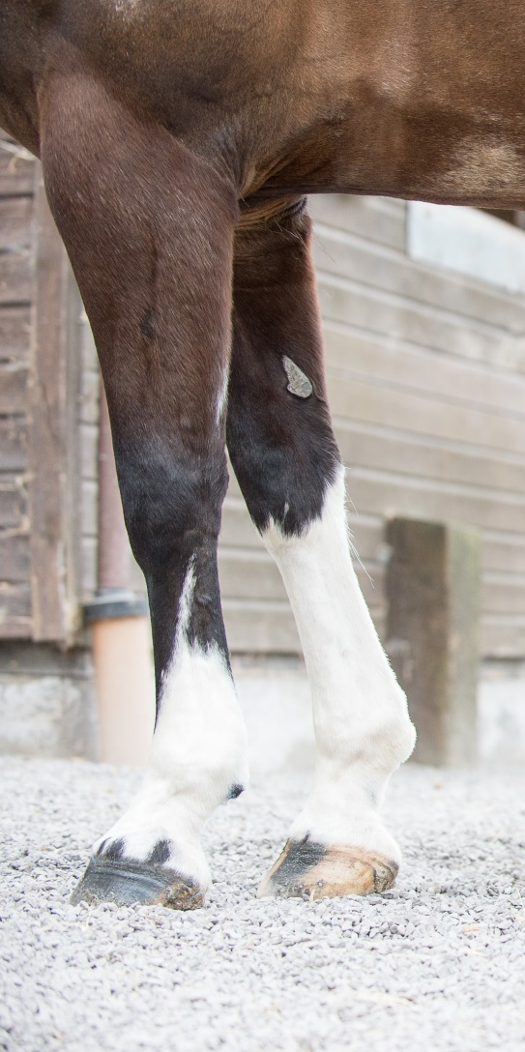
Leg Markings
White to mid cannon
White to knee
Notes:
Can also include terms: Socks, Stockings
Ermine mark

Slide 14
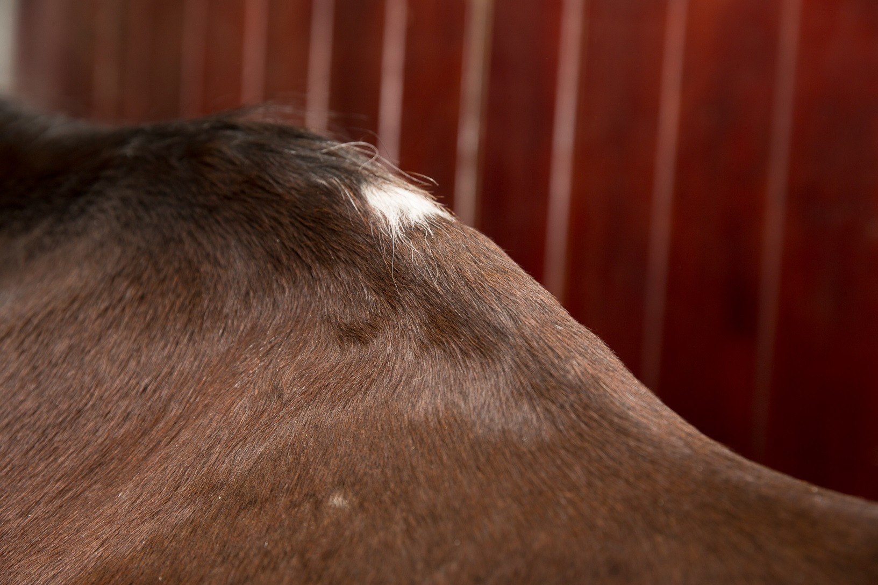
Injury markings
Notes:
Discuss how the withers are a common sight for pressure marks due to ill fitting rugs or saddles.

Slide 15
Measuring height
Horses and ponies are measured in:
Hands and Inches
One hand equals:
4 Inches or 10cms
Written as:
16.2hh
Notes:
If possible have a measuring stick, tape measure or rulers available to use
Split into pairs and start by estimating each others height in hands. Then using just width of hand measure each others height and make a note
Convert it to hands and inches
Measure each other with a measuring stick to see how accurate the hand measurement was
Using the tape or ruler convert the hands and inches into CMs

Slide 16
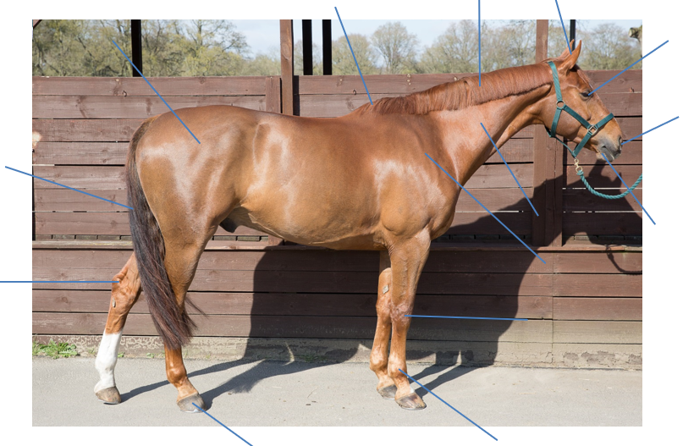
Points of the horse
Notes:
This picture is in the booklet with space for the points to be filled in.

Slide 17
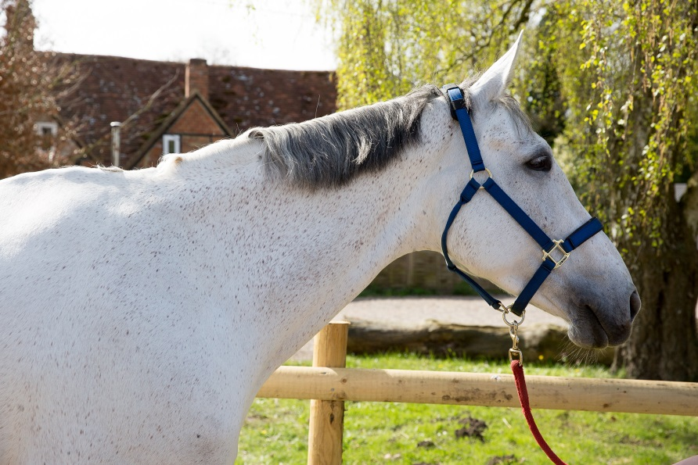
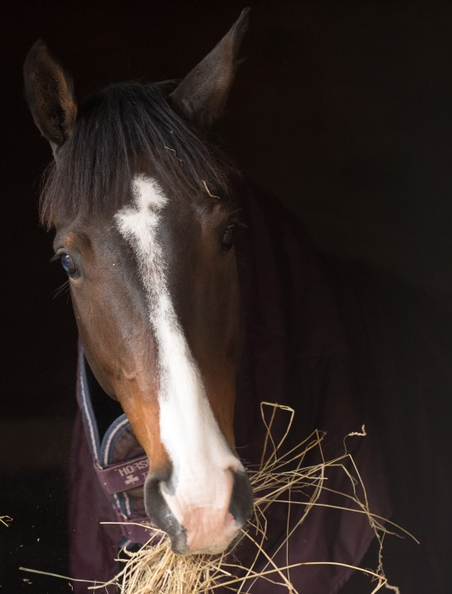
Quick quiz
1. Name the colours and markings shown in the pictures:
Notes:
This optional quiz is very informal and is not designed to be a test. Answers can be written or verbal.

Slide 18
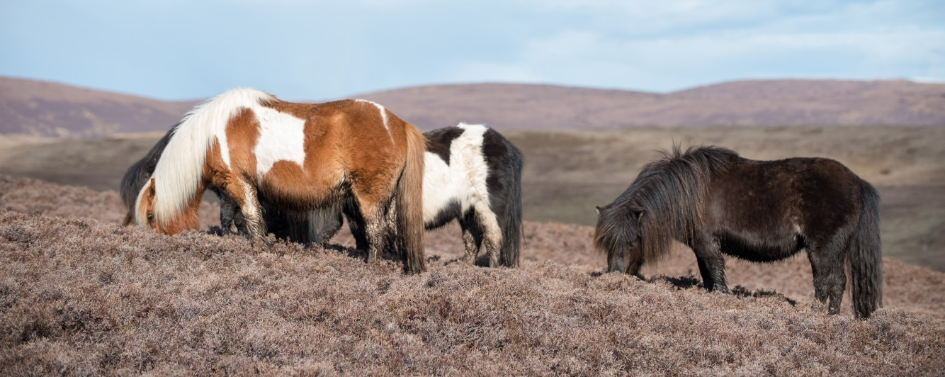
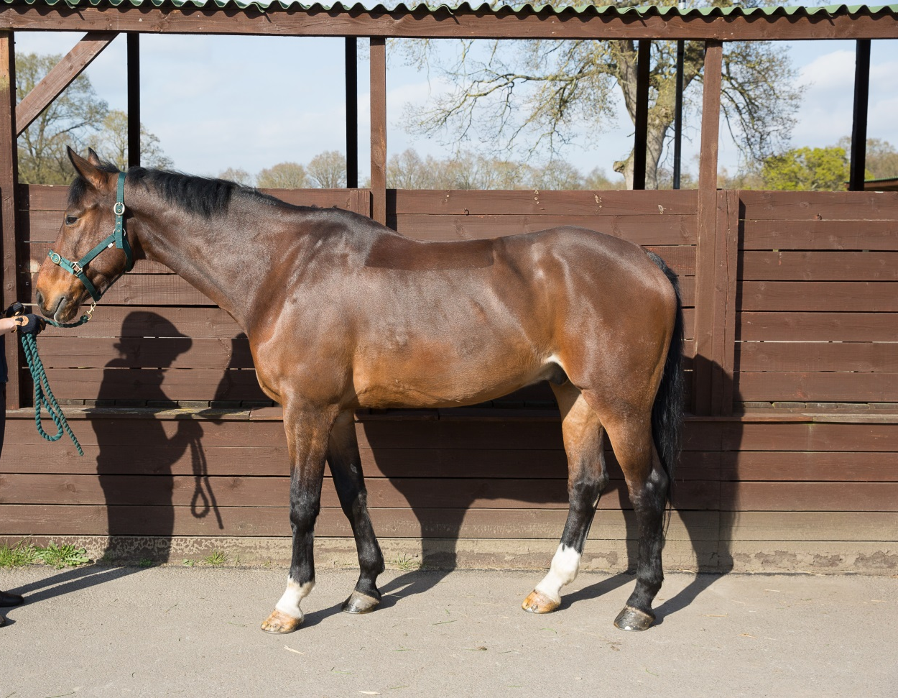

Slide 19
Quick quiz cntd
2. What is the height measurement used for horses and ponies
3. What is the maximum height to be classed as a pony?
Notes:
This quiz is very informal and is not designed to be a test. Answers can be written or verbal and there is space for the participants to write answers in their booklet.
Suggested answers:
As per pictures
Hands and inches, centimetres
14.2hh

Slide 20
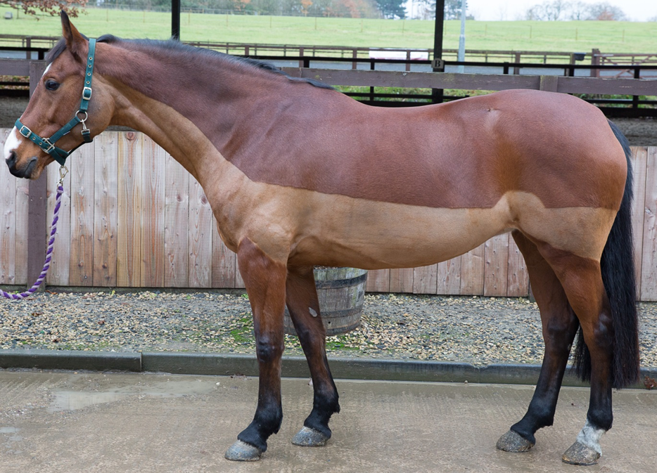
Can you identify the following points of the horse?

Slide 21

Can you identify the following points of the horse?
Neck
Withers
Quarters
Knee
Fetlock
Hoof

Slide 22
Congratulations you have completed Horse Knowledge part one.

Slide 23
Notes:
This slide has been left blank intentionally, for coaches to fill in their next steps. E.g. progress to Part Two or The Introduction to About the Horse award

