Slide 1
Horse Knowledge
Part One
Notes:
Add coach name to the text box
The slides are grouped by topic and can be delivered in any order
There are optional notes giving ideas for session plans or activities to go along with each presentation
There are optional handouts available to download from the BHS Cloud

Slide 2
Horse Behaviour
Think about how horses live in the wild live
  Natural instincts
  Protection
  Nourishment
  Activity
Notes:
Discuss what the group know about the natural lifestyle of the horse use the headings on the slide to help with the discussion. Consider splitting them into small groups for discussion and then feedback to the rest of the group.
Discuss with the group why they need to know this and how it affects how we behave around horses
If possible show some video clips of horses in the wild or freely grazing and discuss the types of behaviour you can see
Flight or fight response

Slide 3
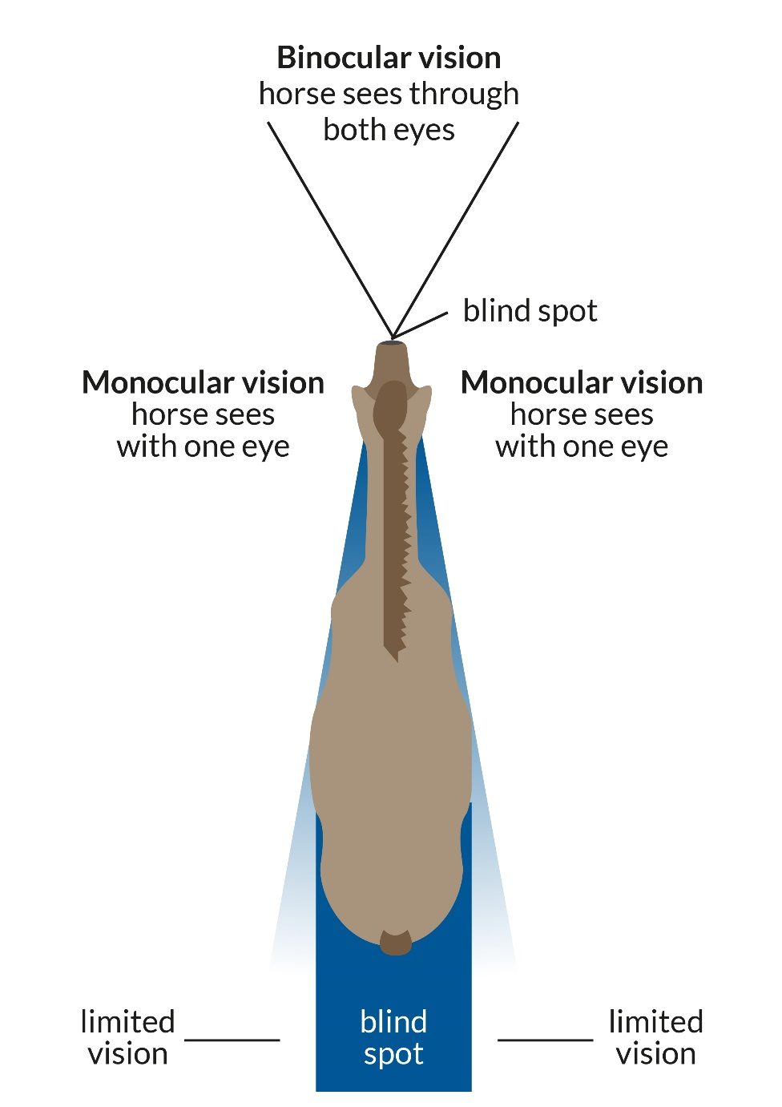
Horse vision
Notes:
Discuss how the horses vision differs from ours and how this affects how we handle them
Ask Alex W to cut the picture from Caring Bronze to use on this slide and in the booklet

Slide 4
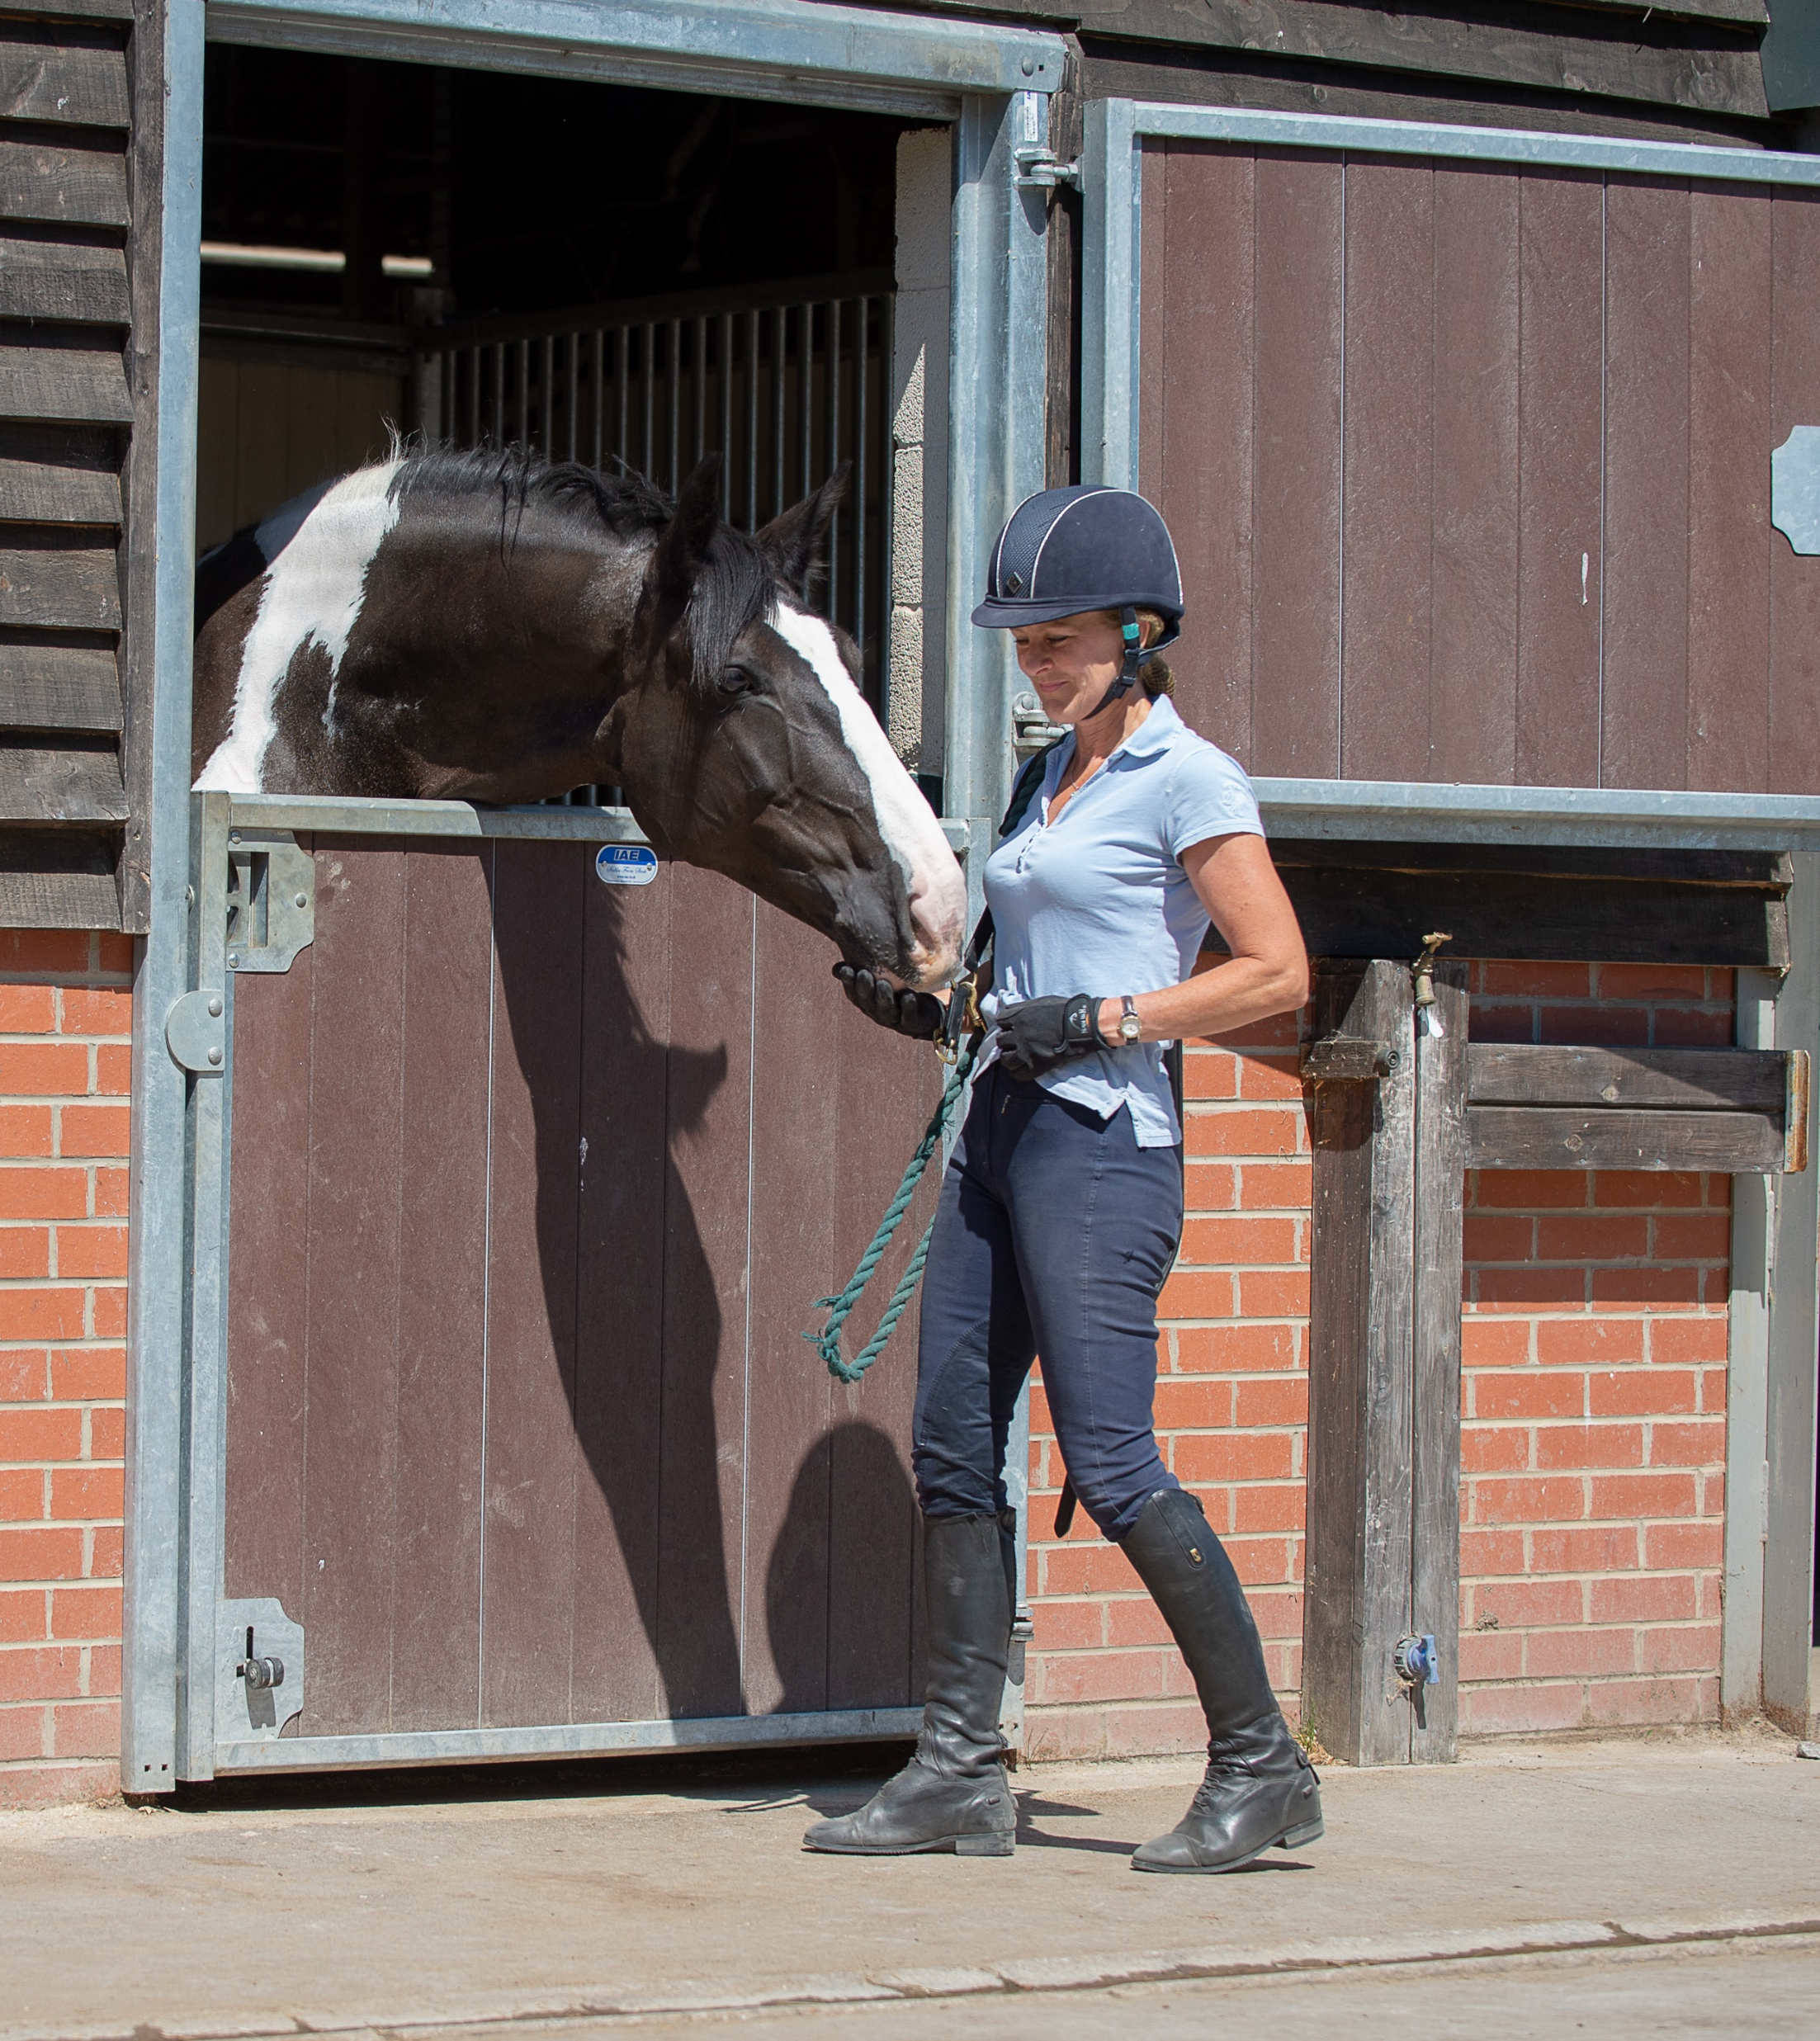
How to approach a horse safely
What should you consider before approaching a horse?
Notes:
Discuss as a group what you need to take into consideration when approaching a horse
- Relate back to flight or fight instinct, position of horse’s eyes and what was discussed in the behaviour section
Discuss PPE
Discuss when it is not safe to approach a horse?

Slide 5
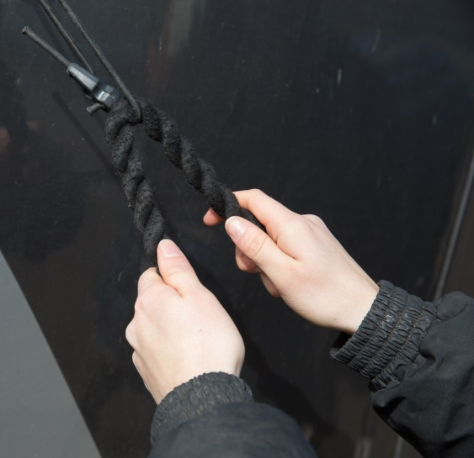
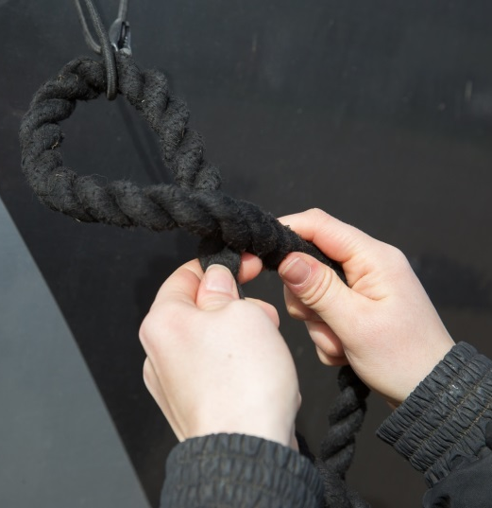
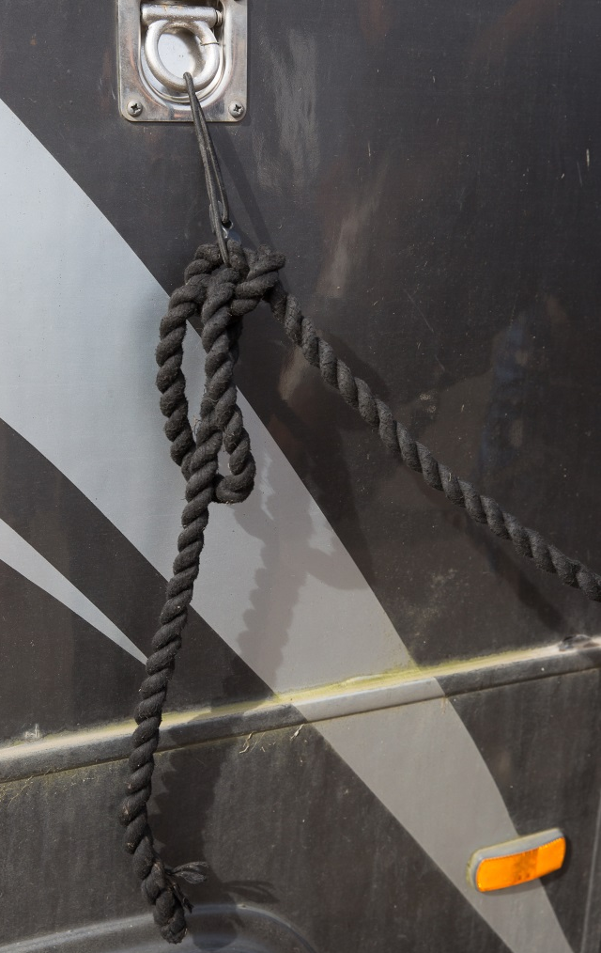
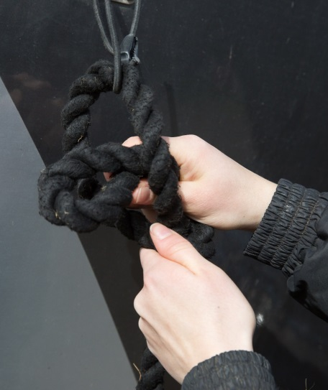
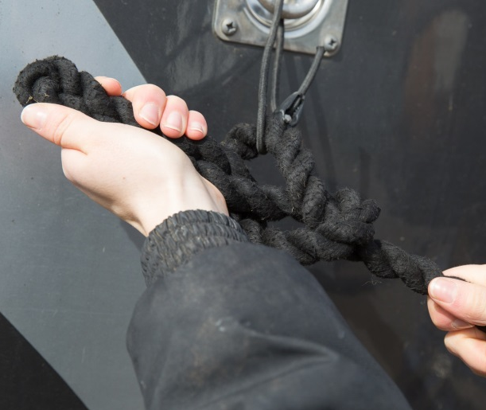
Quick release knot
5. Thread the end of the rope through the loop
1. Place the rope through the string
2. Cross the tail of the rope over
3. Make a loop with the tail end and thread it through
4. Pull the loop tight
Notes:
Discuss reasons for tying up when working around a horse
Safety considerations – area safe, horse calm, movement of other people/horses, suitable tie ring
As a group discuss why tie the lead rope to piece of string? What can happen if the string is too thick/thin? Can also include the use of break away clips/lead ropes clips
Split group into pairs – hand out lead ropes and string. One pair holds the string loop while the second follows the procedure to tying a quick release knot. Swap between pairs and practice each technique. Show both methods of tying a quick release knot.
Discuss why tuck end of rope through the loop

Slide 6
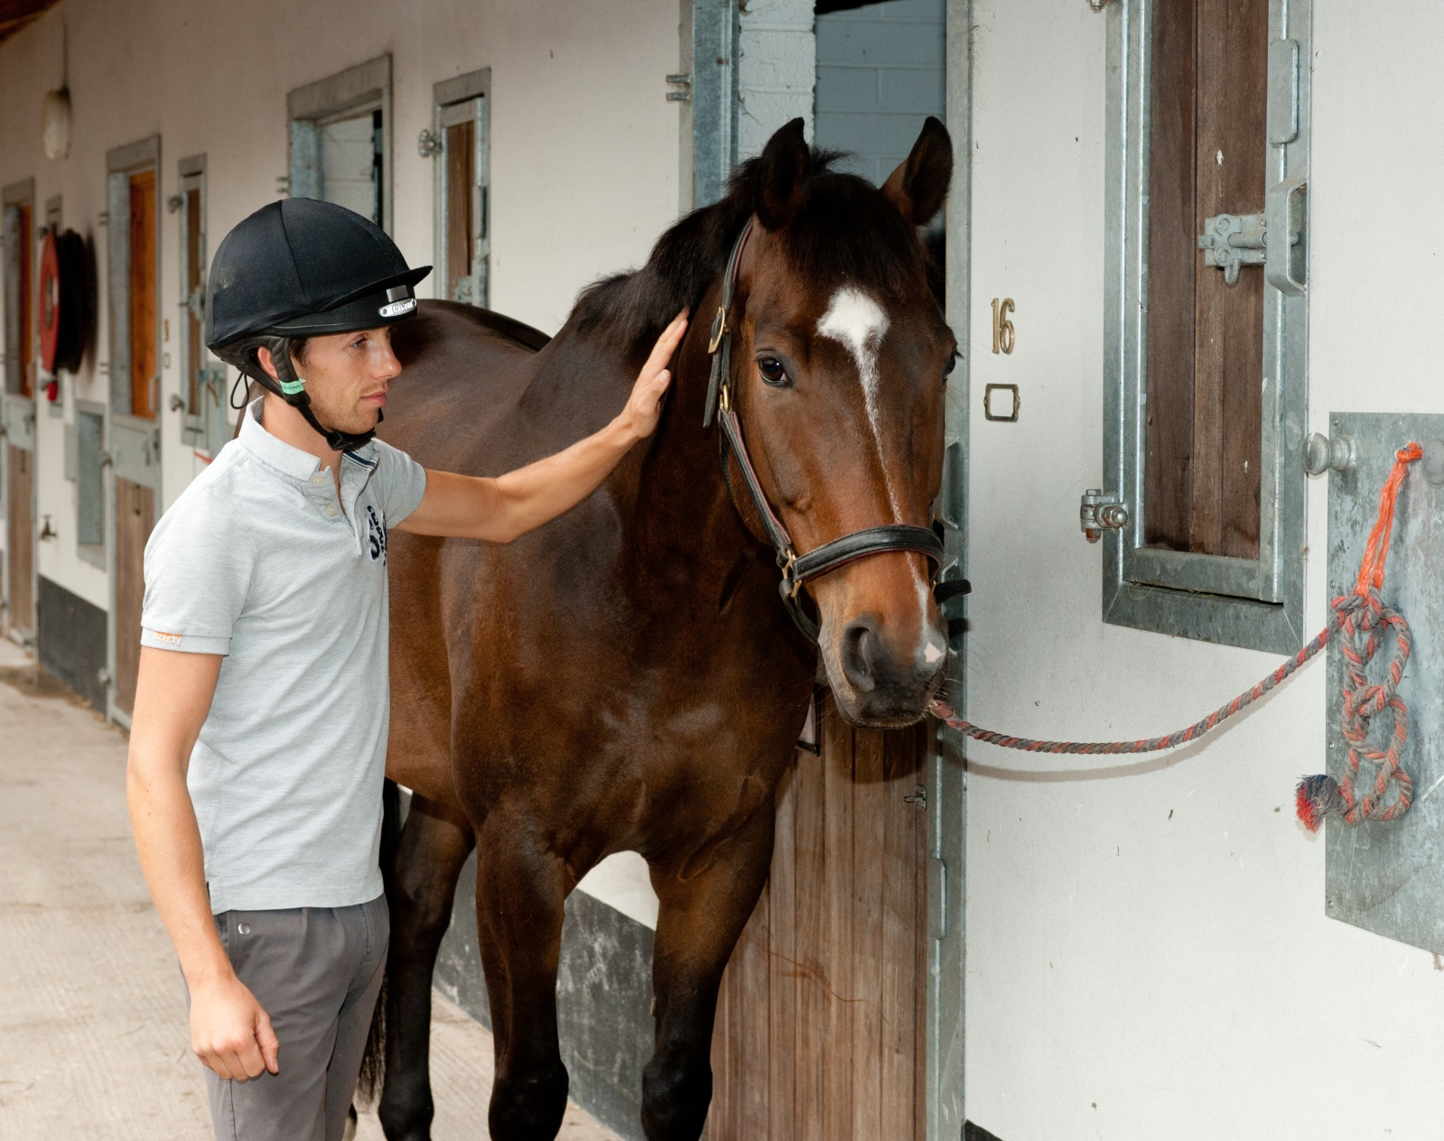
Notes:
Discuss the correct length to tie a horse up. What do the group think might happen if the rope is too short or too long?

Slide 7
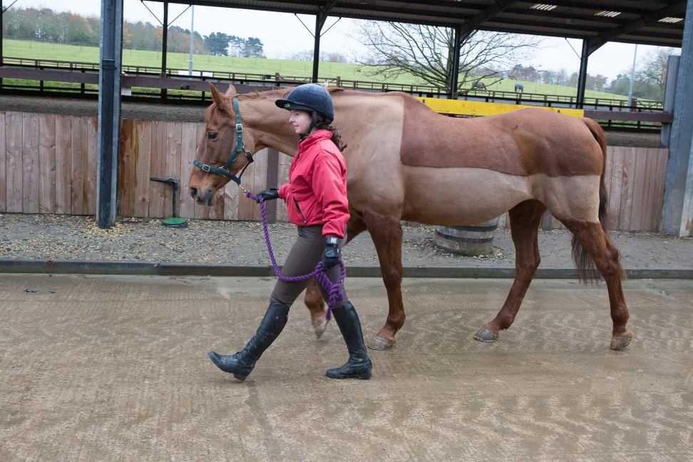
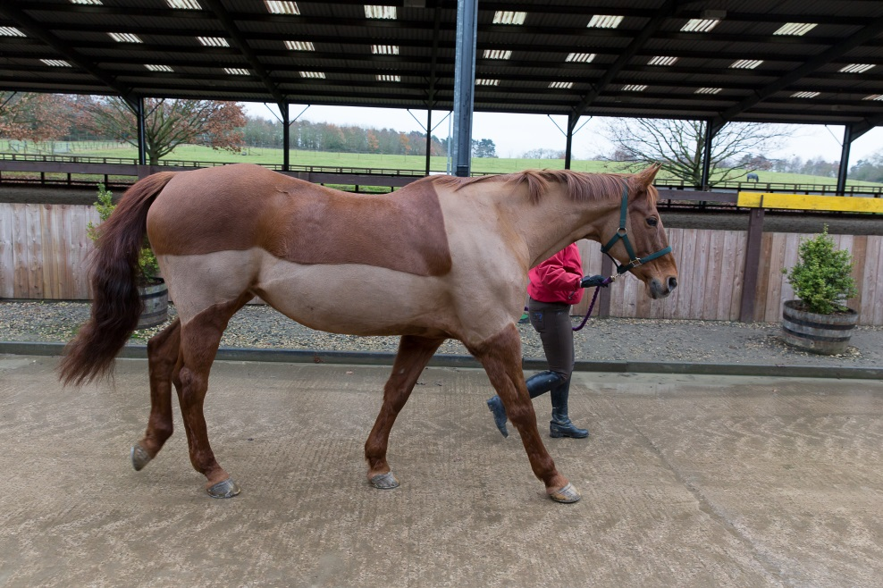
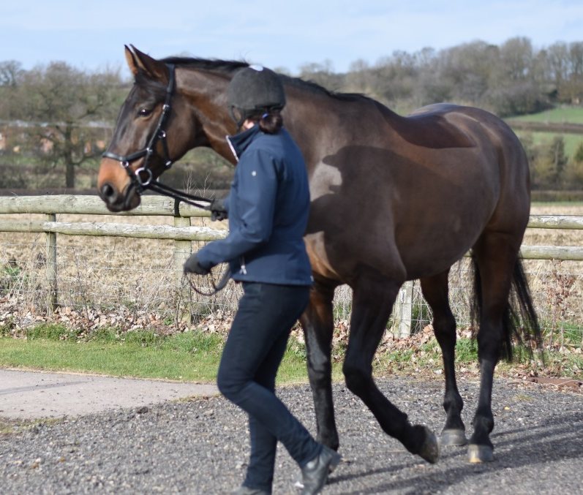
Leading
Notes:
As a group discuss use of PPE when leading. What potential dangers can they think of?
In pairs using the lead ropes demonstrate how to hold the rope when leading. Demonstrate (gently!)what can happen if you wrap the lead rope around your hand.
Discuss how the position of the handler can influence the horse. What can happen if you get in front of horse or left behind?
How to control the horse – voice commands and body language.
Demonstrate with the group - the difference between standing up tall/shoulders back/head up and slouching/rounded shoulders/head down.
Discuss how to turn the horse – how to control the size of the turn.

Slide 8
Quick Quiz
What are the horses natural instincts?
How does the horse vision differ from ours?
Why should you approach a horse from the side?
What type of knot is used to tie a horse up?
Why is this knot used?
Why should you tie the lead rope to a piece of string?
Where should you position yourself when leading a horse?
Why should you turn the horse away from you?
Notes:
This quiz is very informal and is not designed to be a test. Answers can be written or verbal and there is space for the participants to write answers in their booklet.
Suggested answers:
Fight, flight
Their eyes are positioned on the side of their head, giving them good vision to the sides, blind spot immediately infront and behind
To make sure they see you
Quick release knot
It can undone quickly in emergency
To provide a breaking point, reduce the risk of injury if horse panics
By the horses shoulder
Control the size of the turn, stop horse from standing on you

